Slide 1
Colorado Climate Center – WATF Climate Update
Becky Bolinger, Assistant State Climatologist
Water Availability Task Force
June 24, 2021

Slide 2
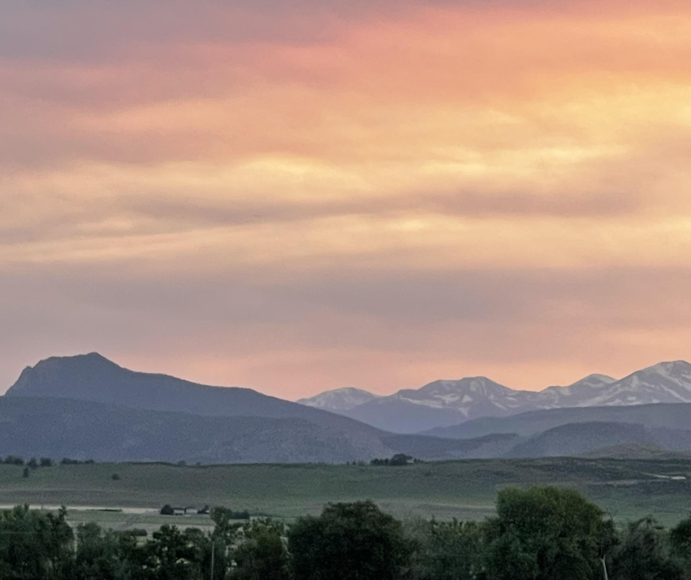
2021 Water Year To Date
temperature, precipitation, evaporative demand

Slide 3
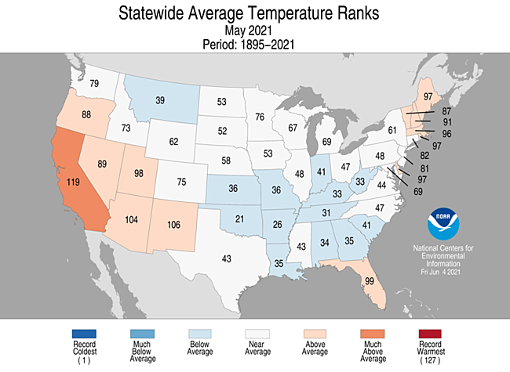
Month | T Rank (of 127 years) | Above, below, or near avg?
Oct | 52nd warmest | average
Nov | 7th warmest | much above
Dec | 42nd warmest | above
Jan | 32nd warmest | above
Feb | 28th coolest | below
Mar | 46th warmest | average
Apr | 62nd coolest | average
May | 53rd warmest | average
June
July
August
https://www.ncdc.noaa.gov/cag

Slide 4
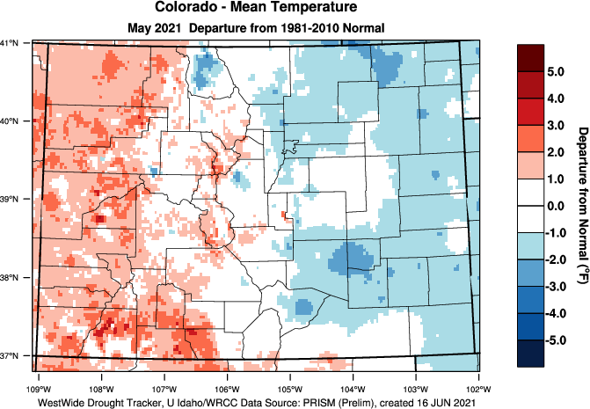
https://wrcc.dri.edu/wwdt/index.php?region=co

Slide 5
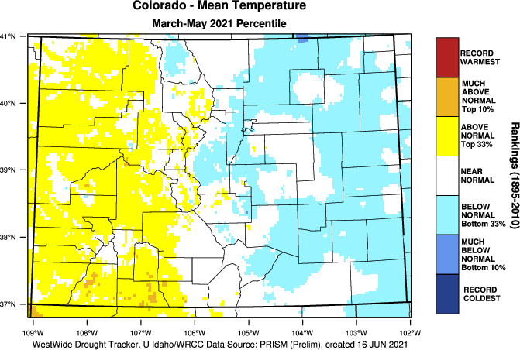
https://wrcc.dri.edu/wwdt/index.php?region=co

Slide 6
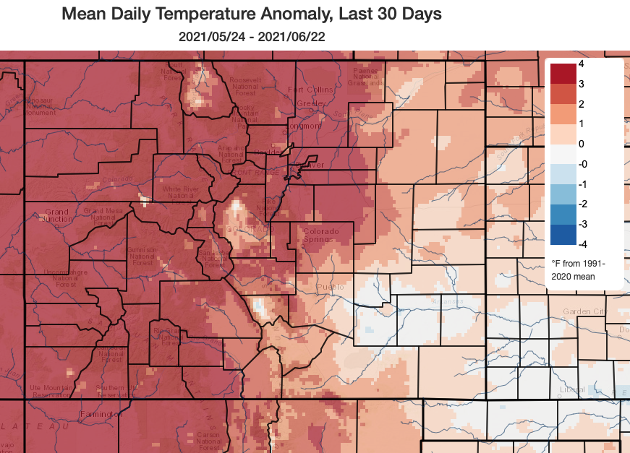

Slide 7
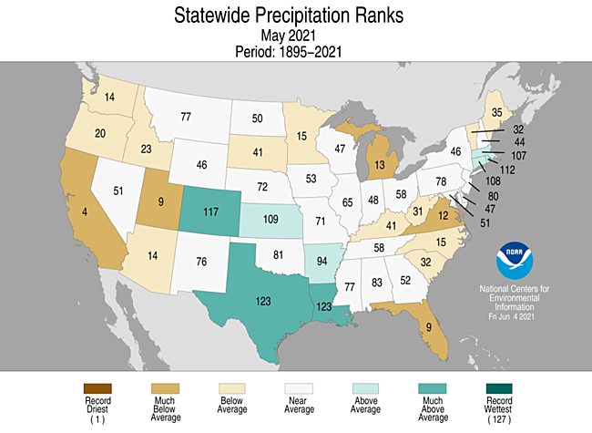
Month | P Rank (of 127 years) | Above, below, or near avg?
Oct | 16th driest | below
Nov | 44th driest | average
Dec | 60th driest | average
Jan | 38th driest | below
Feb | 58th wettest | average
Mar | 20th wettest | above
Apr | 18th driest | below
May | 11th wettest | much abv
June
July
August
Wettest May since 2015
https://www.ncdc.noaa.gov/cag

Slide 8
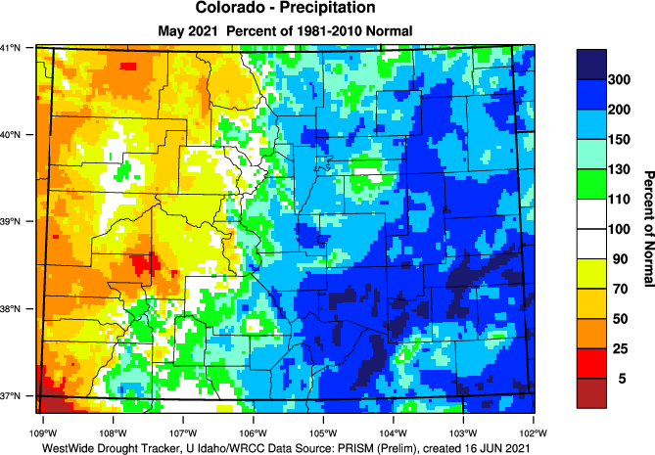
https://wrcc.dri.edu/wwdt/index.php?region=co

Slide 9
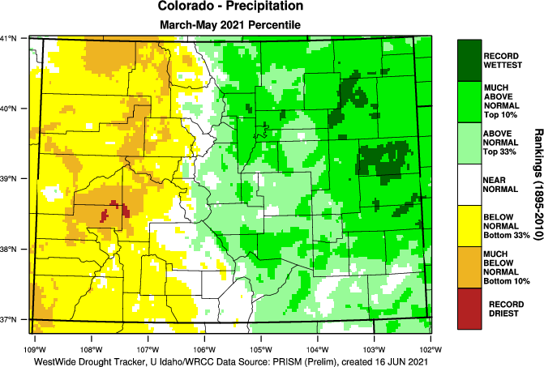
https://wrcc.dri.edu/wwdt/index.php?region=co

Slide 10
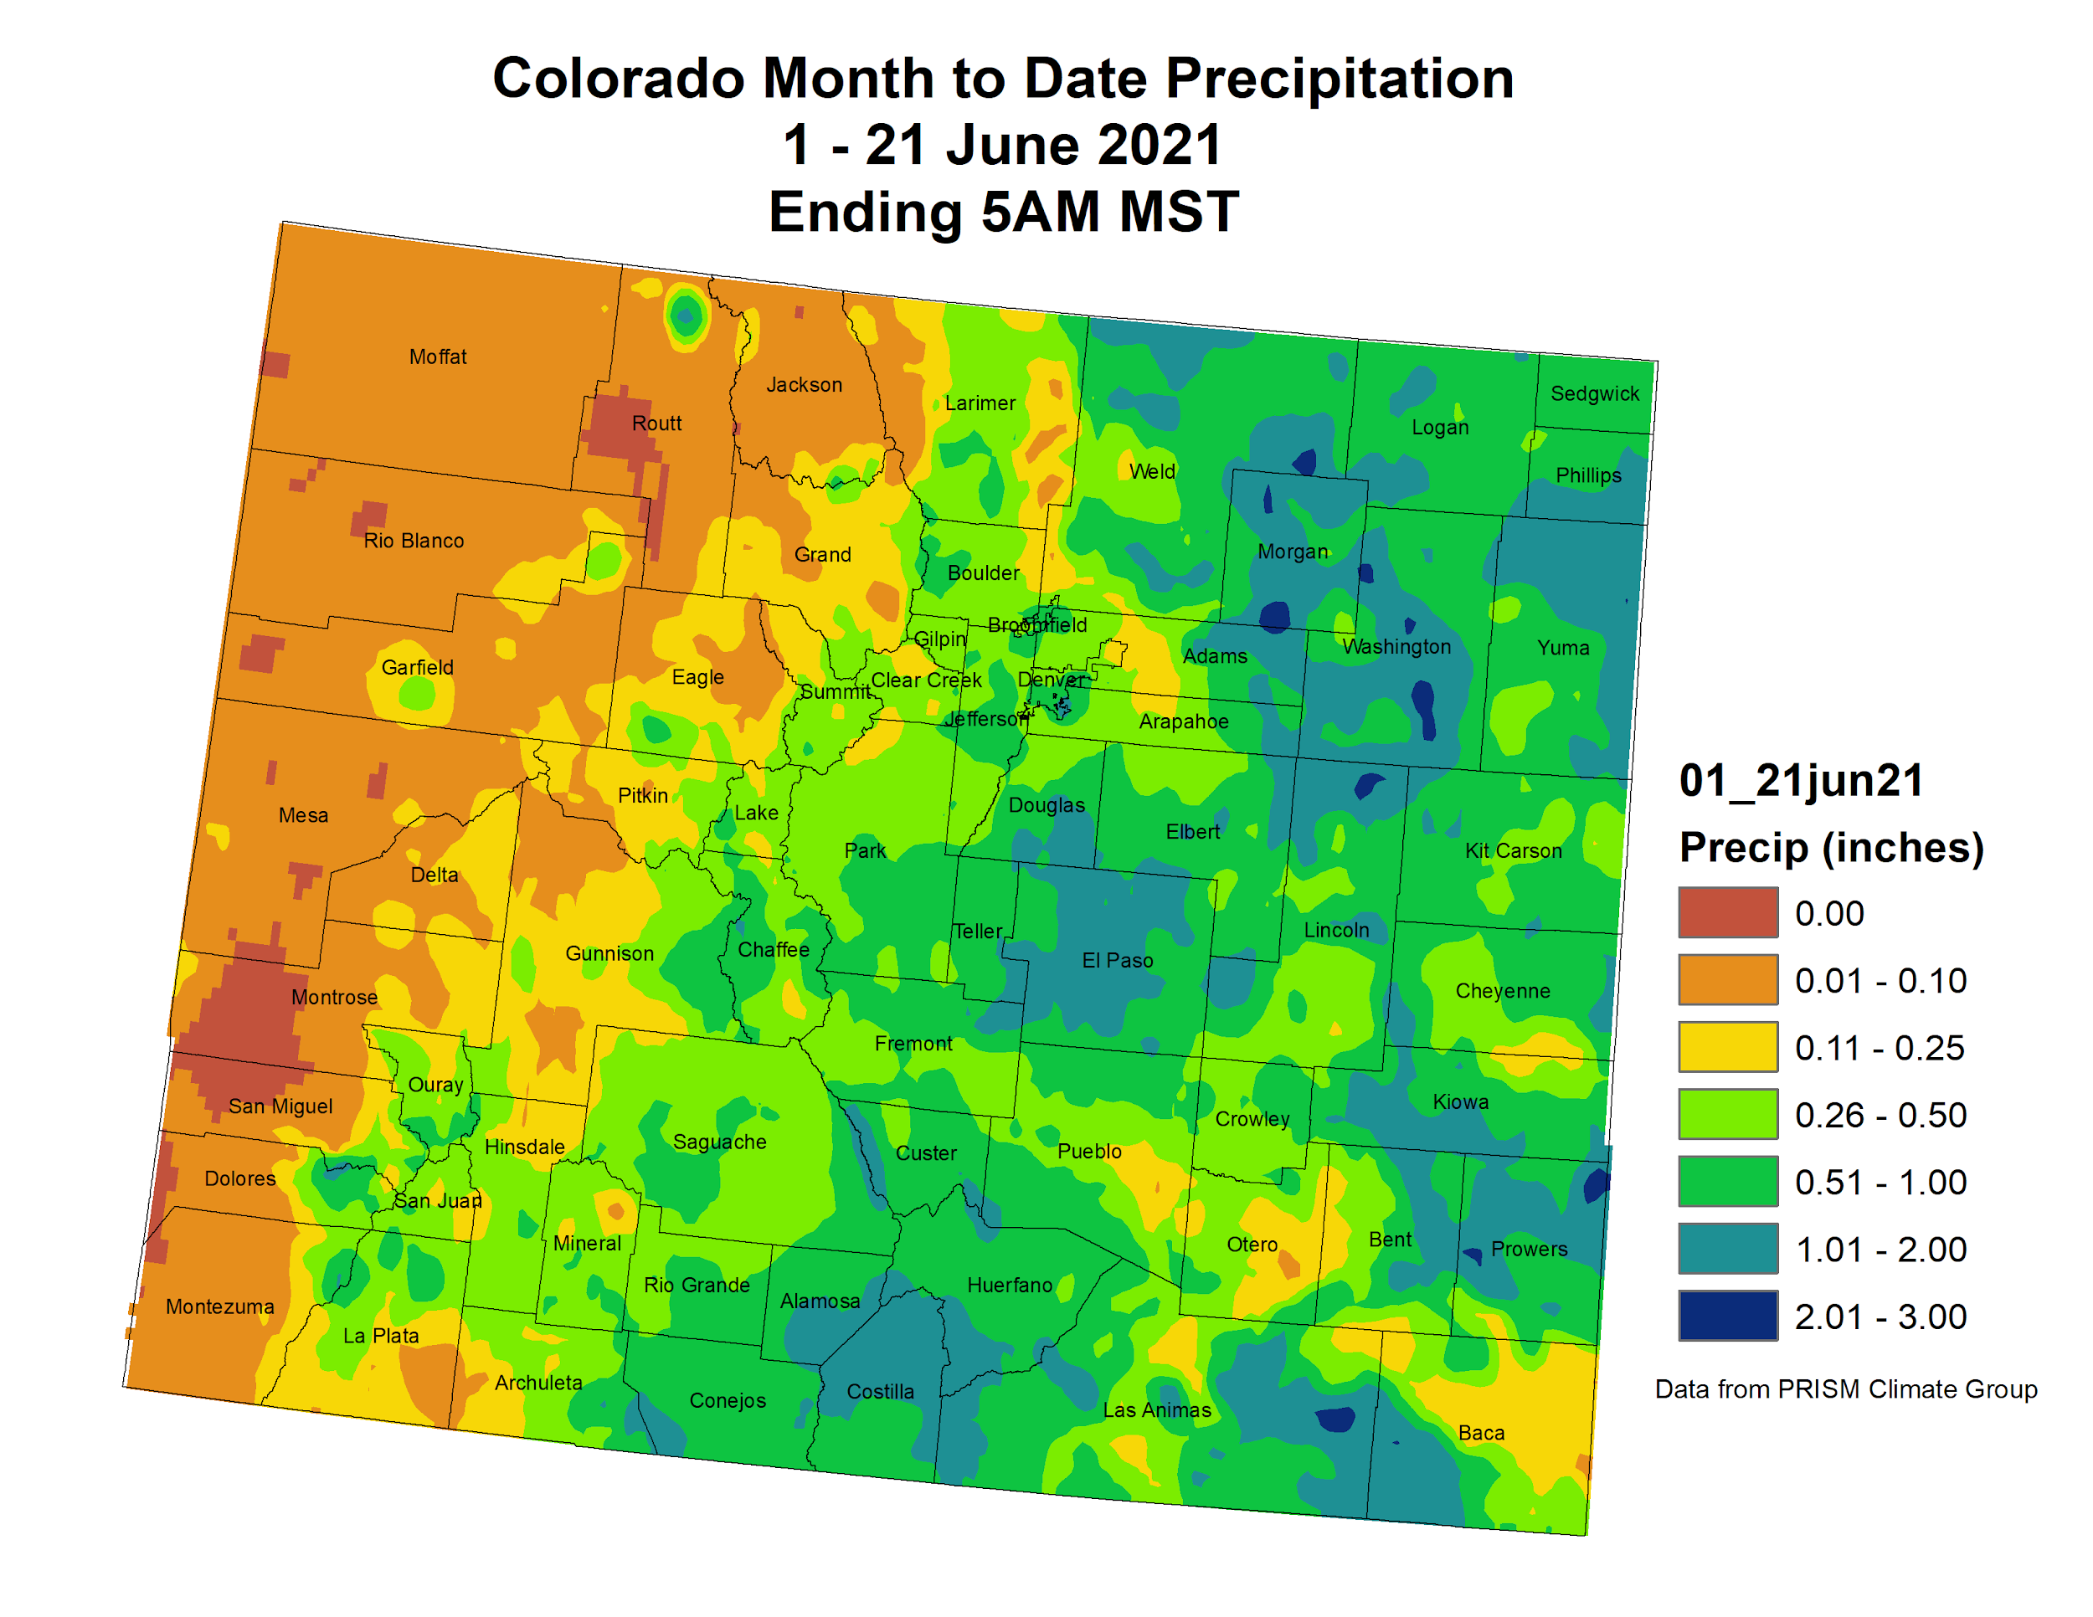

Slide 11
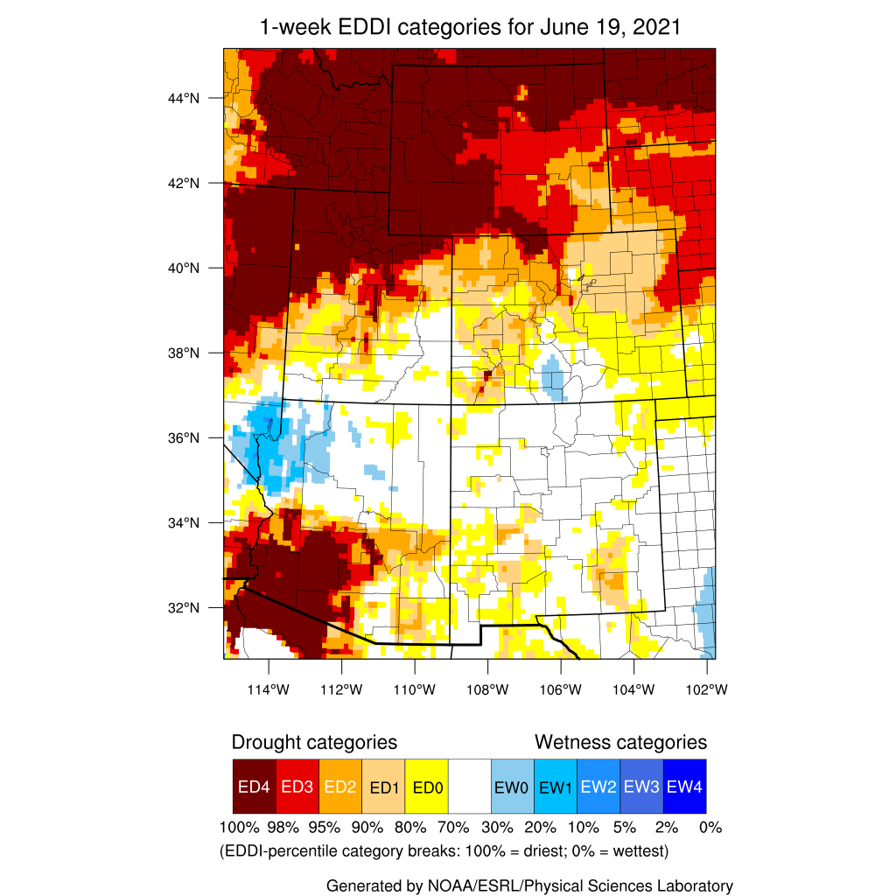
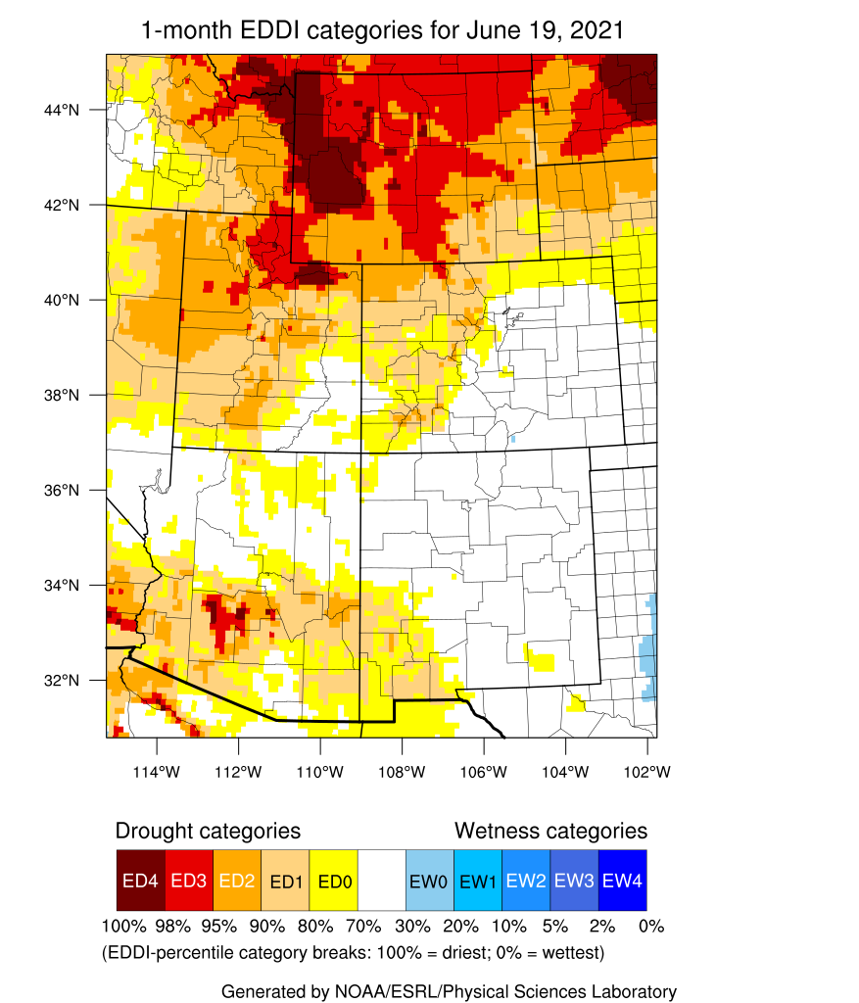
Evaporative Demand
https://psl.noaa.gov/eddi/

Slide 12
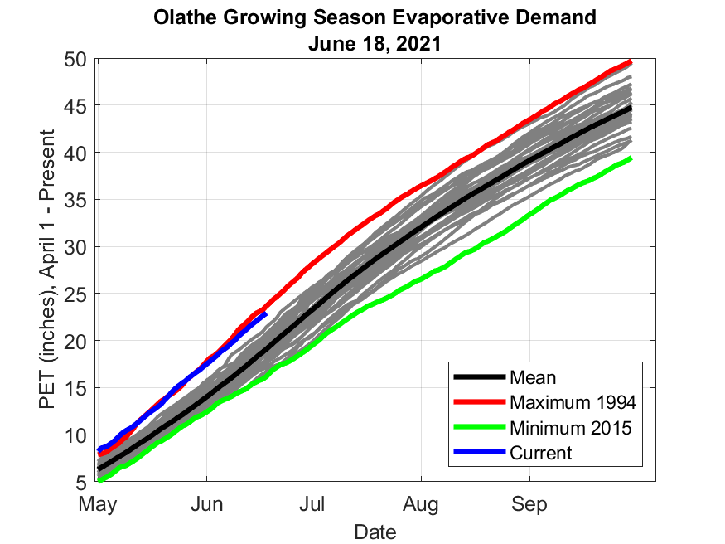
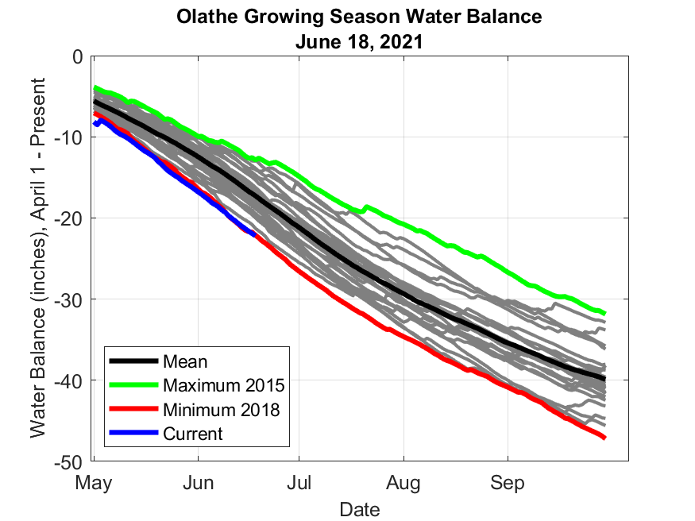
https://coagmet.colostate.edu/station/oth01_main.html

Slide 13
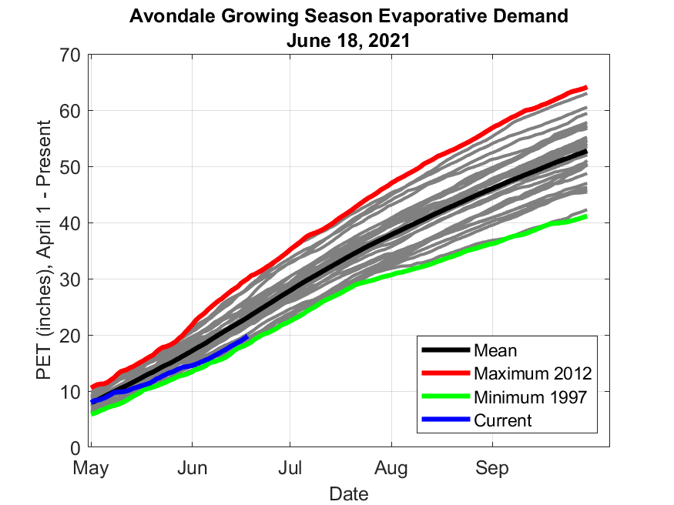
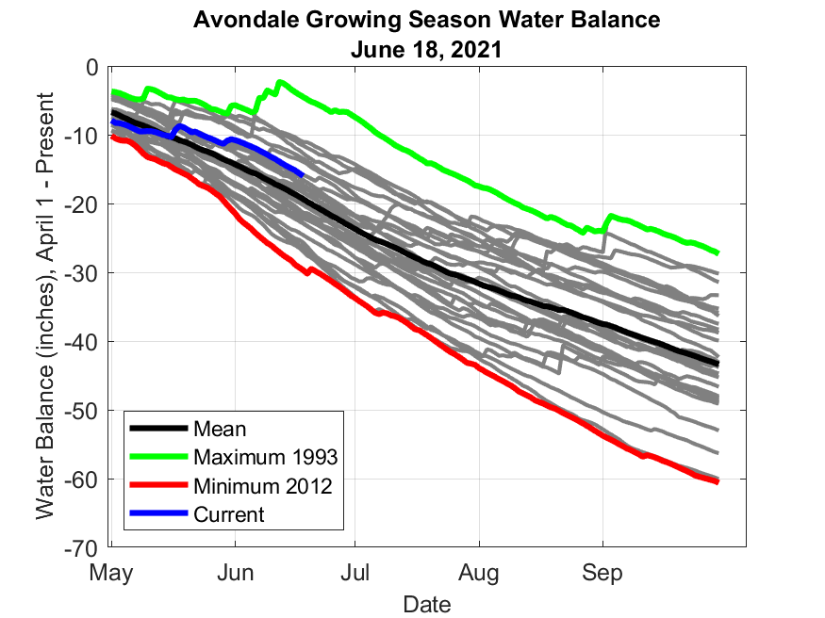
https://coagmet.colostate.edu/station/avn01_main.html

Slide 14
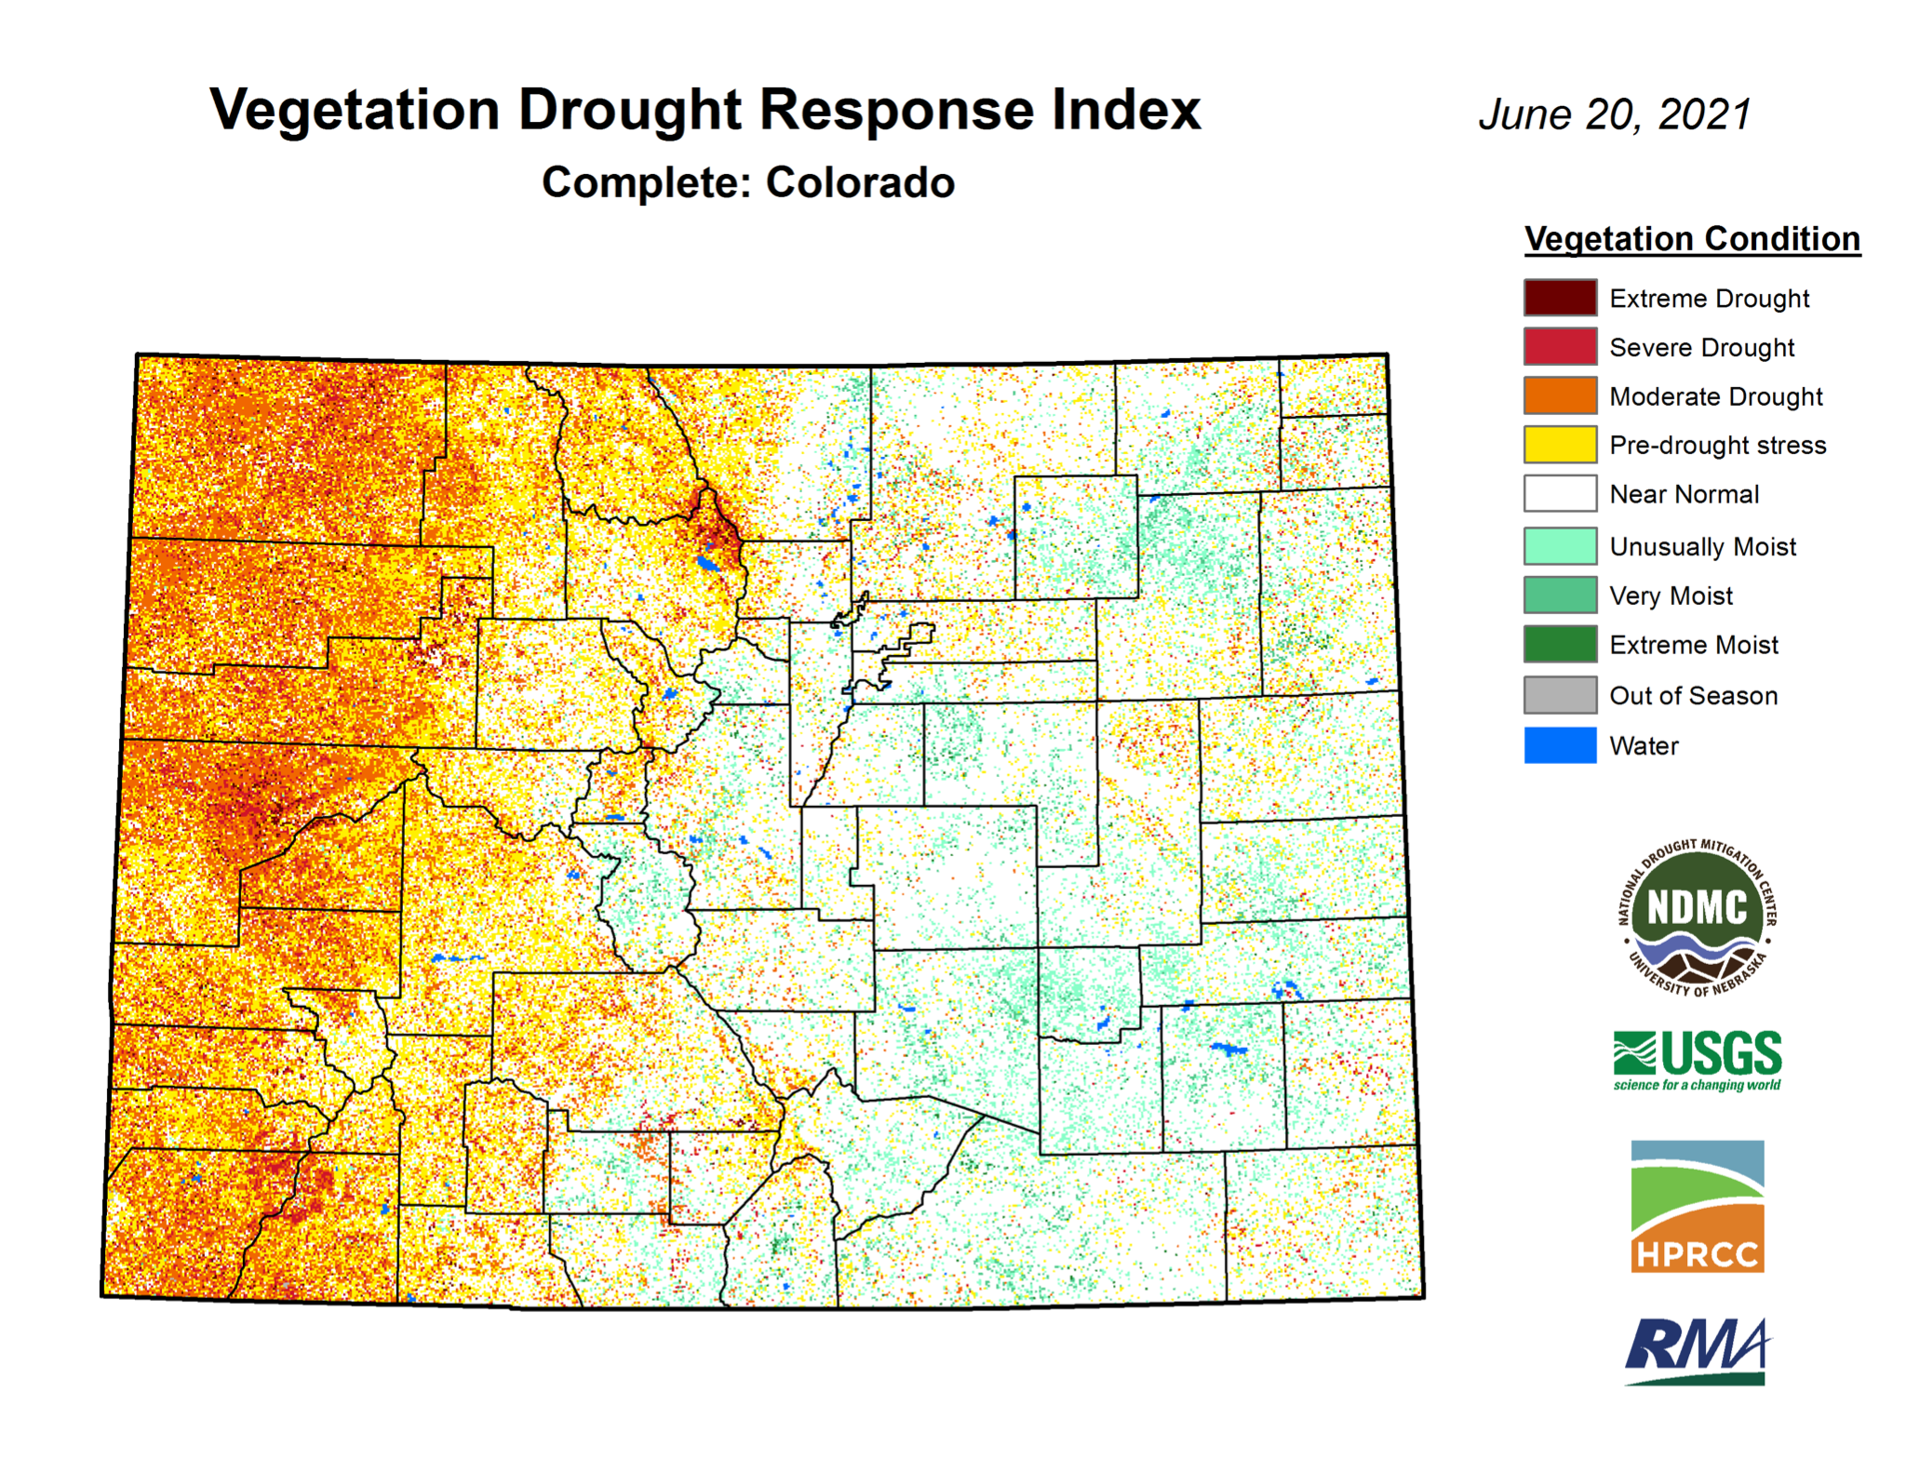
https://vegdri.unl.edu/Home/StateVegDRI.aspx?CO

Slide 15
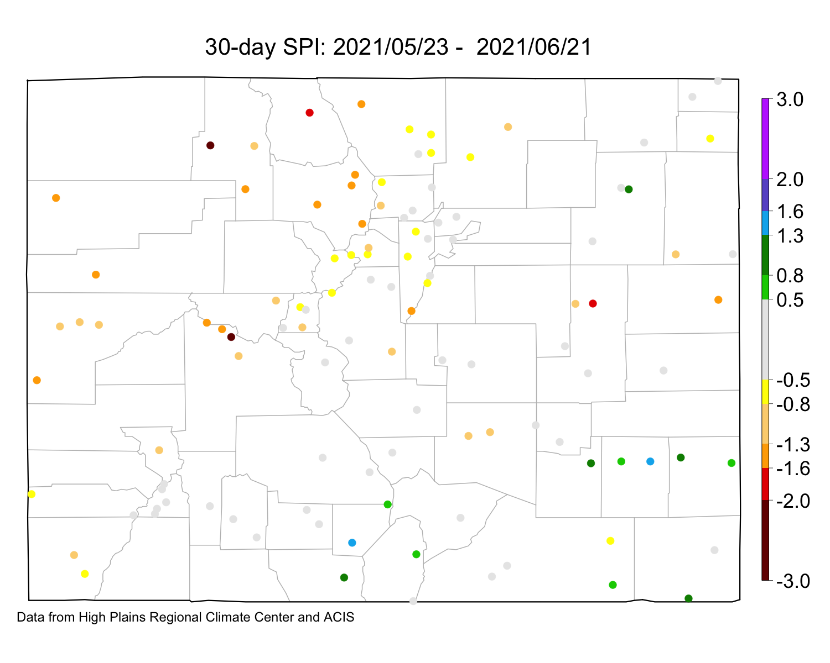
https://climate.colostate.edu/drought/

Slide 16
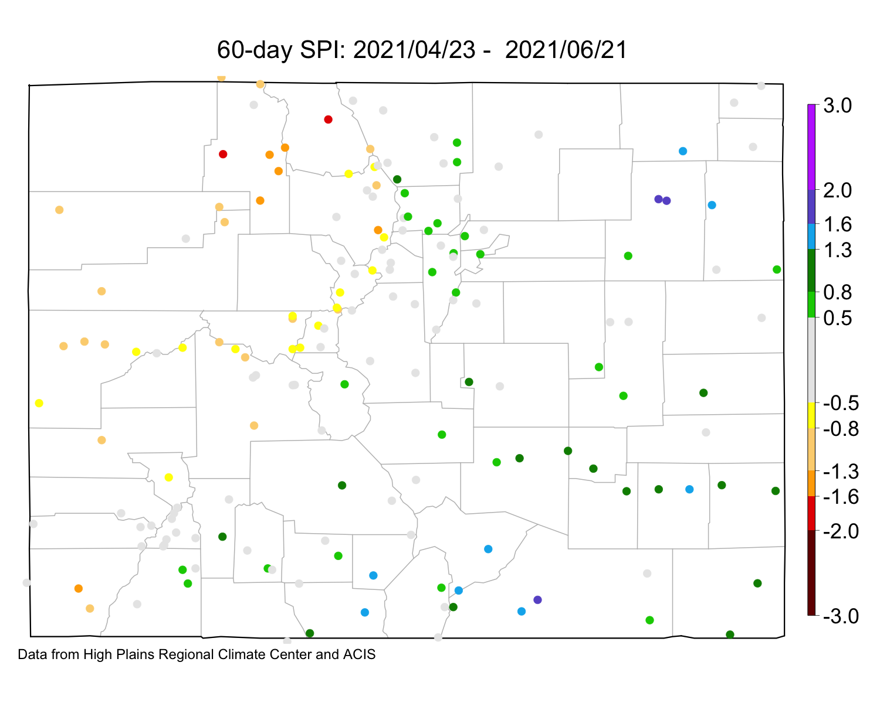
https://climate.colostate.edu/drought/

Slide 17
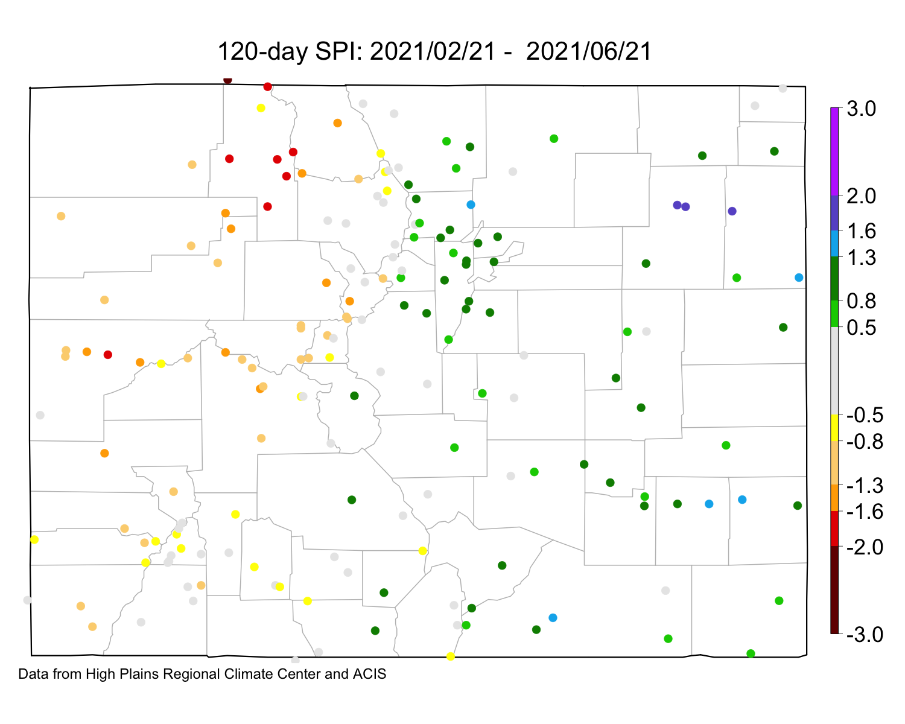
https://climate.colostate.edu/drought/

Slide 18
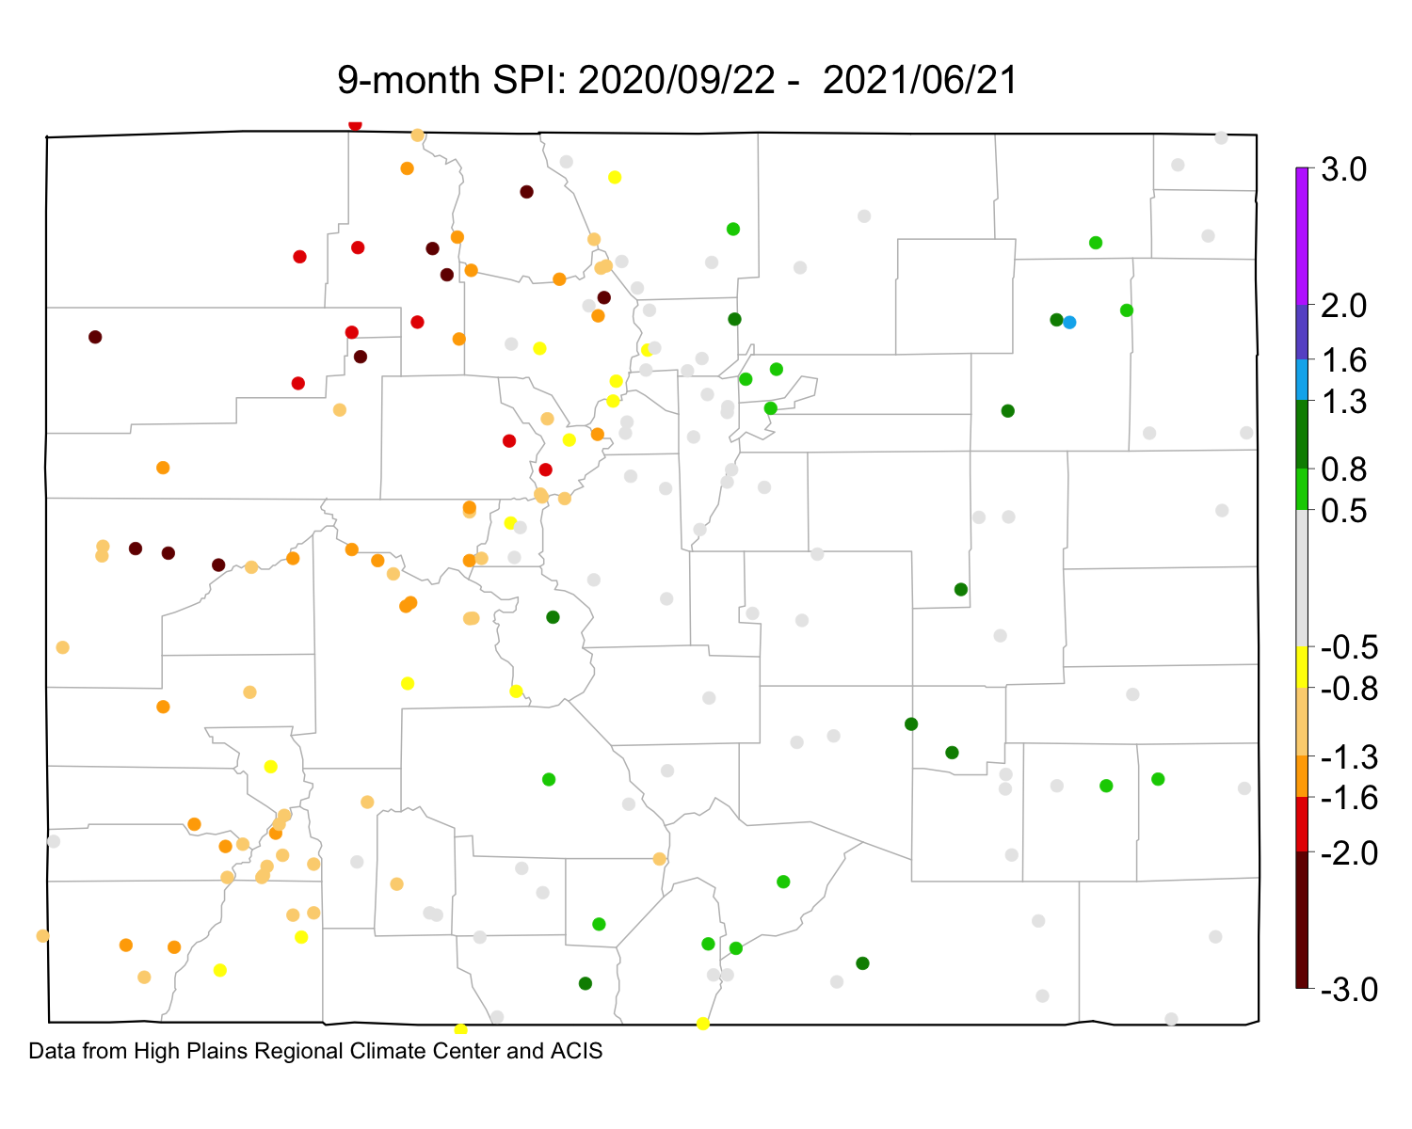
https://climate.colostate.edu/drought/

Slide 19
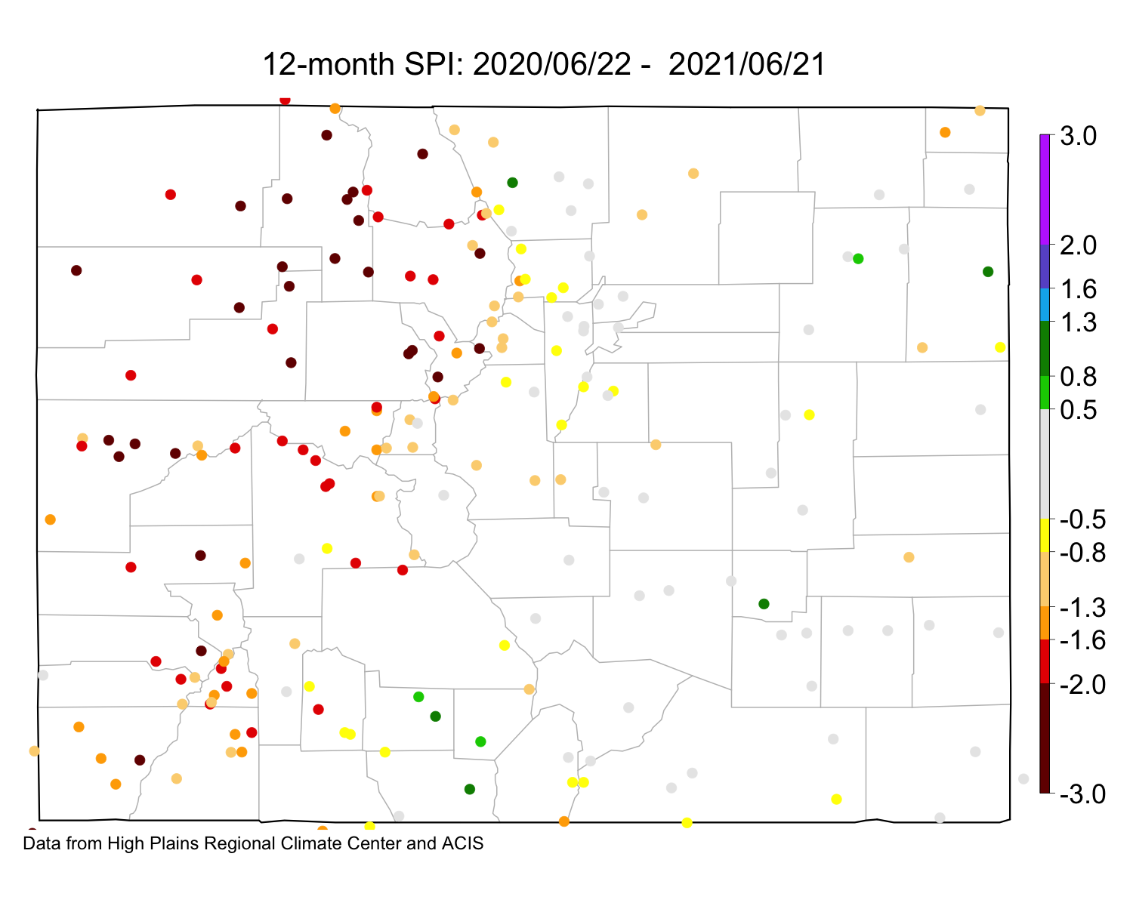
https://climate.colostate.edu/drought/

Slide 20
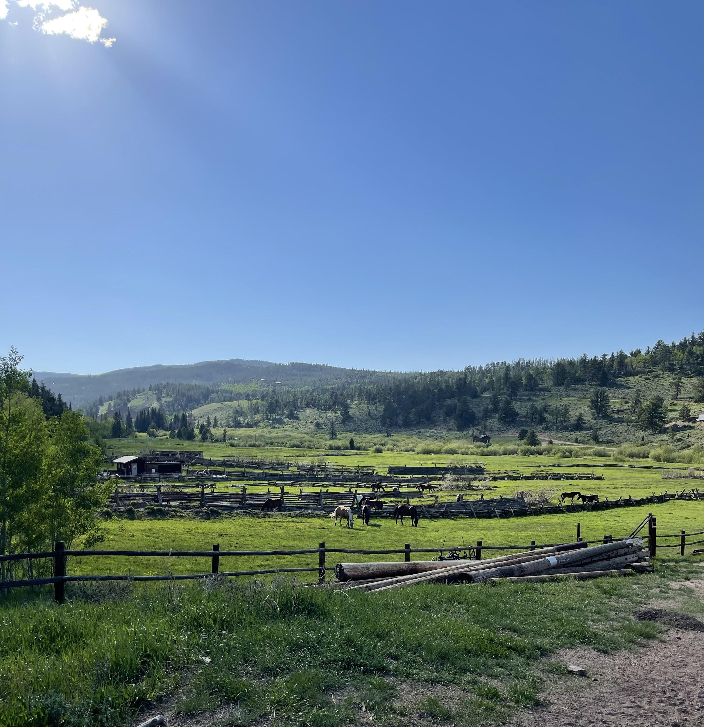
Drought
National Drought
Colorado Drought
Colorado Drought Facts

Slide 21
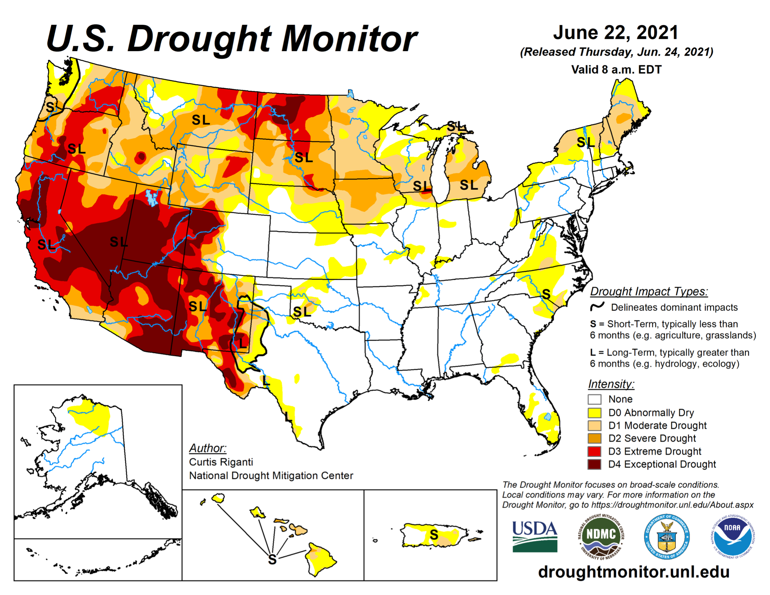

Slide 22
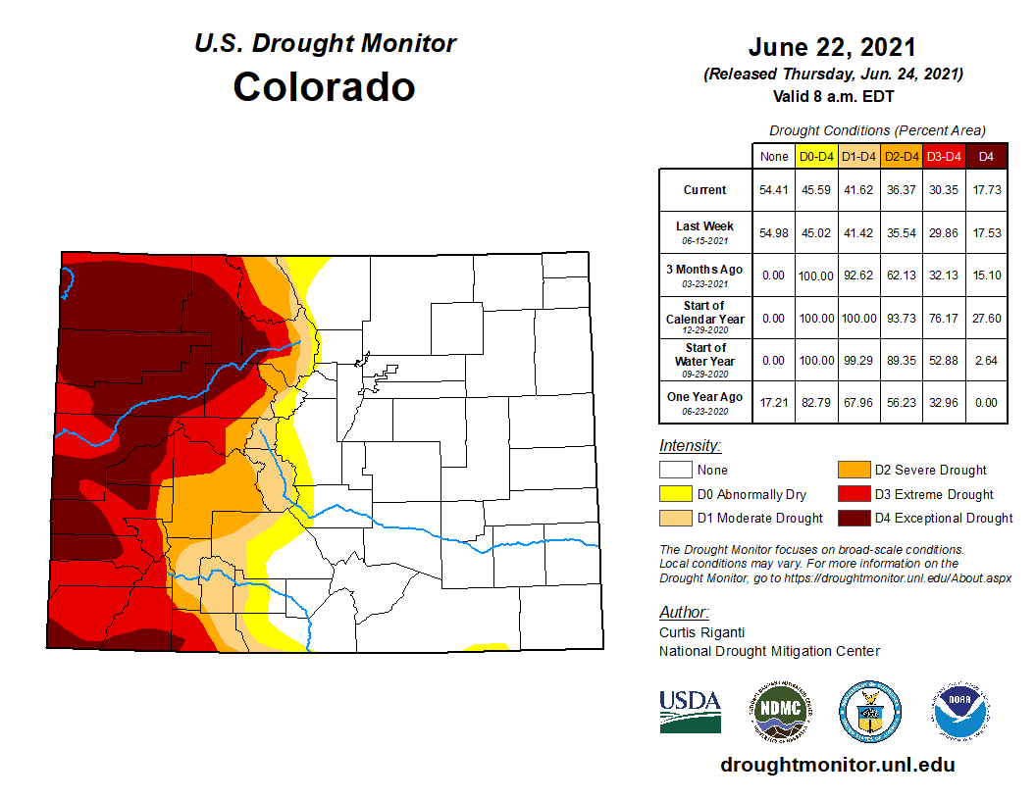

Slide 23
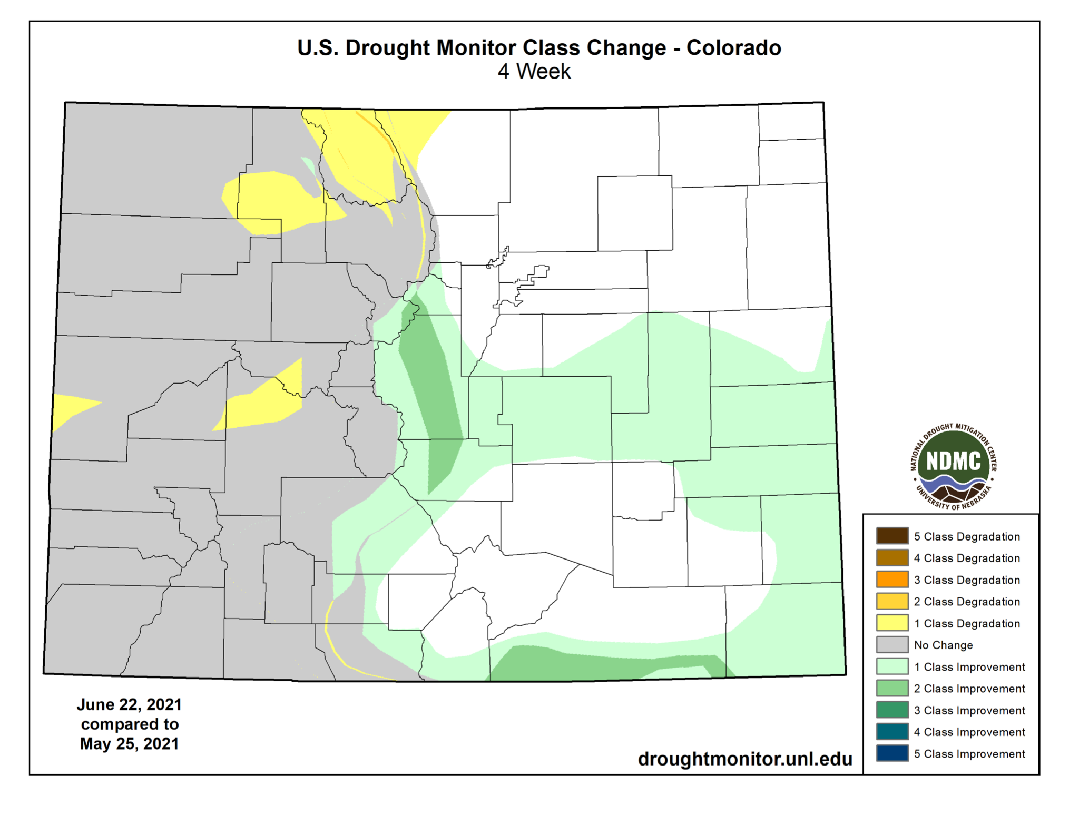
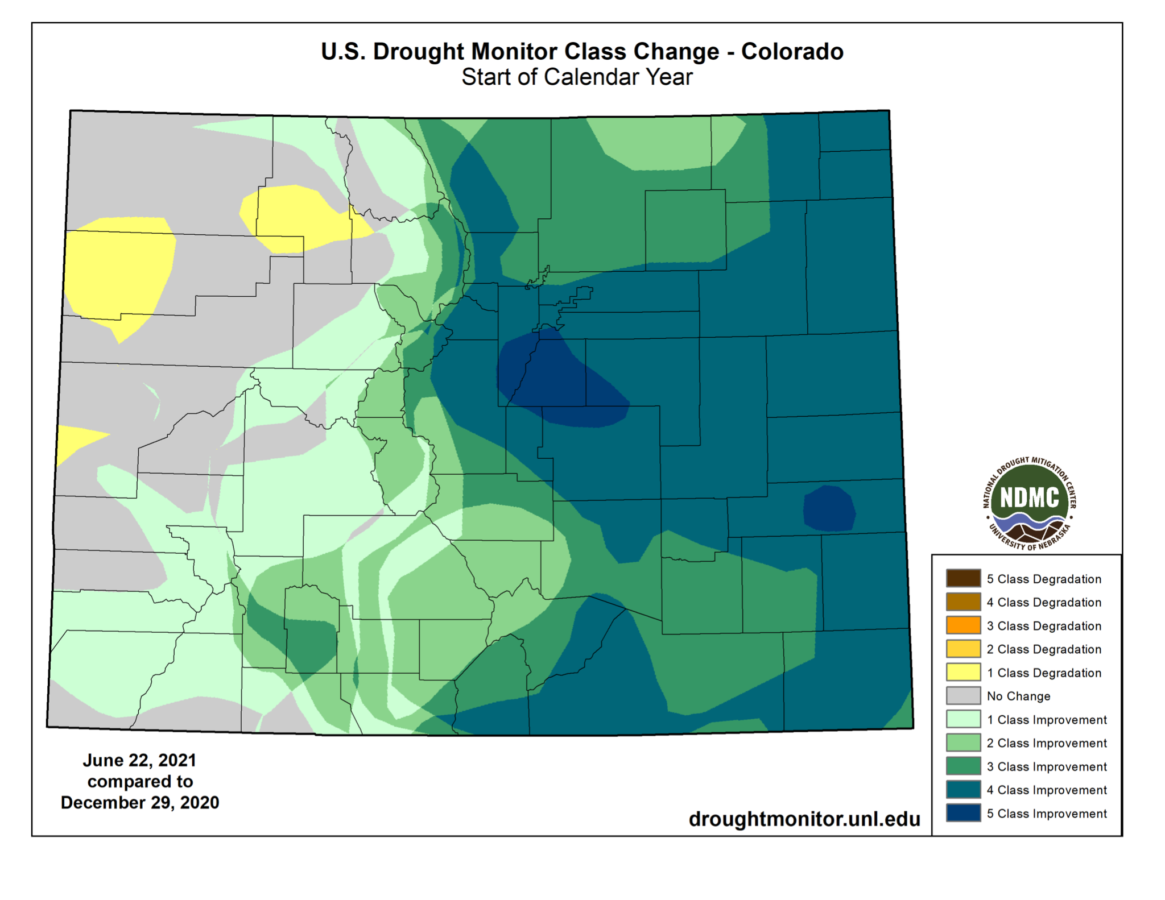

Slide 24
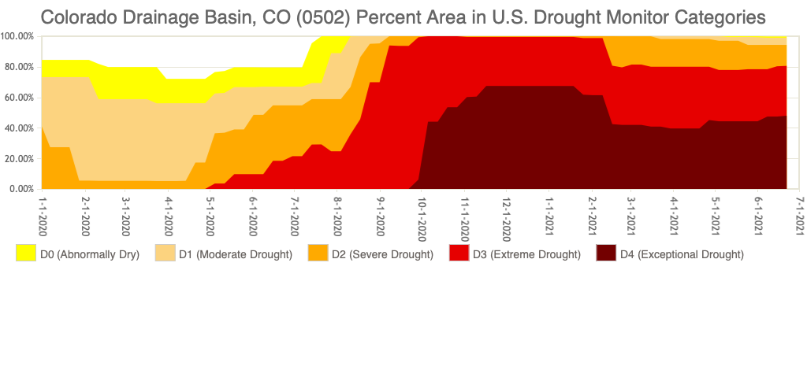
D4 entered western CO on September 29, 2021. There have now been 38 consecutive weeks with D4 drought in western CO.
80% of western CO is in D3/D4

Slide 25

Outlook
Next 7 days
8-14 day Outlook
CPC Outlooks
ENSO Neutral
Monsoon???

Slide 26
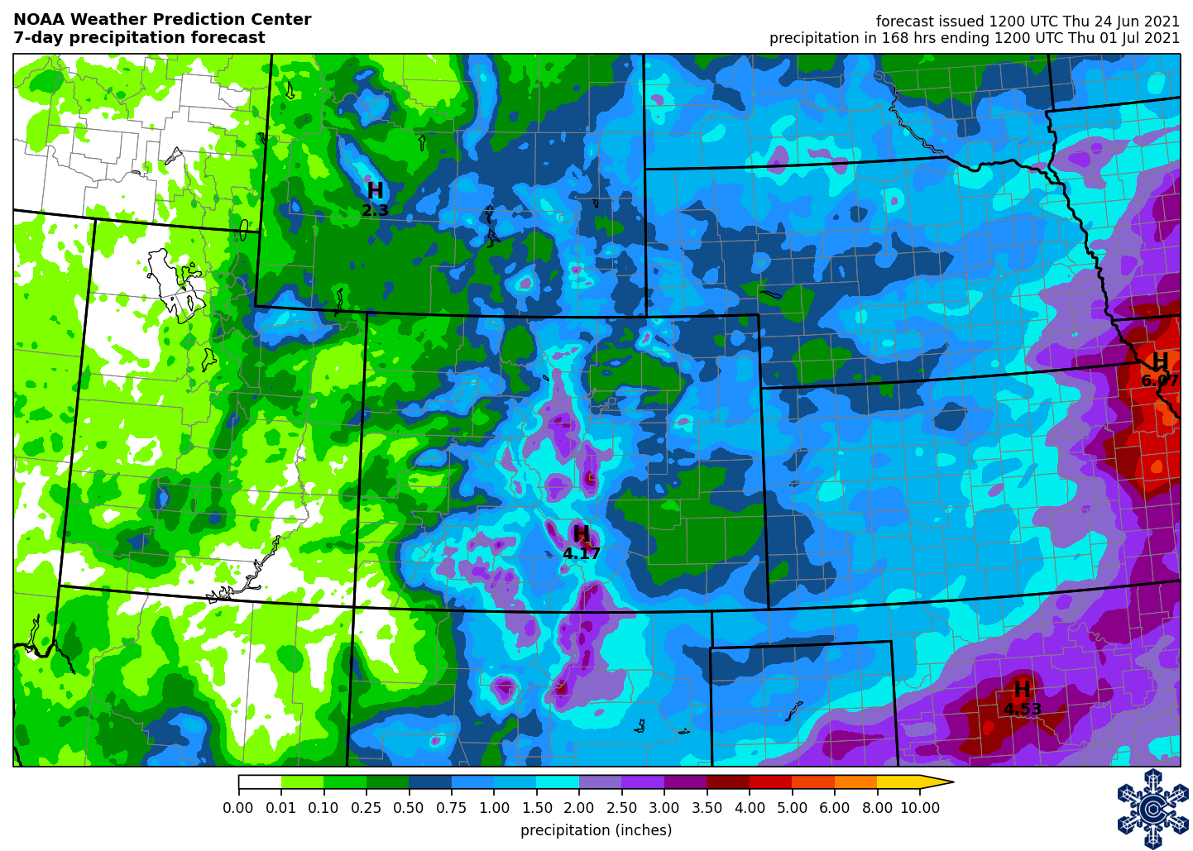
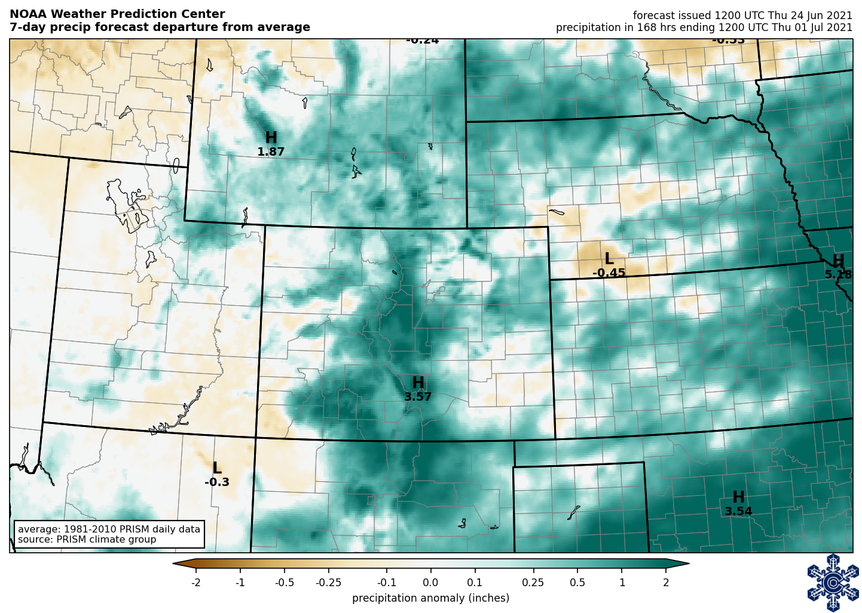
NOAA 7-day precip forecast
http://schumacher.atmos.colostate.edu/weather/

Slide 27
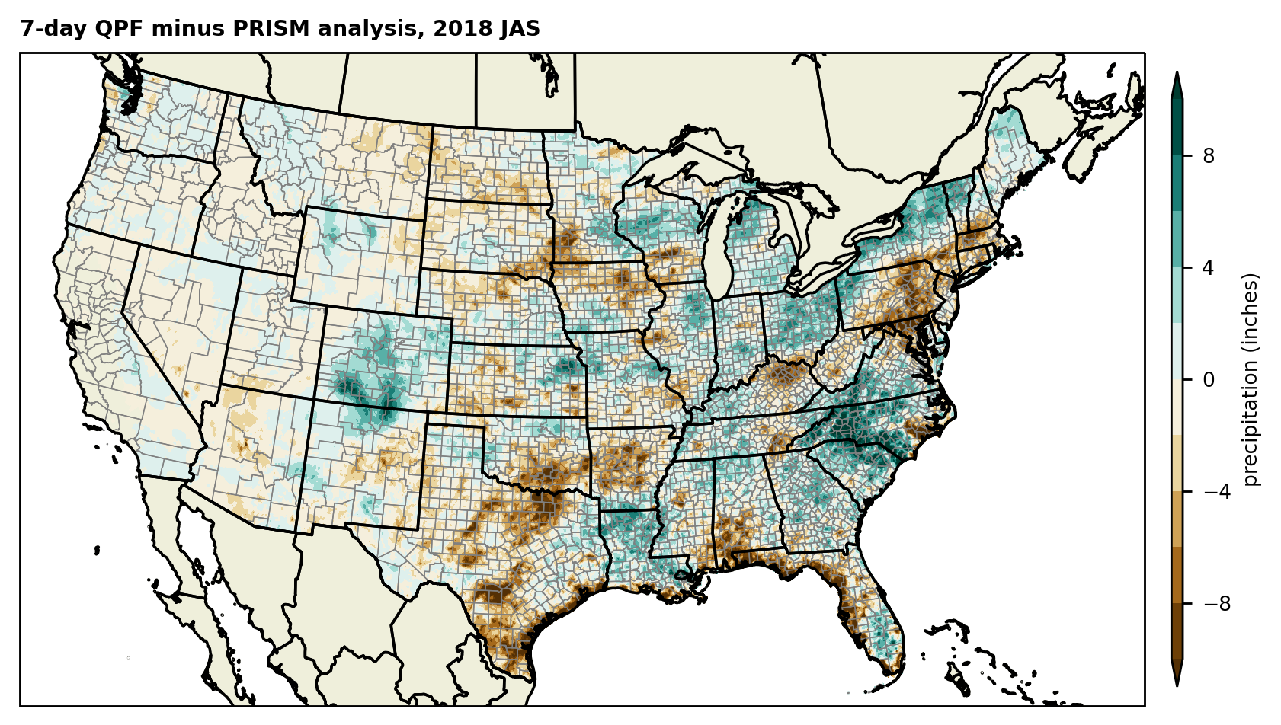
Does the 7-day QPF consistently over-predict precipitation in the summer?
Graphic by Abby Thornton, summer REU intern

Slide 28
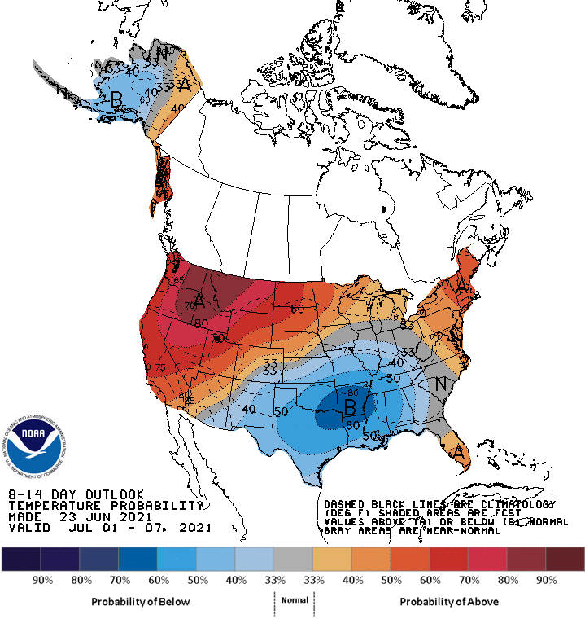
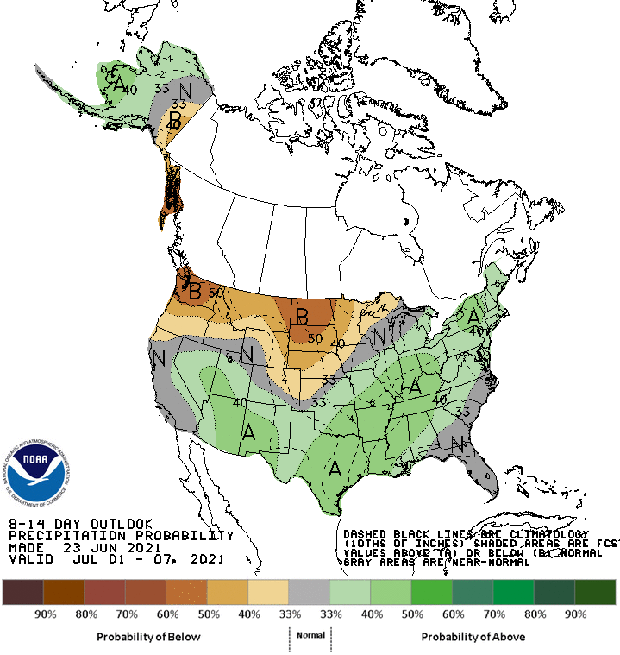
8-14 day outlook
https://www.cpc.ncep.noaa.gov

Slide 29
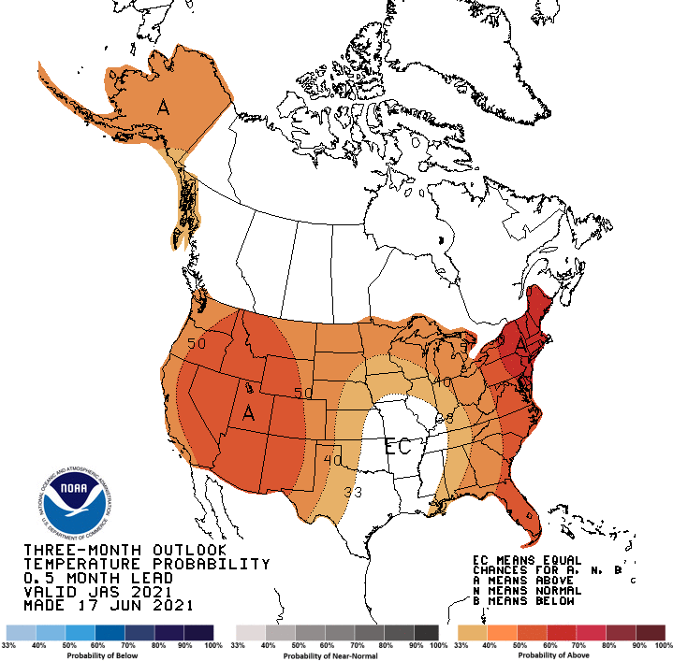
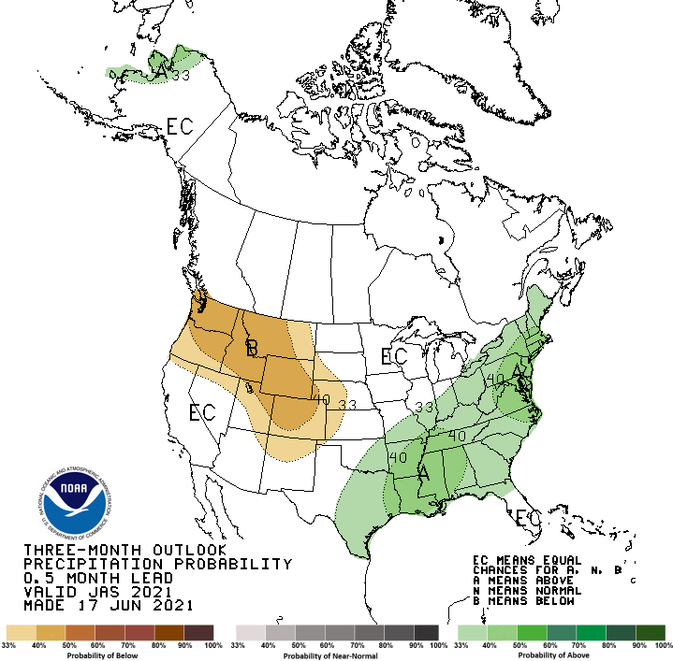
Seasonal outlook
https://www.cpc.ncep.noaa.gov

Slide 30
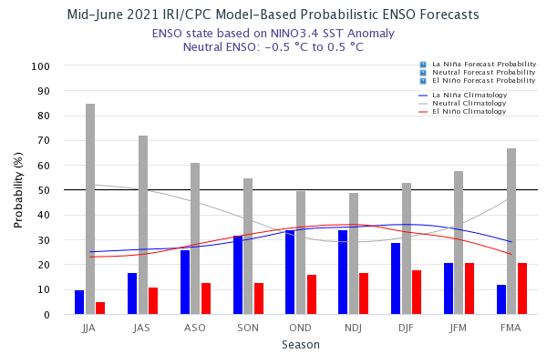
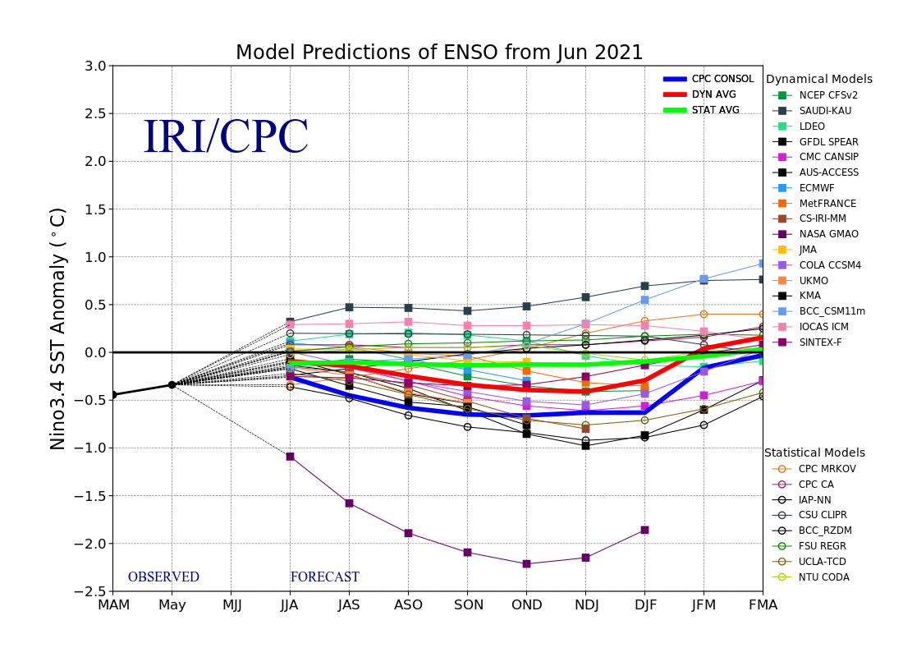
What’s the El Niño forecast?
In mid-June, SSTs in the east-central Pacific are roughly 0.0 degree C different from average, and the evolution of most key atmospheric variables are consistent with ENSO-neutral conditions. A large majority of the model forecasts predict SSTs to remain near-normal through boreal summer. Similar to the new official CPC/IRI outlook issued earlier this month this objective outlook calls for ENSO-neutral to persist through at least Aug-Sep-Oct, with greater uncertainty later in the year.
https://iri.columbia.edu/our-expertise/climate/forecasts/enso/current/

Slide 31
Will we have another “non”-soon?
“Given recent FCH persistence during the past 15 years or so (polar regions are warming at a faster rate than the tropics, weakening the westerlies/polar jet stream) due to climate change, near average precipitation during July, August and September is getting harder to come by in NM.”
https://www.weather.gov/media/abq/Briefings/2021MonsoonOutlook.pdf

Slide 32
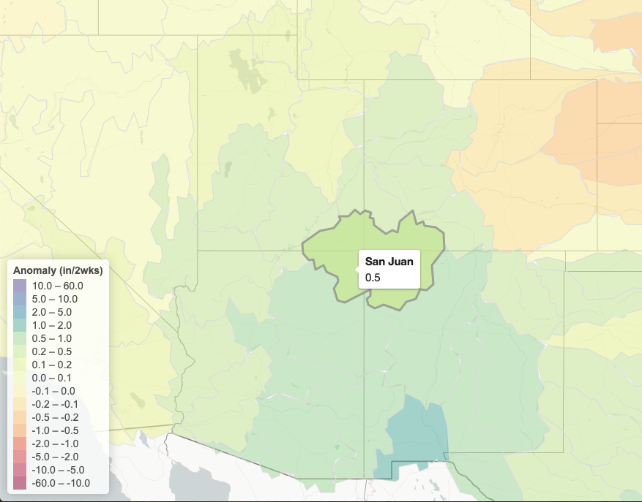
https://hydro.rap.ucar.edu/s2s/
Some models are indicating onset of monsoon moisture in the next couple of weeks.
CFSv2 showing above average moisture out to the 3-4 week time period for the Four Corners region.
The NMME is less confident - some show drier than average for July, some wetter. Ensemble mean is trending towards near average July precipitation.

Slide 33
Summary points
Continental Divide is the literal divide between cooler and wetter conditions to the east and drier and warmer to the west.
Evaporative demand is kicking up. This, combined with drought in the west, is resulting in increased fire activity. This will be a continuing concern as summer progresses.
Many indicators are calling for an increased chance of warmer and drier than average conditions across the state for the rest of the summer.
Predictive skill for monsoon onset right now is lower. Some models are showing onset is imminent, but some models do indicate drier than average conditions in July. Recent history tells us that the monsoon is not as stable or consistent and it may be harder to get that near average moisture from year-to-year.

Slide 34
To view this and other presentations:
http://climate.colostate.edu/ccc_archive.html
Becky.Bolinger@colostate.edu

