Slide 1
Colorado Climate Center Yearly Update
Peter Goble
WERA 102
September, 2017

Slide 2
Overview
Nolan Doesken has retired
The new State Climatologist is to be named next month
CoAgMET is expanding with a website overhaul underway
The Climate Center is working on several evaporative demand-related projects
Drought continues to be a focal point for us. The Climate Center is now including seasonal forecasts

Slide 3
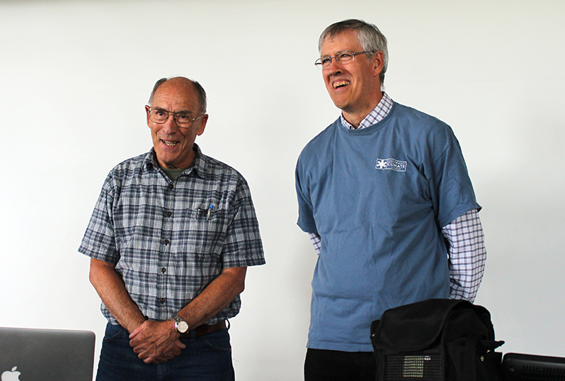
Nolan’s Retirement
Nolan Doesken served as Colorado’s State Climatologist from 2006-2017
He retired in August
WERA 102 was always one of his favorite meetings to attend
He’ll be back in October, primarily to work on CoCoRaHS. You’ll likely see him again

Slide 4
New State Climatologist to be Named in October
Colorado State has conducted and completed a search for a new state climatologist
Expect this person to be a tenured faculty member within Colorado State, and to be named next month
Expect this person to name a deputy director of the Climate Center
…but we are not currently running headless

Slide 5
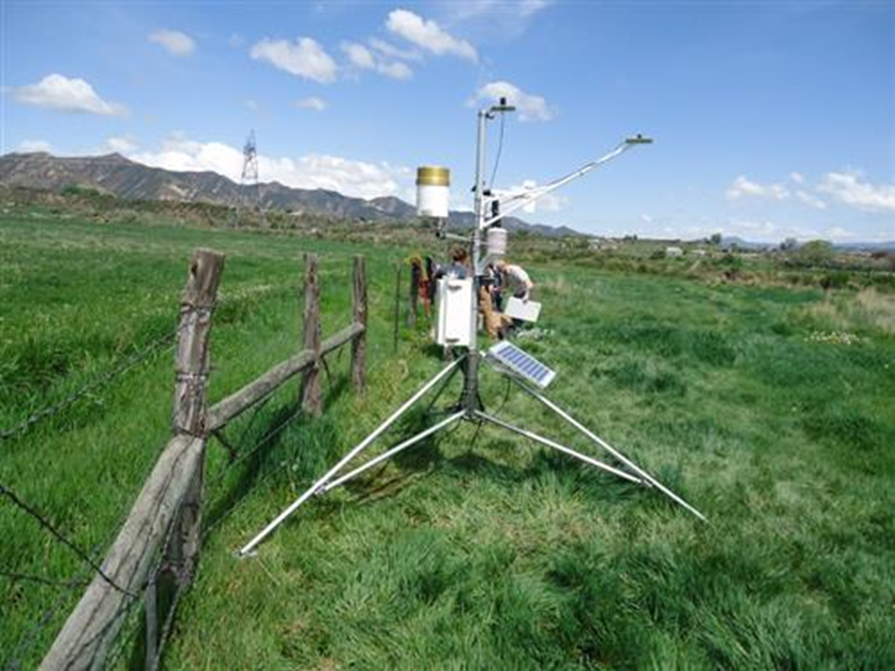
Improvements to CoAgMET
Expansion of stations on the west slope
Website upgrade
5-minute data from stations
New mapping tool
https://erams.com/coagmet/

Slide 6
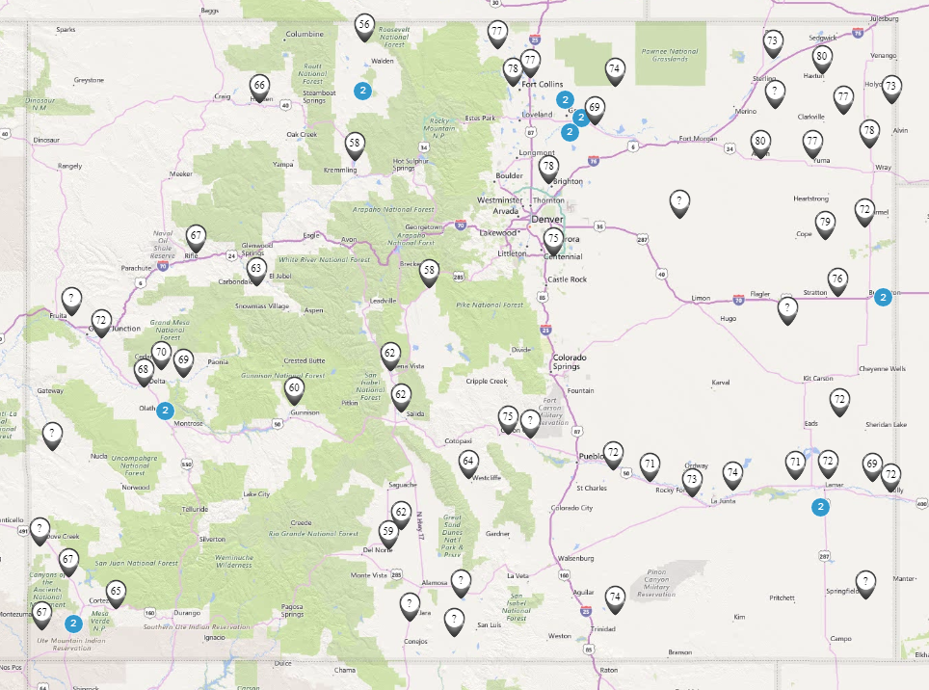
erams.com/coagmet

Slide 7
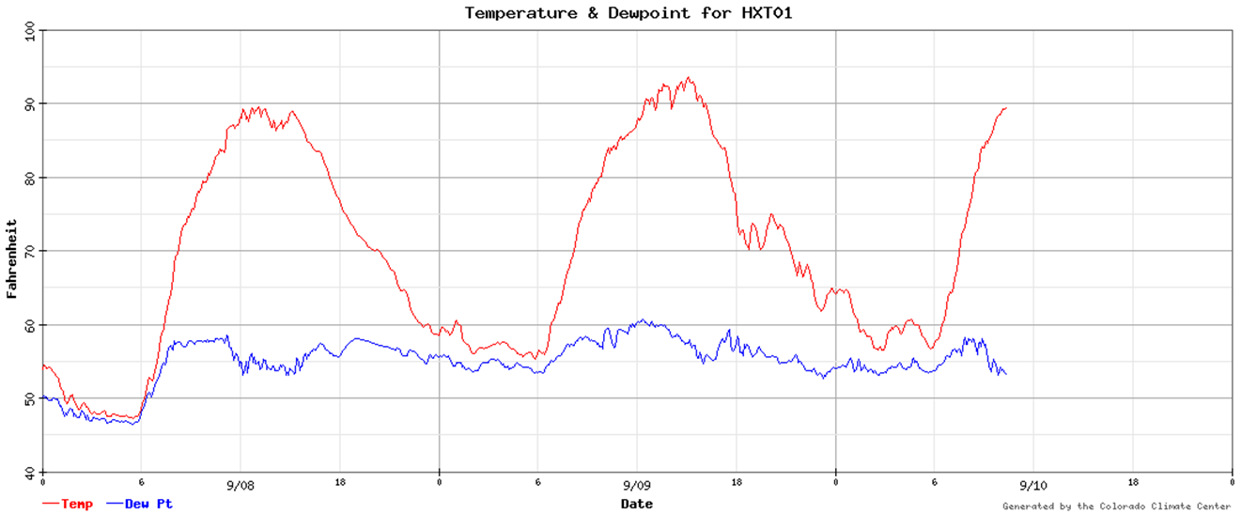
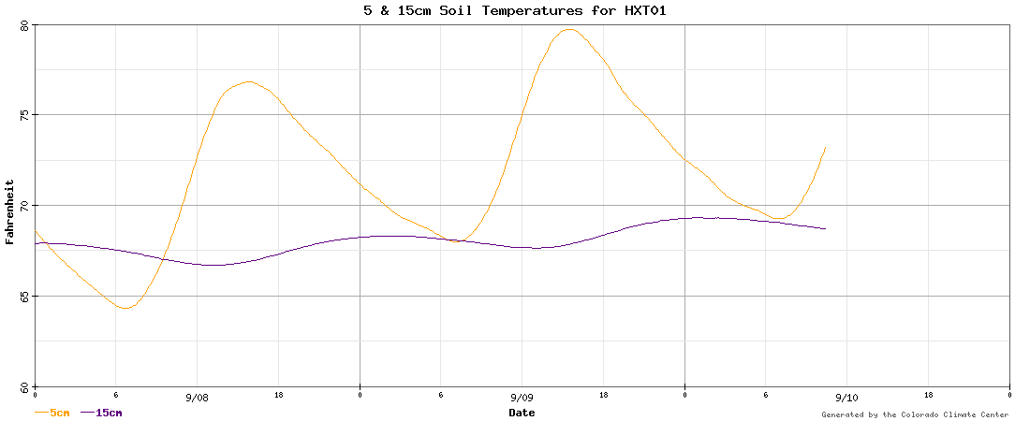

Slide 8
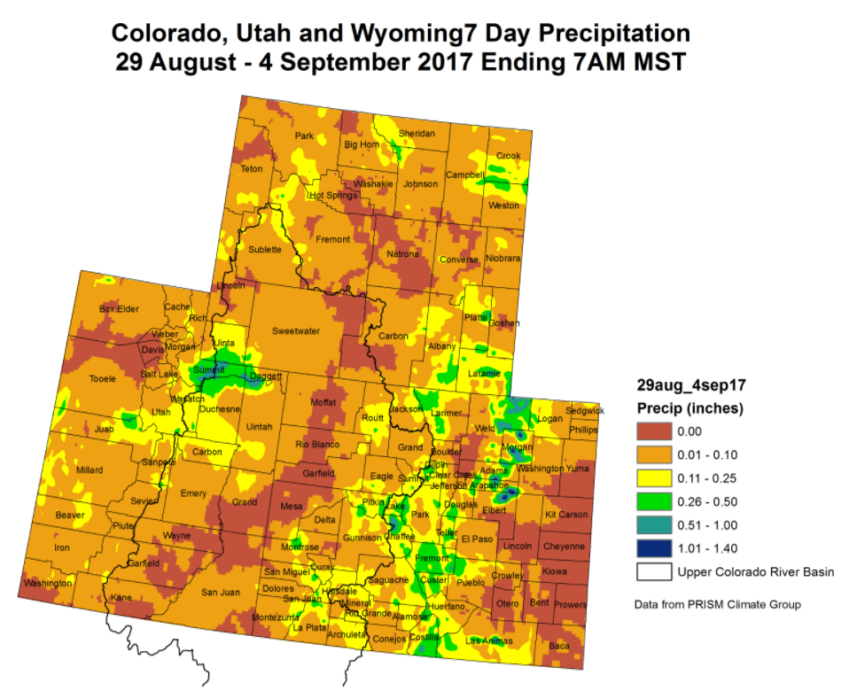
Colorado Climate Center and NIDIS Drought Activities

Slide 9
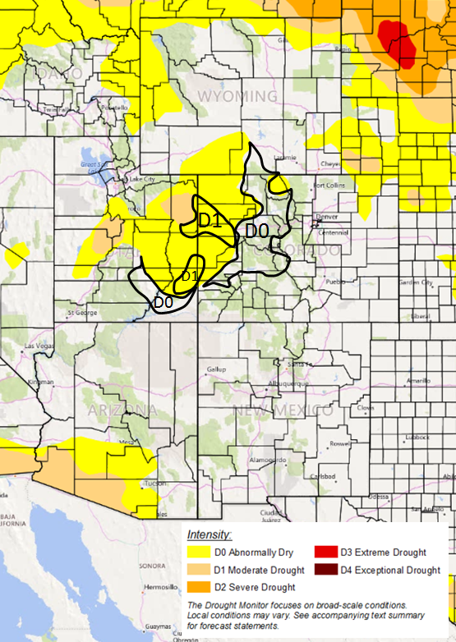
Colorado Climate Center and NIDIS Drought Activities

Slide 10
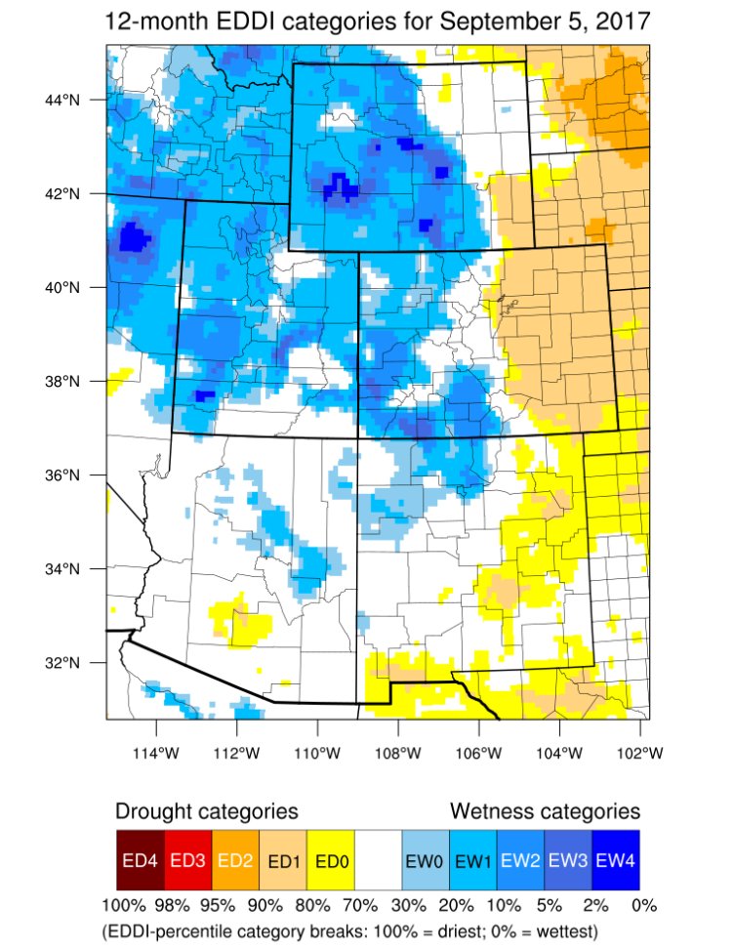

Slide 11
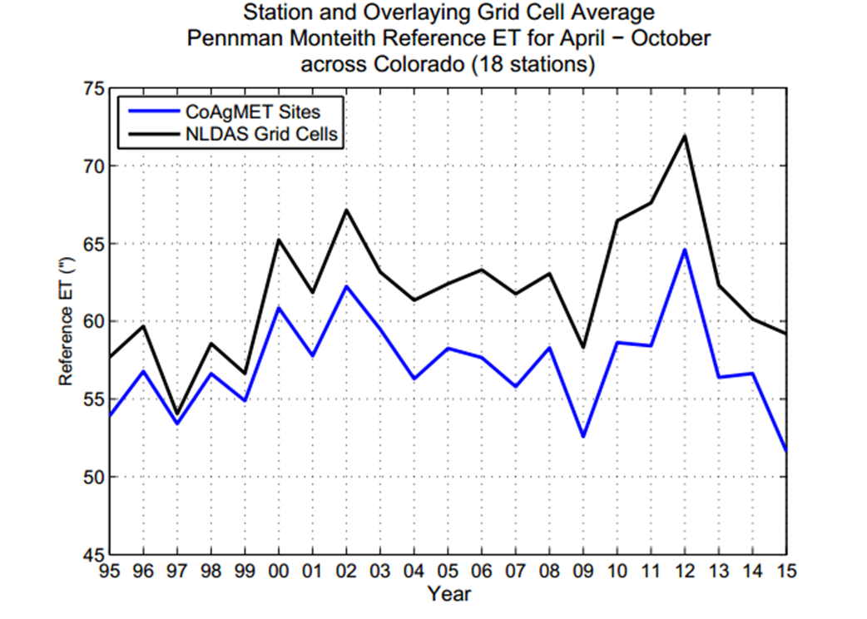

Slide 12
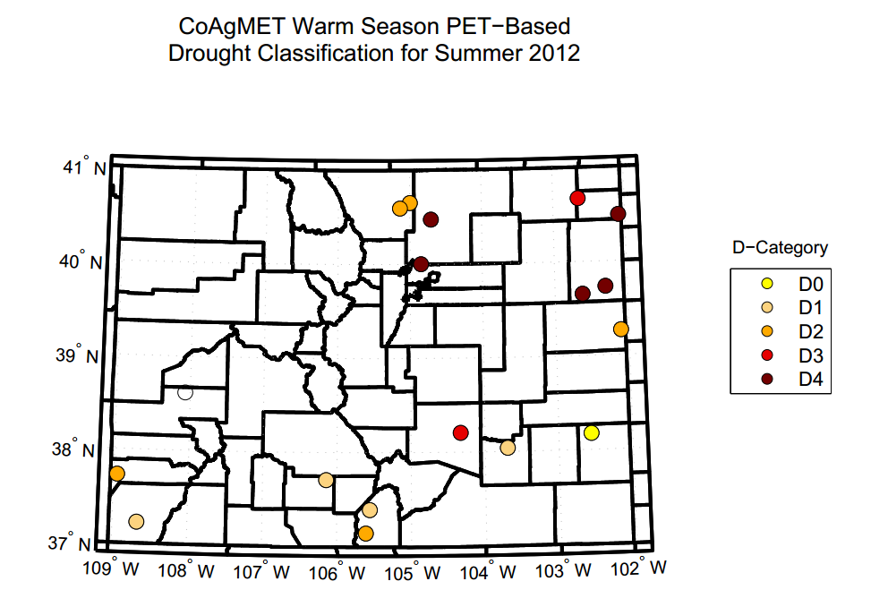

Slide 13
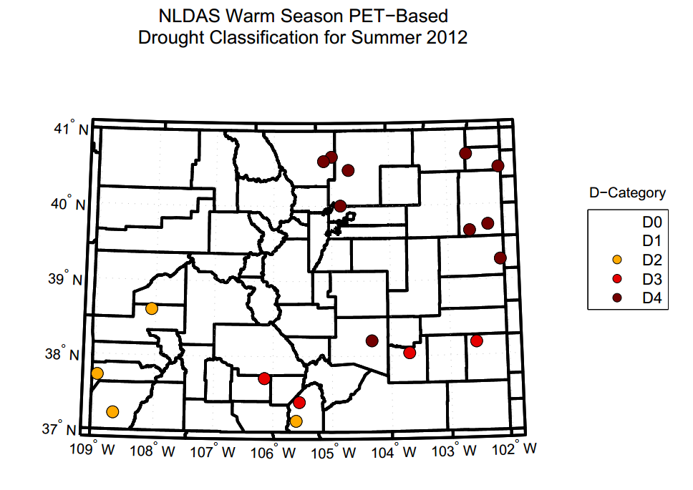

Slide 14
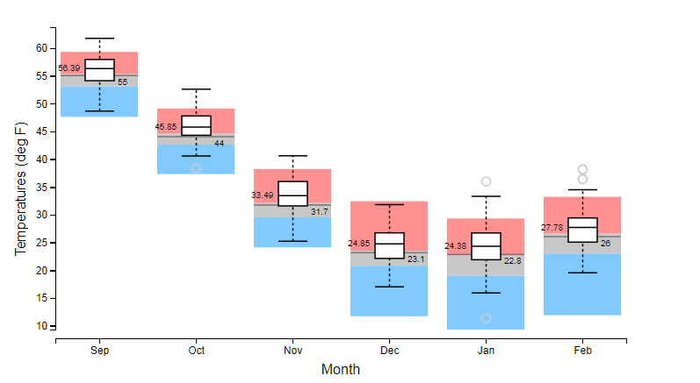
Producing Seasonal Forecasts
Temperature forecast for the Upper Colorado Drainage in CO

Slide 15
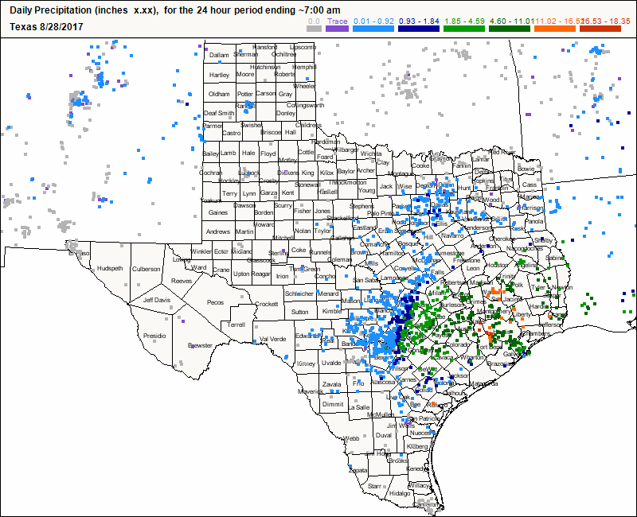
CoCoRaHS

Slide 16
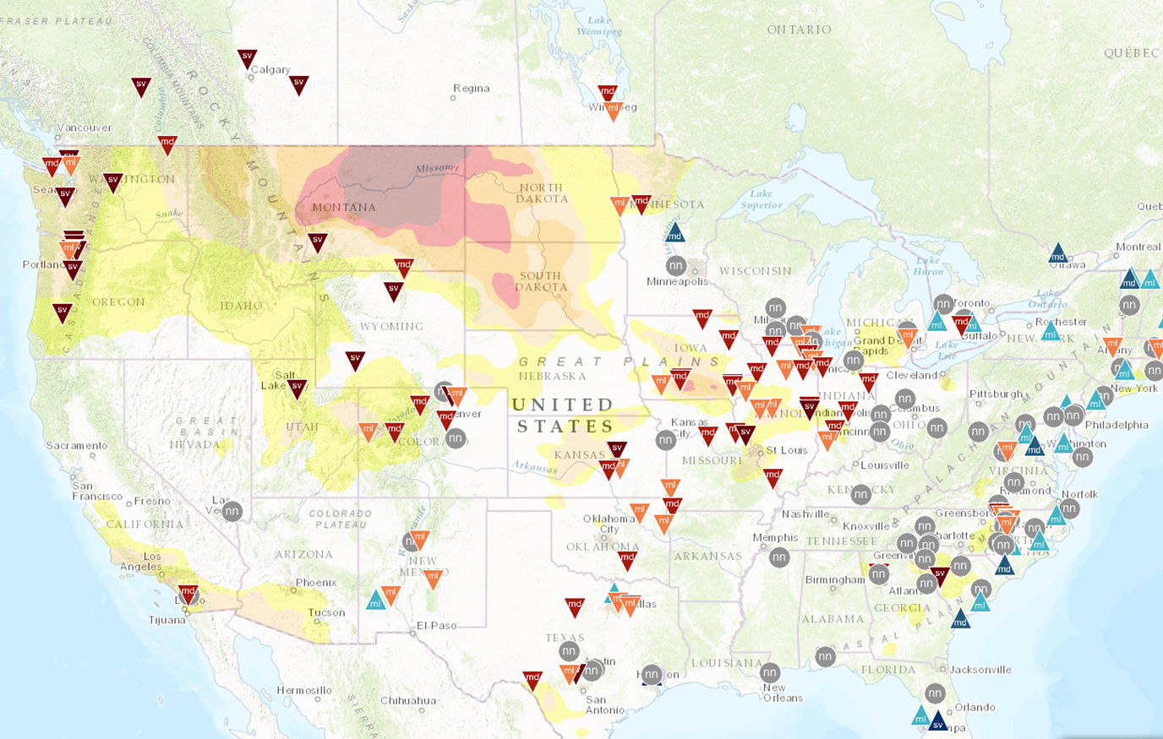
CoCoRaHS

Slide 17
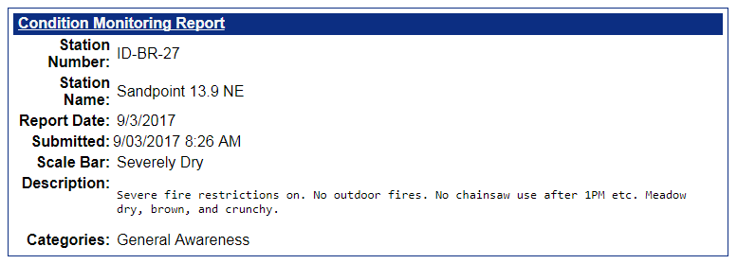
CoCoRaHS
Condition monitoring allows us to track where drought conditions are deteriorating, at least in a colloquial sense

Slide 18
Questions?

