Slide 1
A Reflection on Water Year 2017
Peter Goble

Slide 2
Today’s Roadmap
The story of WY 2017 as told by data
Climate Change and Variability and WY 2017
Major weather events and fun facts from WY 2017
A quick look ahead

Slide 3
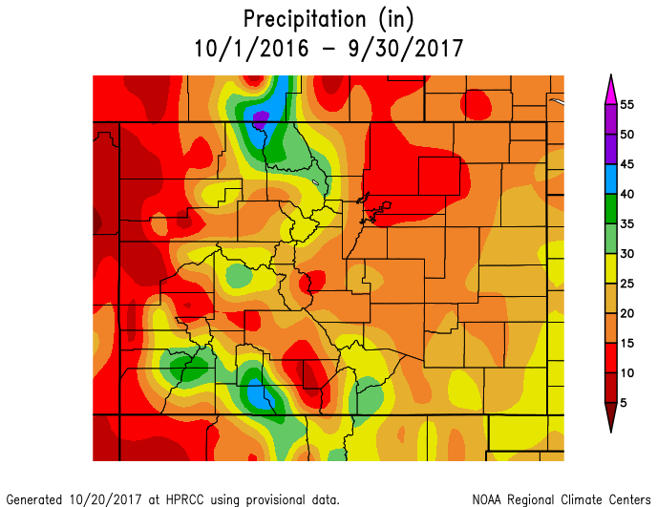

Slide 4
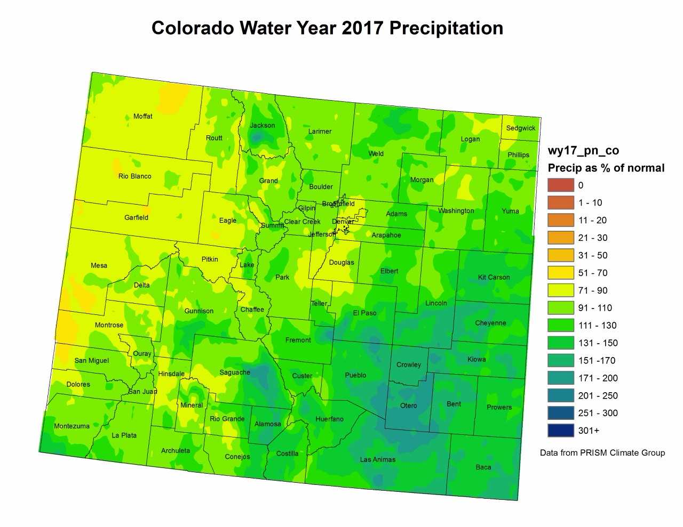

Slide 5
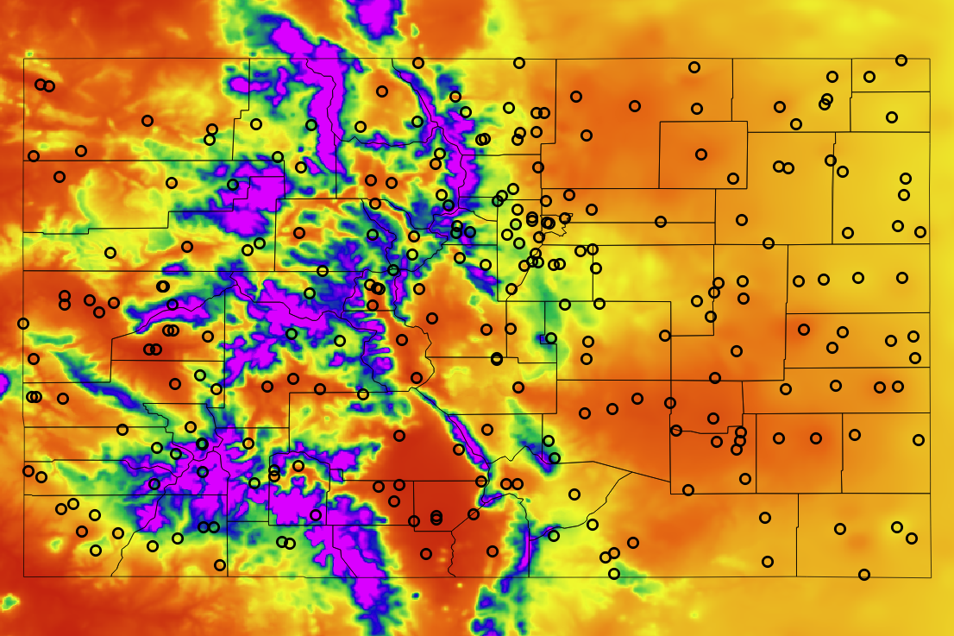

Colorado Precipitation Normals

Slide 6
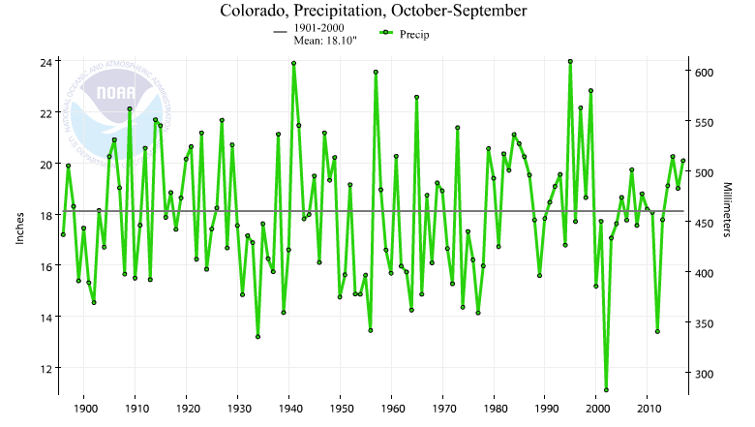
Water Year Colorado Average: 20.09” (1.99”” above normal)

Slide 7
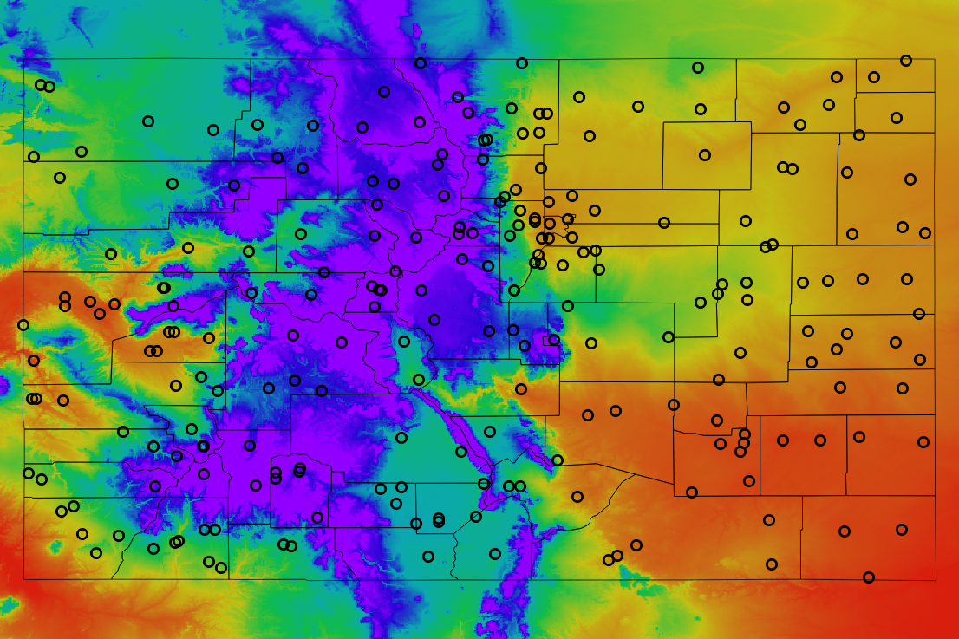

Colorado Annual Average Temperatures

Slide 8
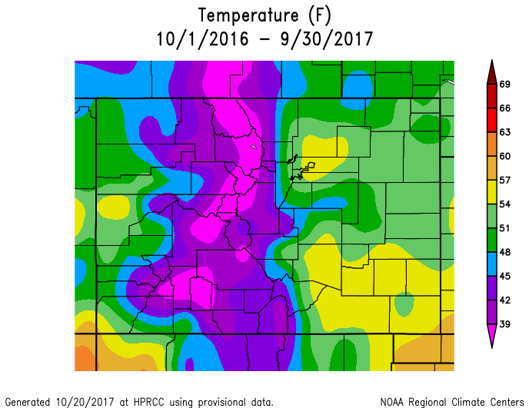

Slide 9
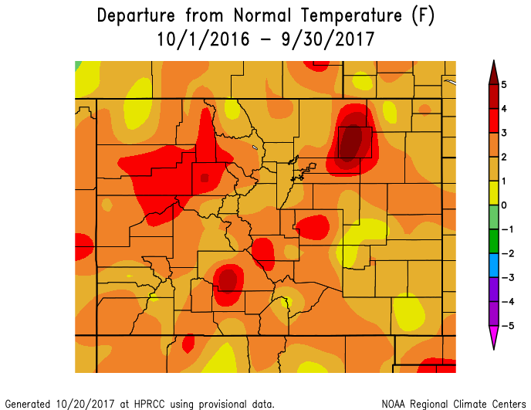

Slide 10
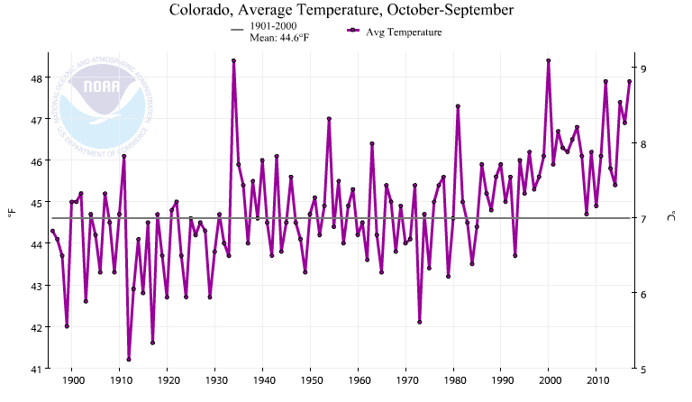
Water Year Colorado Average: 47.9 F (3.3 F above normal)

Slide 11
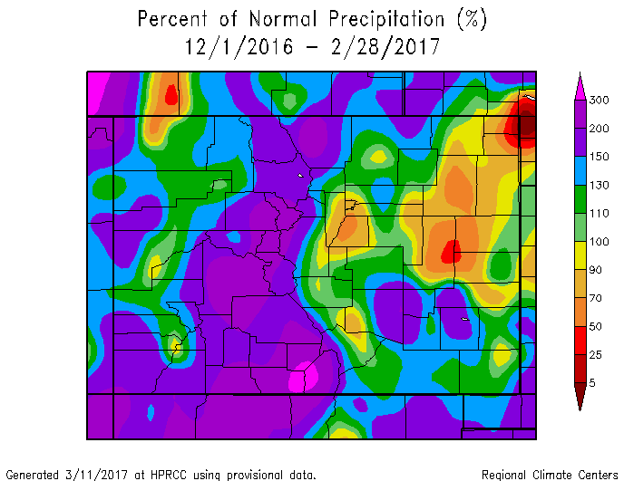
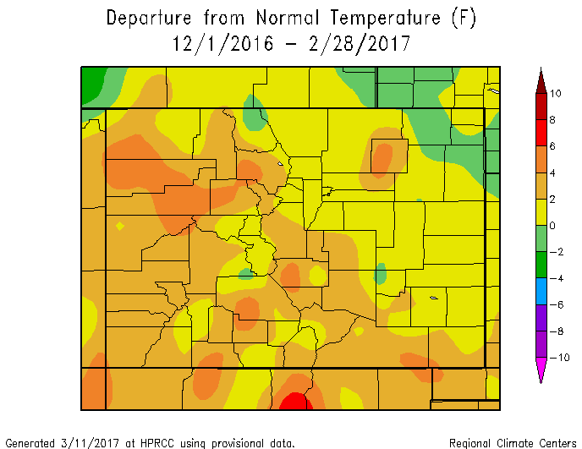

Slide 12
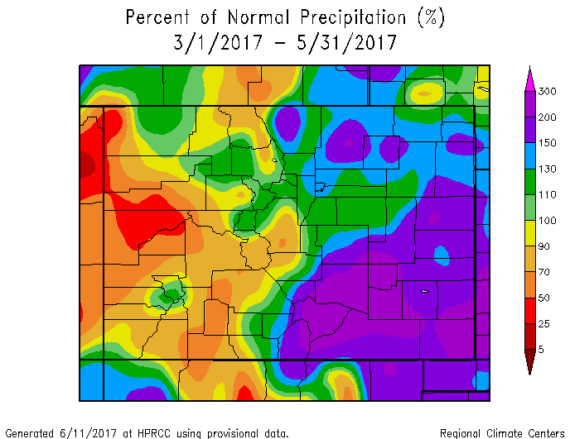
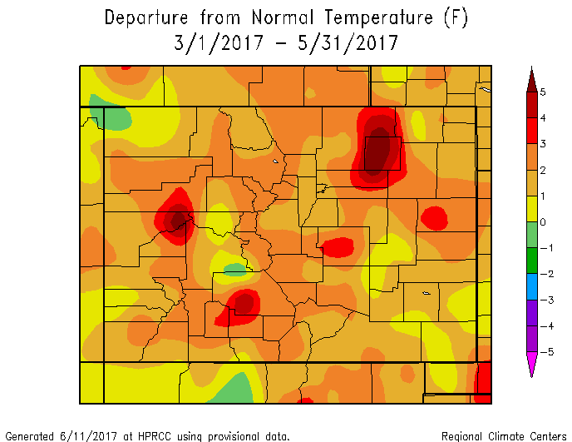

Slide 13
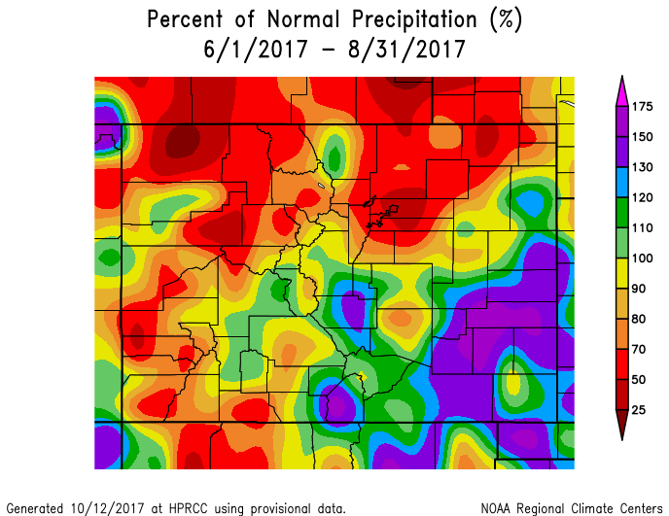
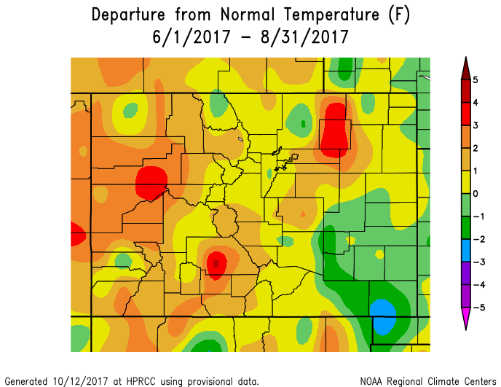

Slide 14
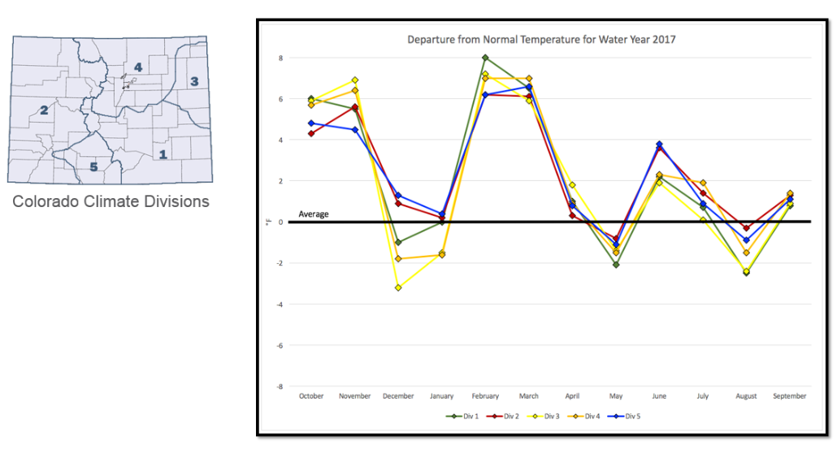

Slide 15
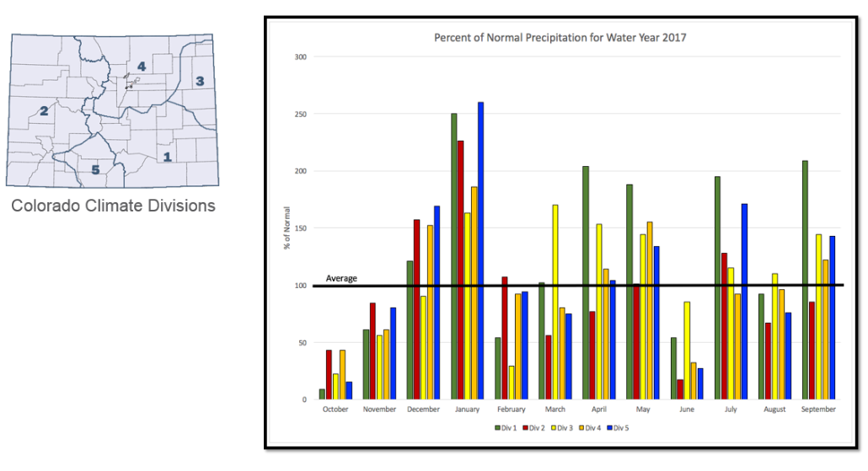

Slide 16
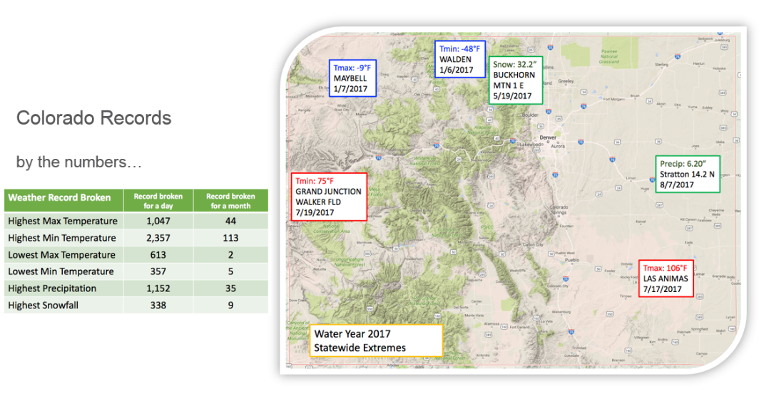

Slide 17
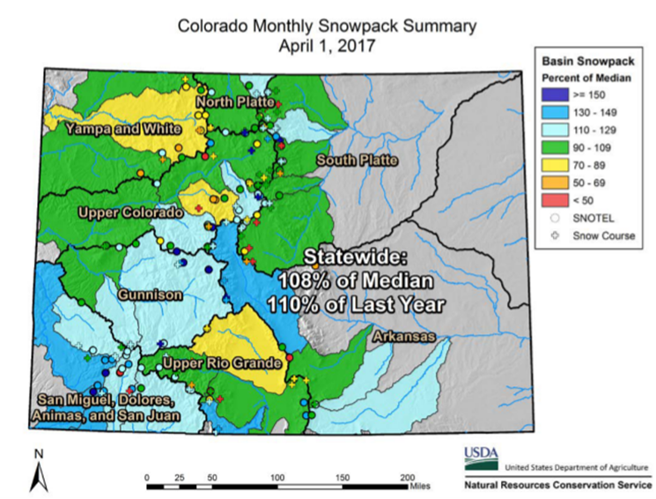

Slide 18
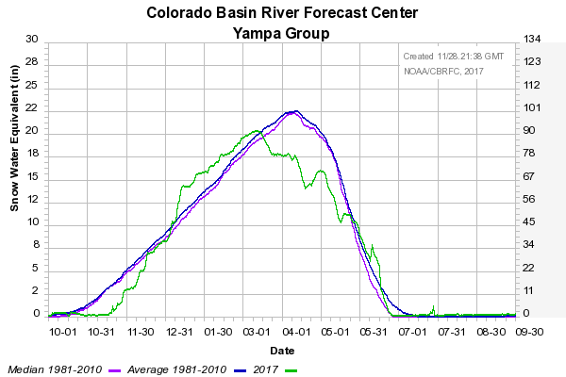

Slide 19
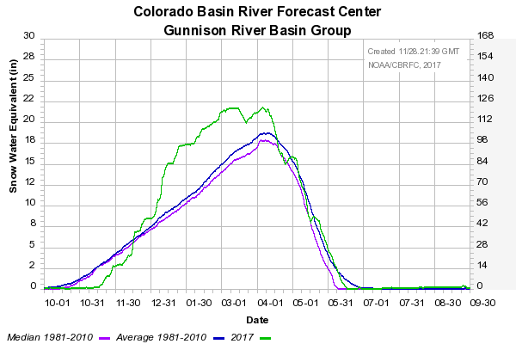

Slide 20
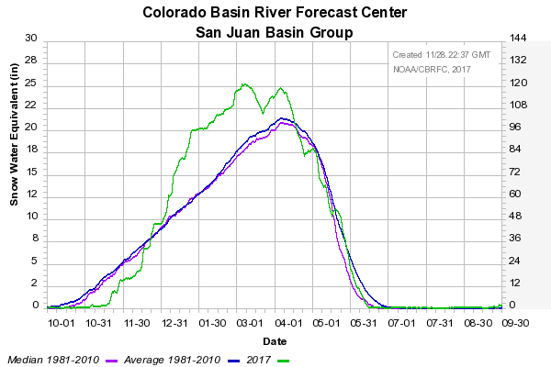

Slide 21
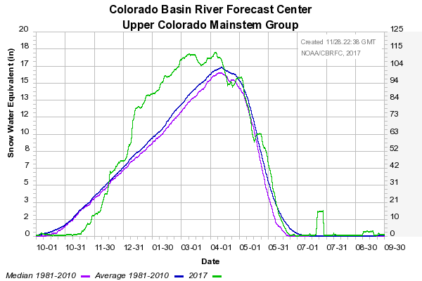

Slide 22
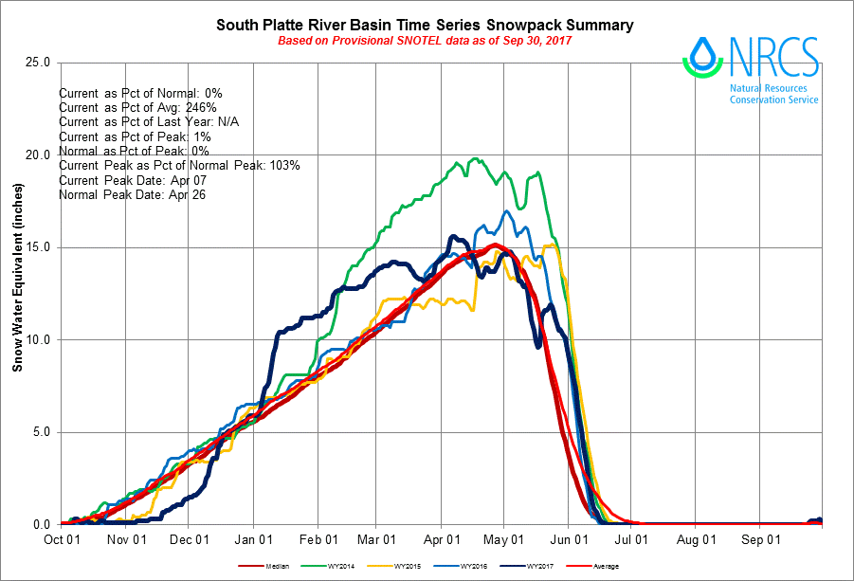

Slide 23
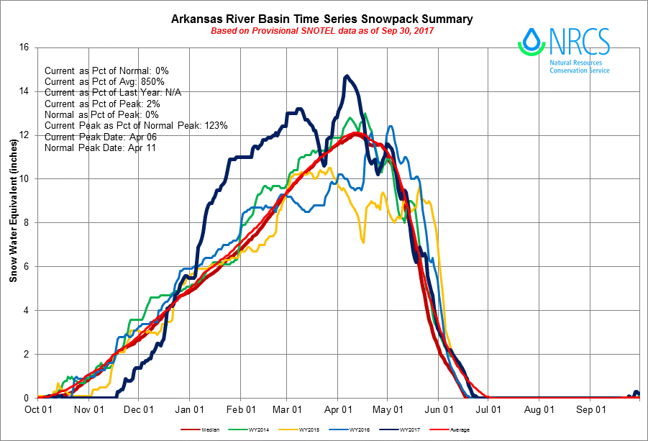

Slide 24
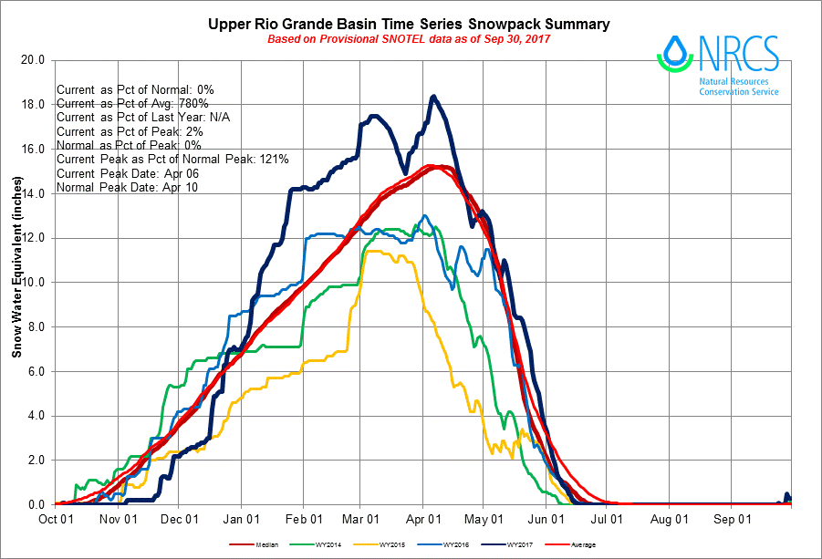

Slide 25
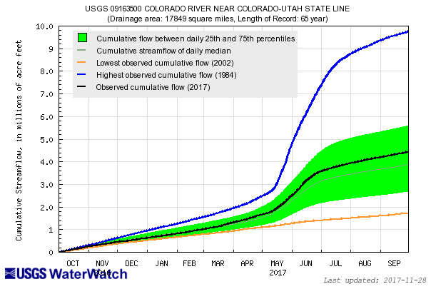

Slide 26
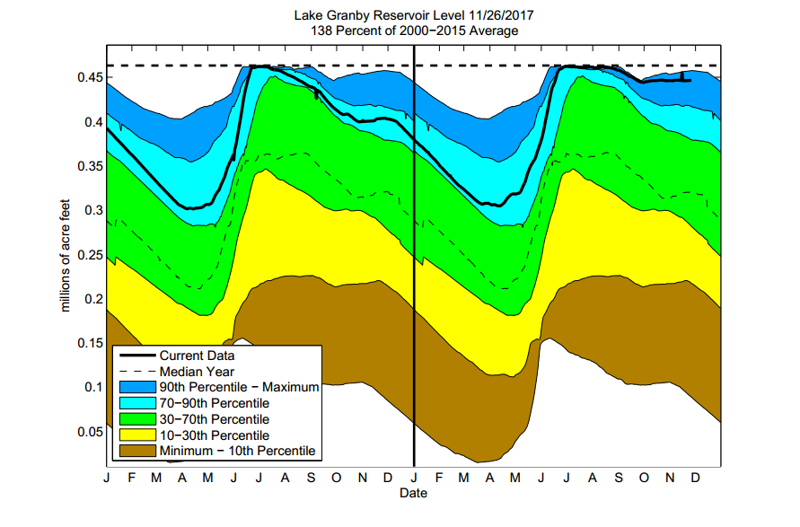

Slide 27
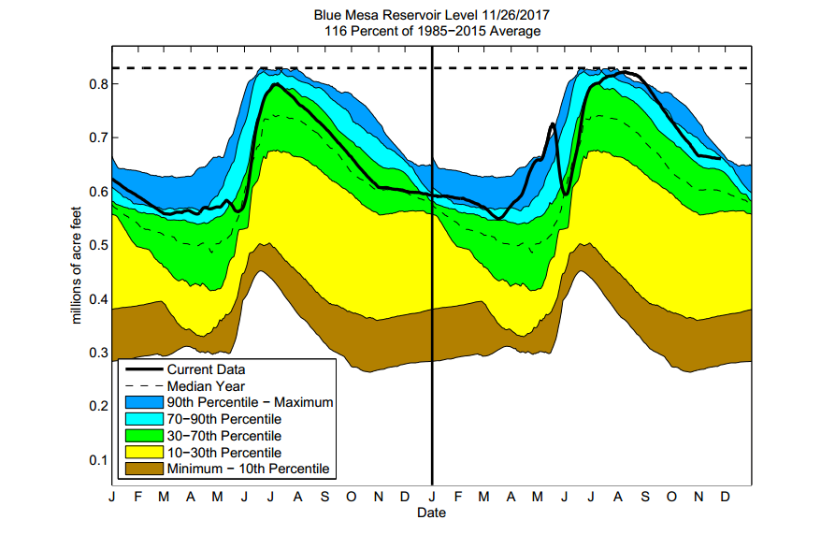

Slide 28
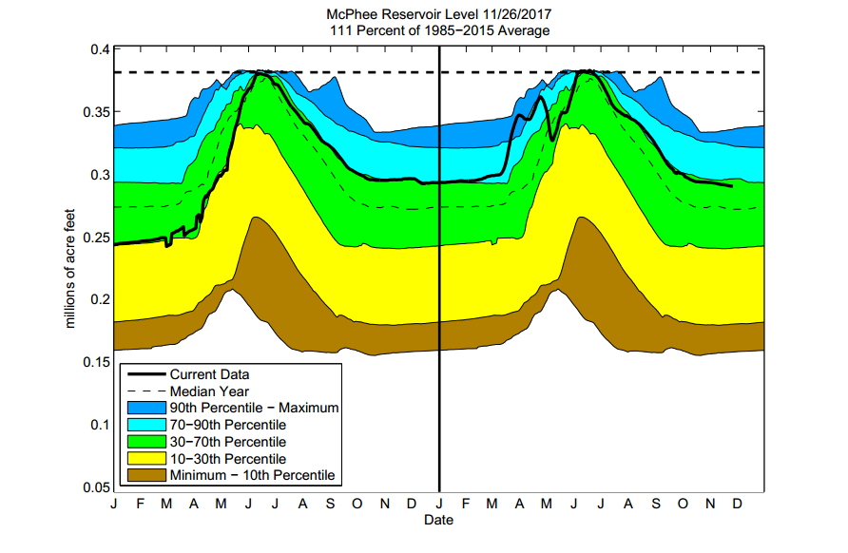

Slide 29
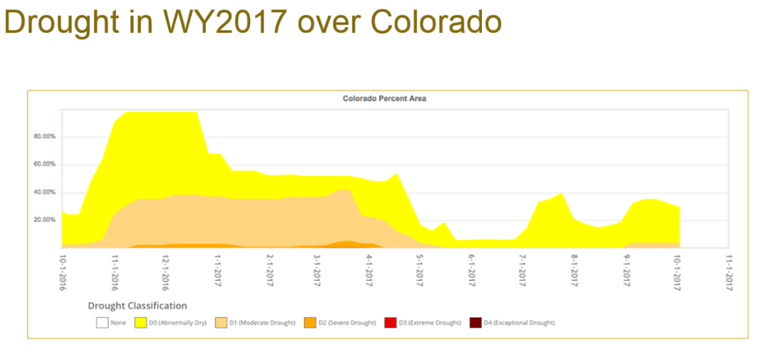

Slide 30
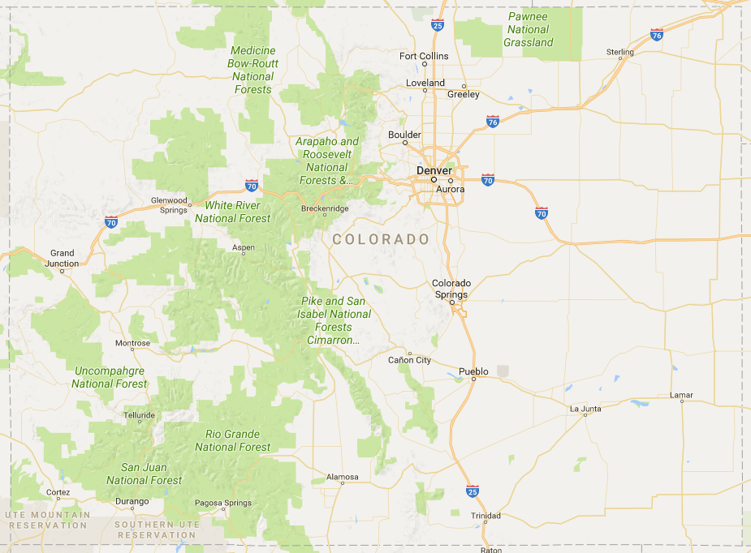

Slide 31
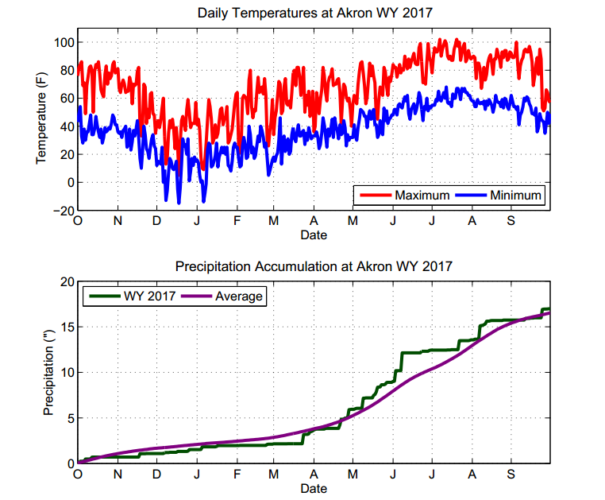

Slide 32
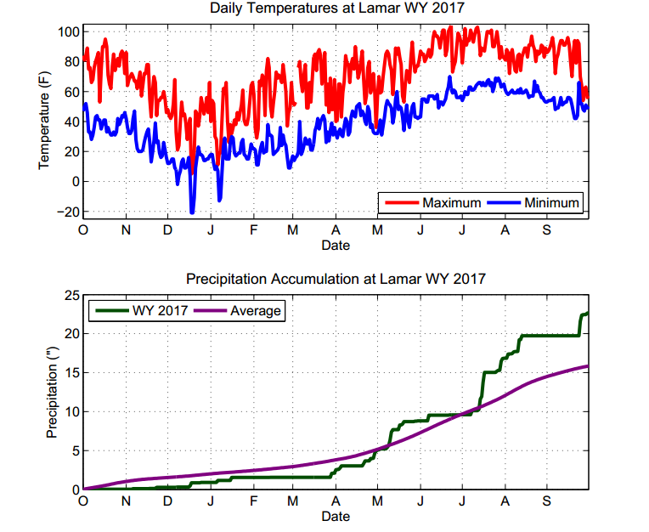

Slide 33
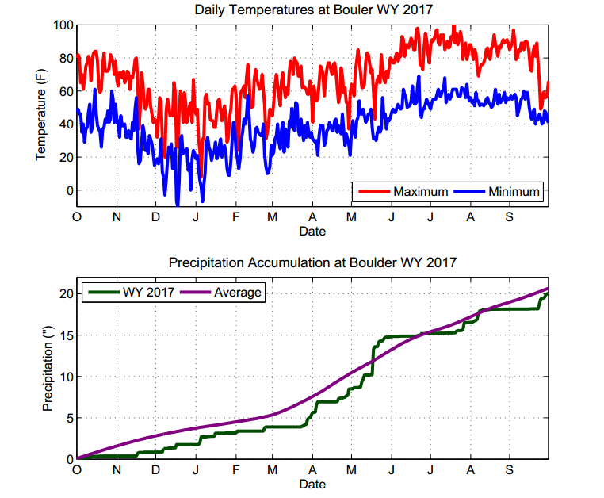

Slide 34
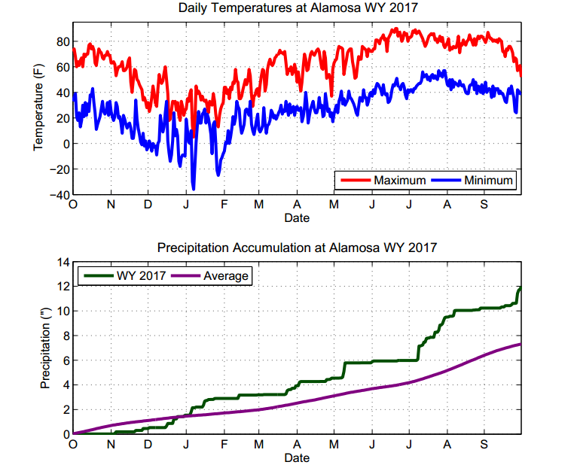

Slide 35
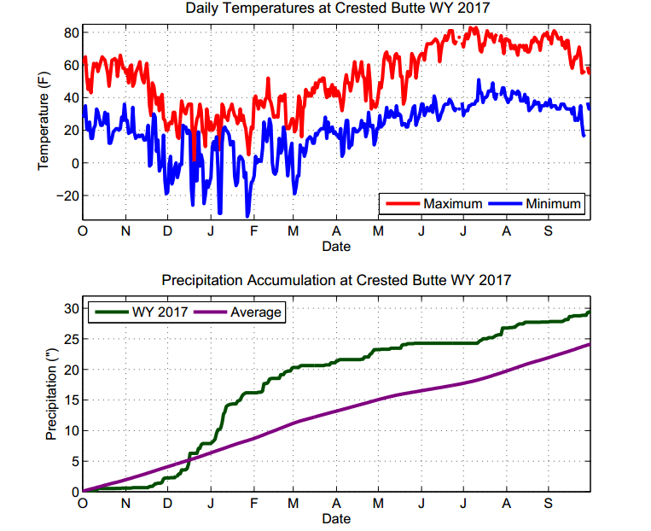

Slide 36
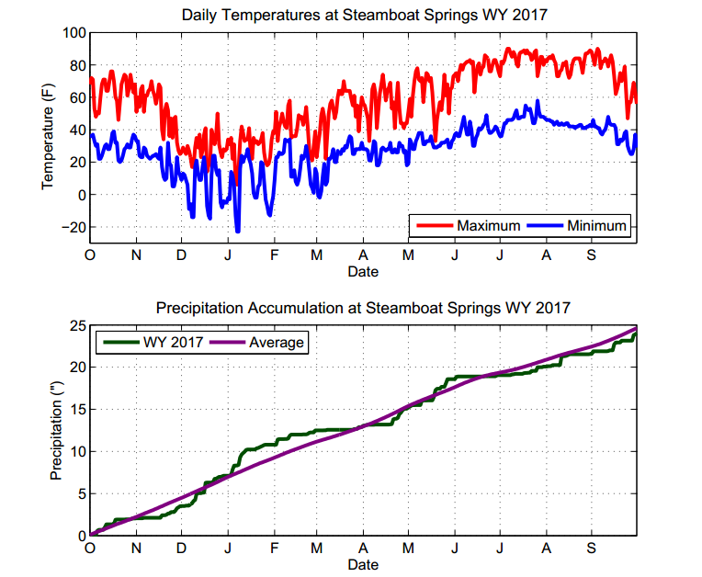

Slide 37
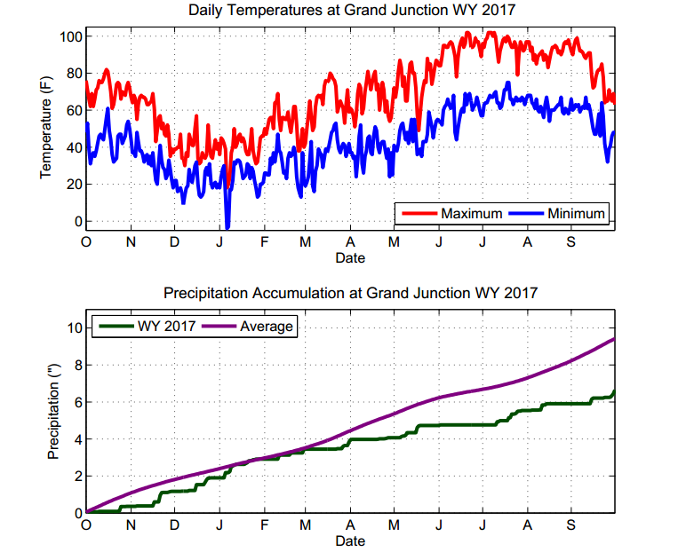

Slide 38
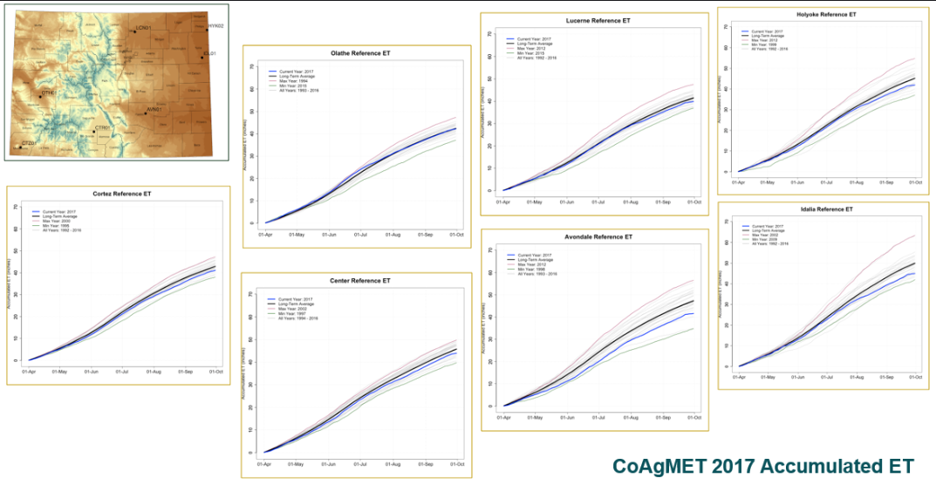

Slide 39
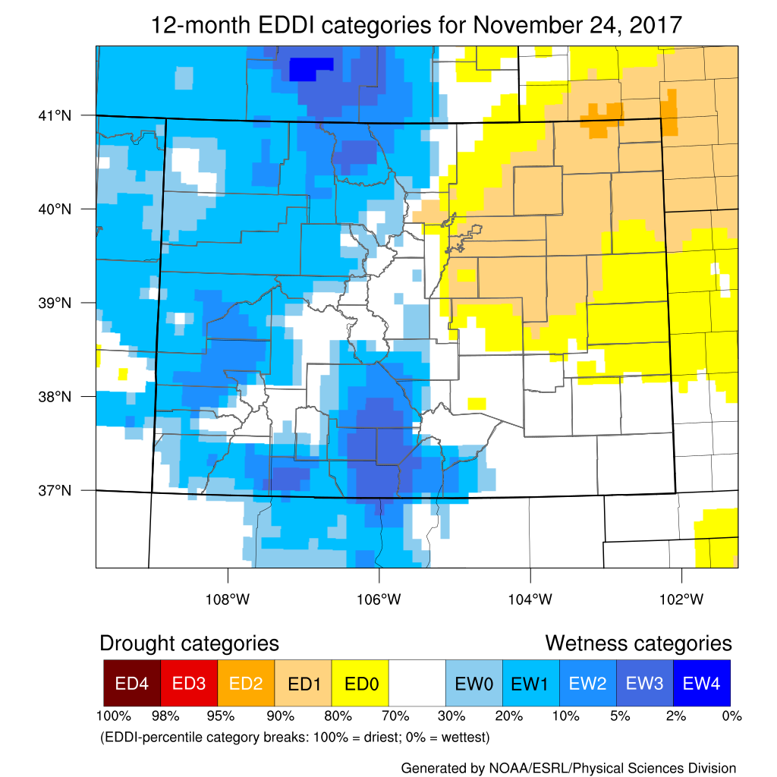

Slide 40
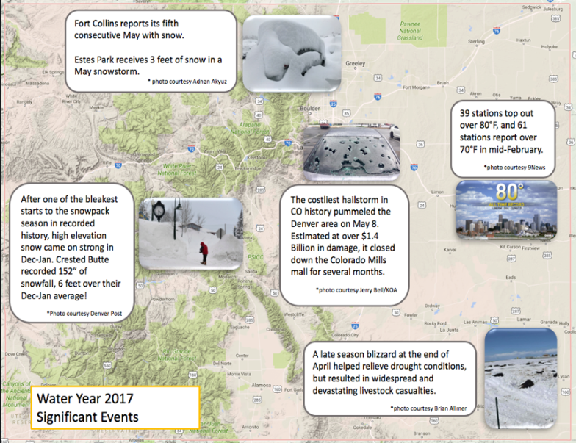

Slide 41
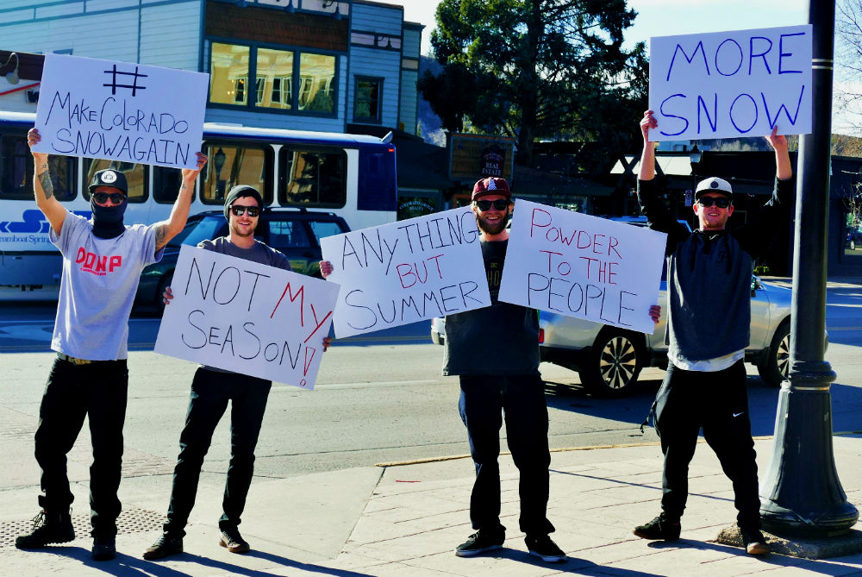
Photo Credit: Shannon Lukens

Slide 42
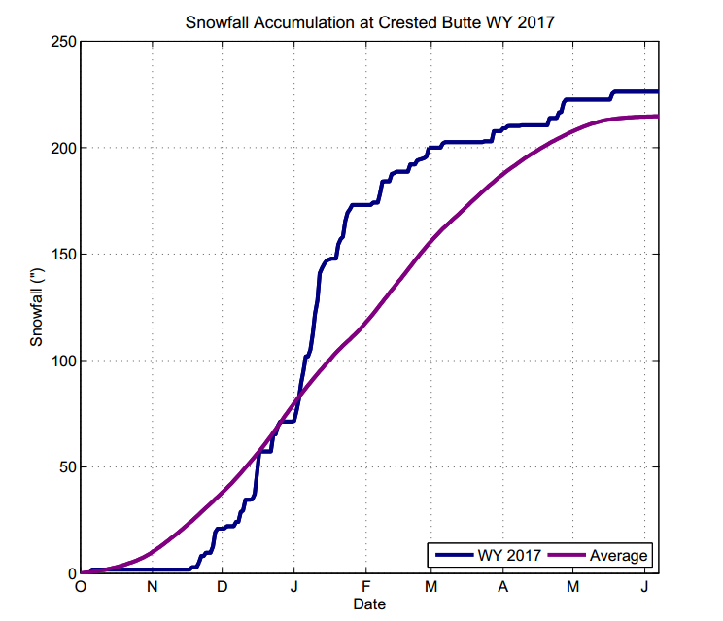

Slide 43
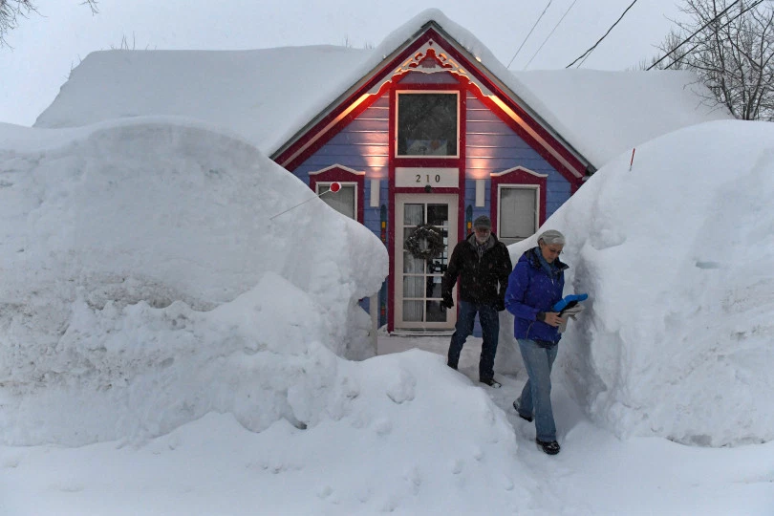
Photo Credit: Helen H. Richardson Denver Post

Slide 44
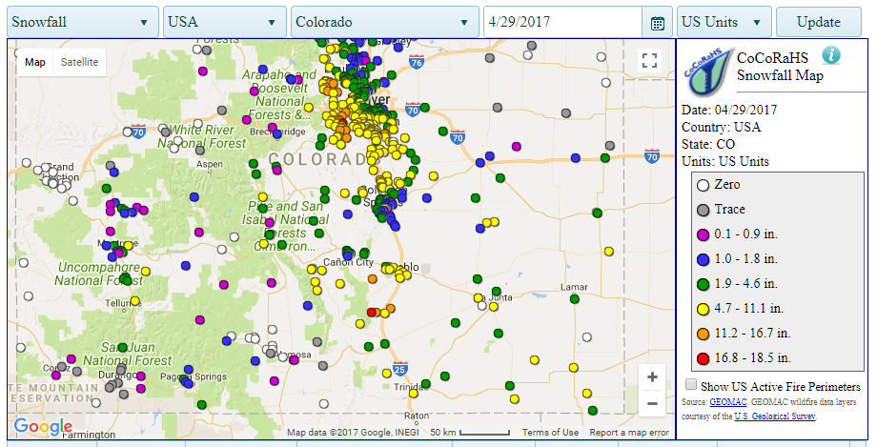

Slide 45
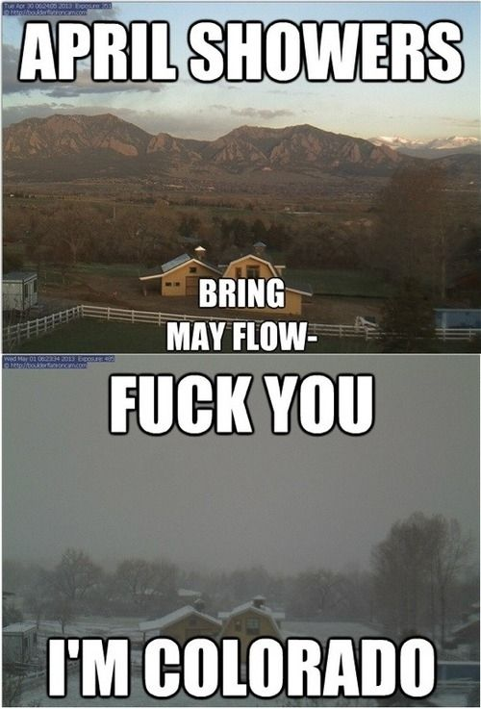
JUST KIDDING

Slide 46
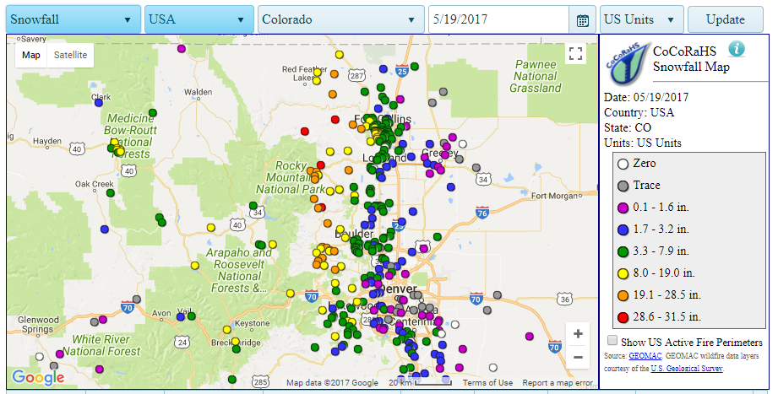

Slide 47
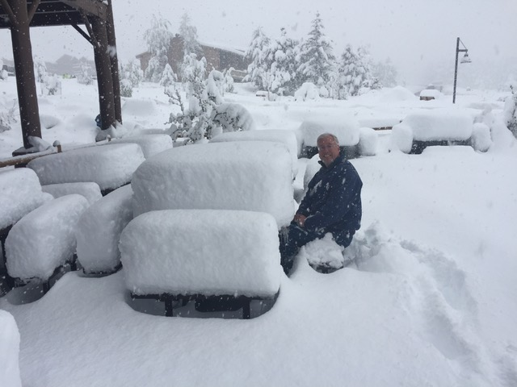
Photo Credit: Henry Reges Colorado Climate Center

Slide 48
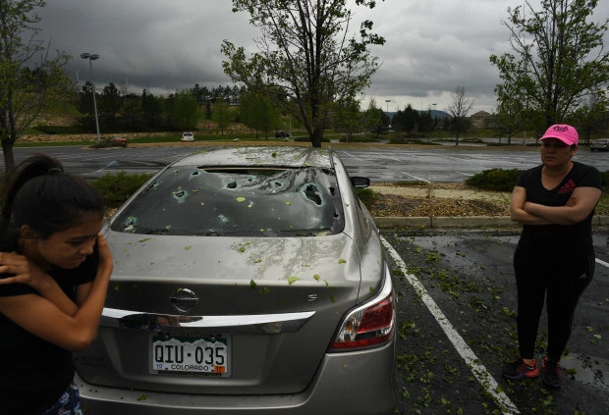
May 8th Hailstorm causes $1.4 Billion in Damage
An estimated 200,000 auto and homeowners insurance claims filed.
Photo Credit: RJ Sangosti
Denver Post

Slide 49
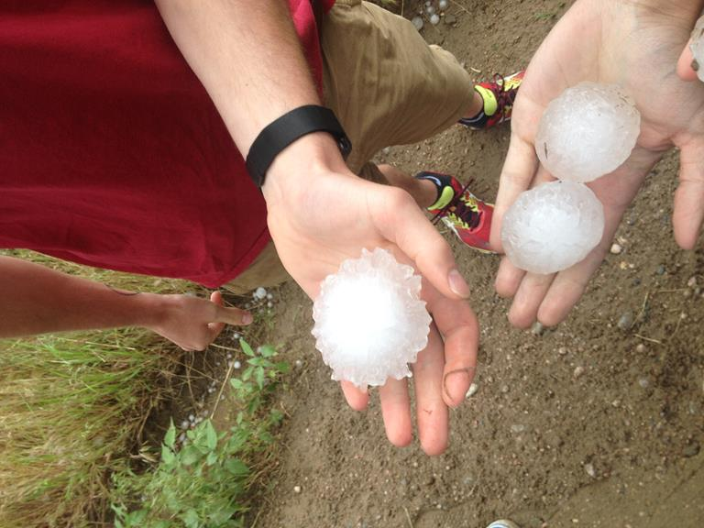

Slide 50

Photo Credit: Chris Slocum
Colorado State Department of Atmospheric Science
PhD

Slide 51


Slide 52

A Quick Look Ahead

Slide 53



Slide 54

Years with similar SST patterns and antecedent conditions have given us near normal precipitation

Slide 55

Dr. Becky Bolinger
Colorado Climate Center

Slide 56


Slide 57

A crushing ridge of high pressure and dry air currently sits over the west US
Looks like a slow start to the snow season

Slide 58


Slide 59
Thanks!

