Slide 1

Water Year 2026 In Review
Compiled by the Colorado Climate Center
Dept. of Atmospheric Science
Colorado State University

Slide 2
View our ArcGIS StoryMaps version of this summary!
https://col.st/aenlo

Slide 3
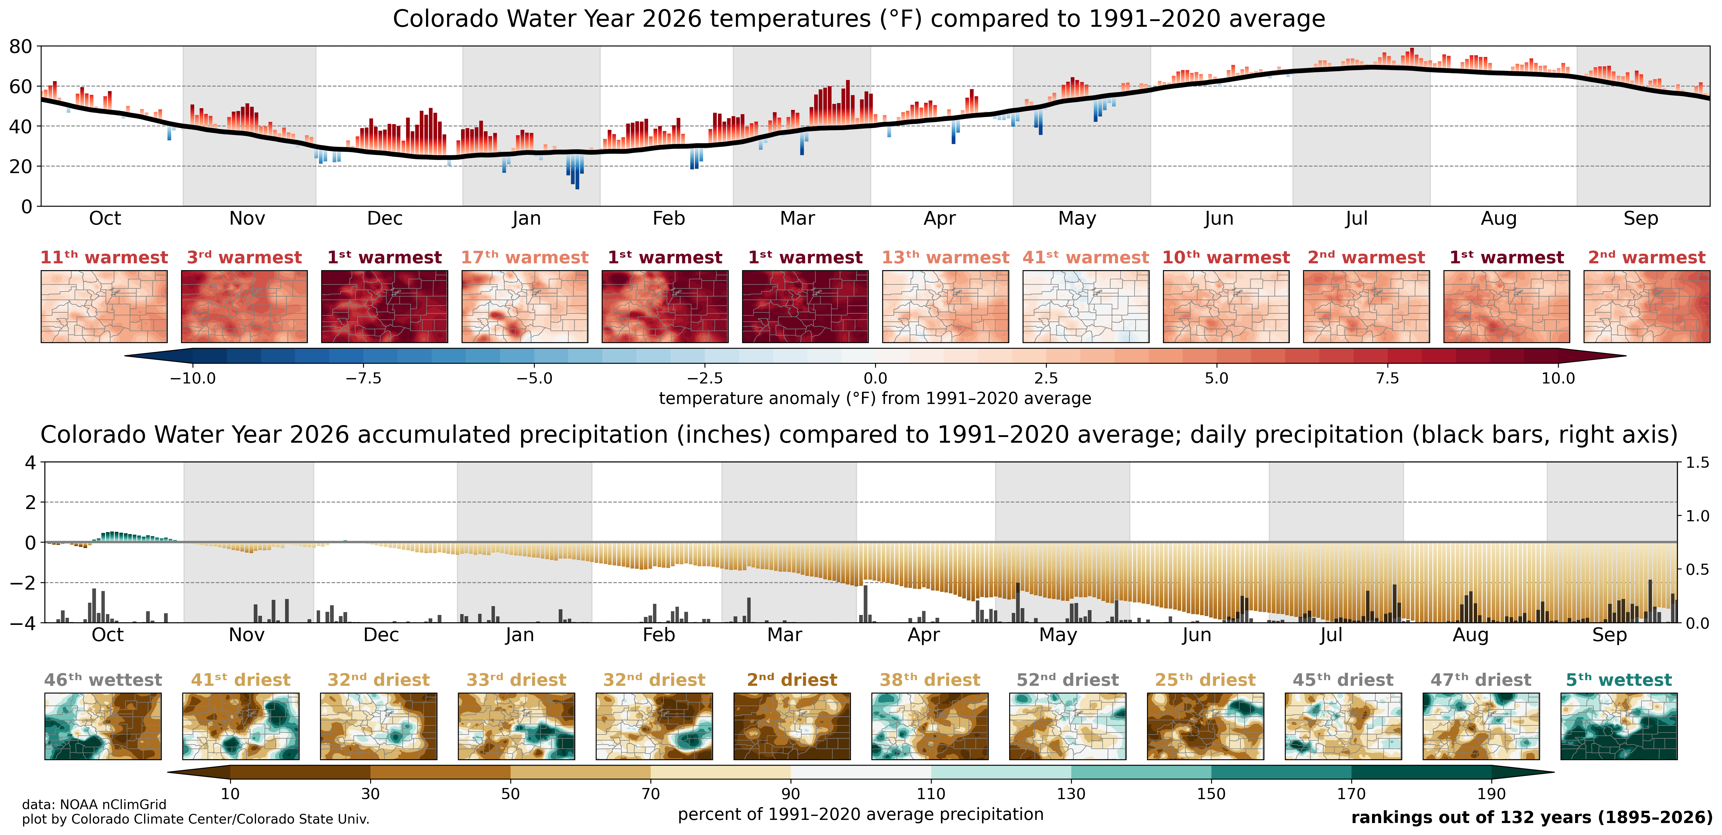
Water Year 2026 at a glance
https://climate.colostate.edu/co_cag/index.html

Slide 4
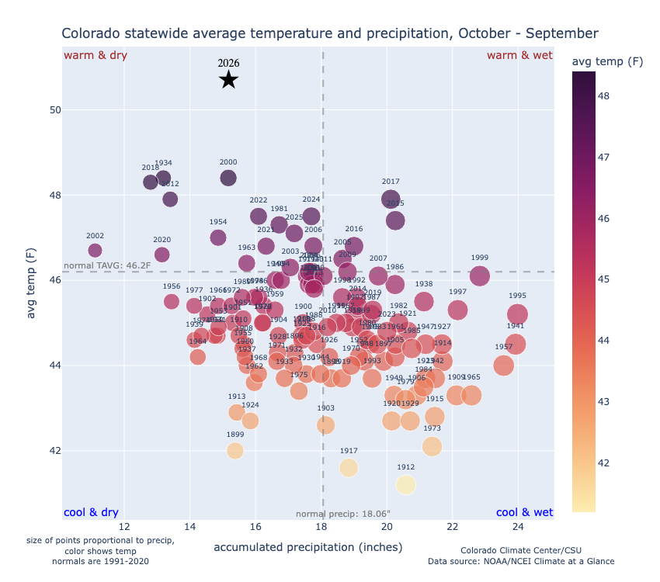
Water Year 2026 was one for the record books in Colorado. It was our warmest on record by a substantial margin, and it was also one of our driest. Our state also recorded its lowest snowpack, which strained water resources and contributed to widespread drought. This year’s climatic conditions had substantial impacts across numerous sectors: from agriculture and wildlife to human health and recreation.
In this summary, we’ll cover the records, trends, and impacts that were recorded across Colorado over the past 12 months.

Slide 5
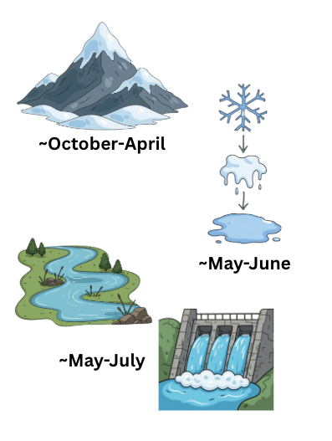
Follow the Water: What is a Water Year?
In the western US, a water year runs from Oct 1 to Sep 30.
Why track climate trends in this way?
  It follows the natural movement of water: from snowpack buildup in the winter, to spring melt off, to flows along our streams and into our reservoirs in the summer, and use of those water resources by crops over our growing season.

Slide 6
Outline
I. Temperature and Precipitation
II. Drought
III. Water: Snowpack, Streamflow & Reservoirs
IV. Notable Events
V. Contact

Slide 7
Temperature and Precipitation

Slide 8
Temperature and Precipitation Ranks for WY 2026
Month | T Rank (of 131 years) | Above, below, or near 20th century avg?
Oct | 11th warmest | much above
Nov | 3rd warmest | much above
Dec | 1st warmest | record warm
Jan | 17th warmest | above
Feb | 1st warmest | record warm
Mar | 1st warmest | record warm
Apr | 13th warmest | much above
May | 36th warmest | above
Jun | 10th warmest | much above
Jul | 2nd warmest | much above
Aug | 1st warmest | record warm
Sep | 2nd warmest | much above
Month | P Rank (of 131 years) | Above, below, or near 20th century avg?
Oct | 46th wettest | near normal
Nov | 42nd driest | below
Dec | 34th driest | below
Jan | 34th driest | below
Feb | 37th driest | below
Mar | 3rd driest | much below
Apr | 36th driest | below
May | 50th driest | near normal
Jun | 17th driest | below
Jul | 45th driest | near normal
Aug | 49th driest | near normal
Sep | 5th wettest | much above

Slide 9
Water Year 2026 was filled with temperature superlatives
According to statewide temperature (data since 1895), Colorado saw its:
  Warmest December
  Warmest February
  Warmest March
  Warmest August
  Warmest winter
  Warmest spring
  Warmest summer
  Warmest water year

Slide 10
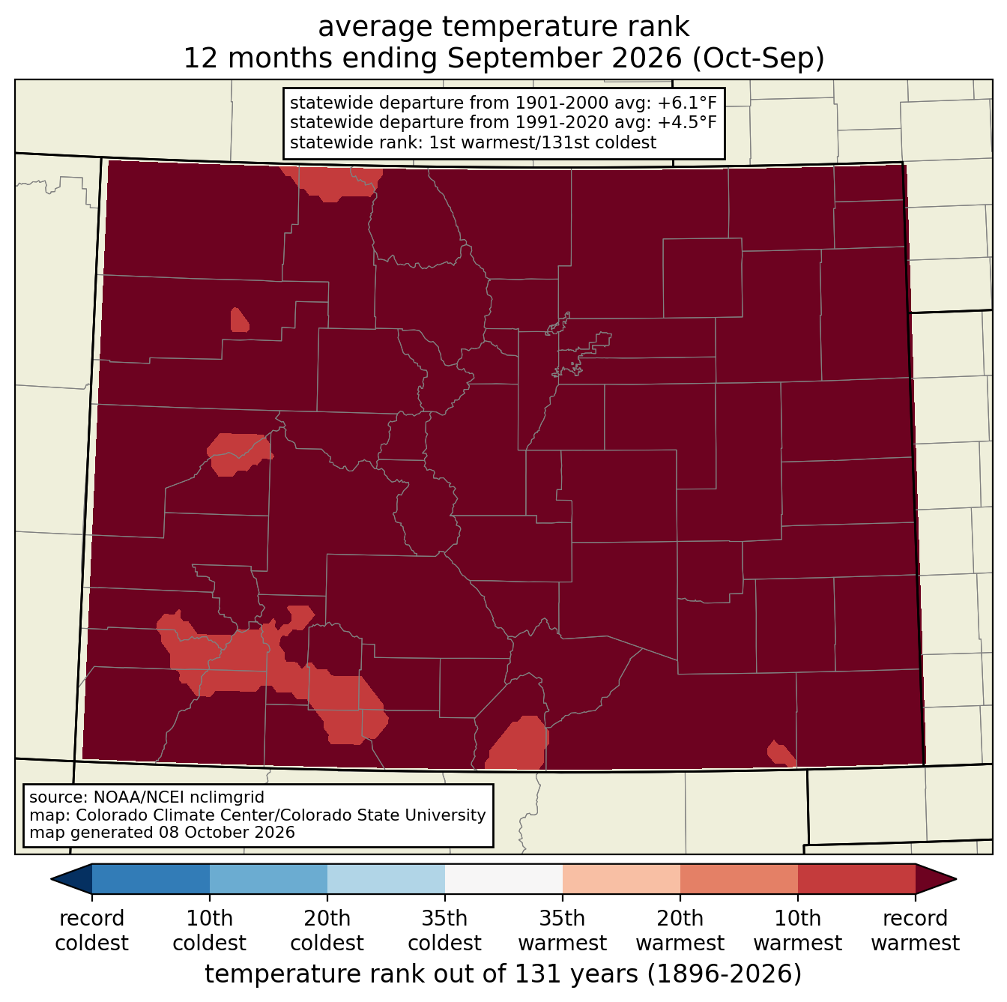
Colorado’s Warmest Water Year on Record
Out of 131 years of data, Water Year 2026 was easily Colorado’s warmest on record. The record-setting warmth was consistent throughout the state, with only a few areas *not* being record-warm

Slide 11
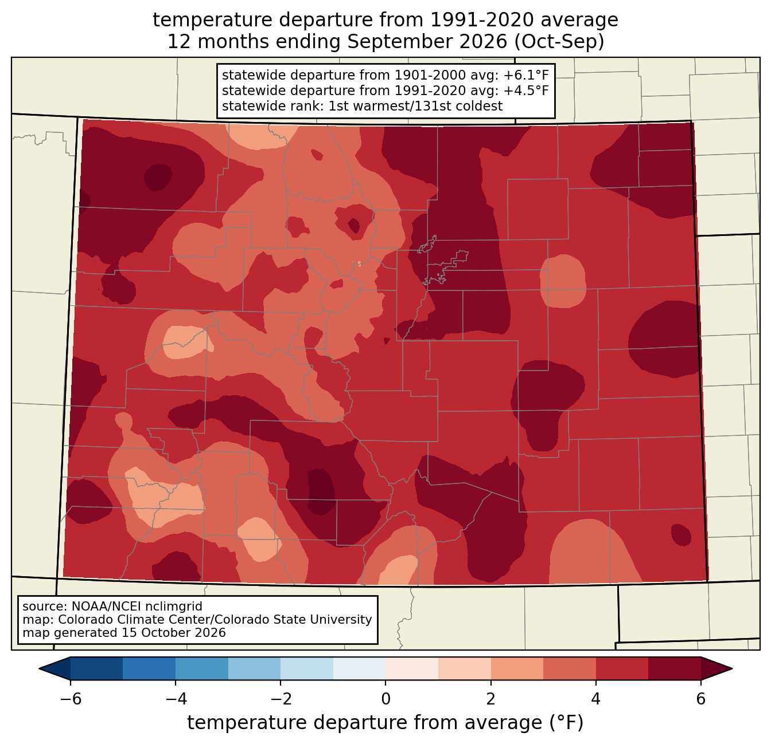
Colorado’s Warmest Water Year on Record (by a lot)
Statewide temperatures were 4.5°F above the 1991-2020 normal and over 2°F warmer than our 2nd-warmest water year on record (1934).

Slide 12
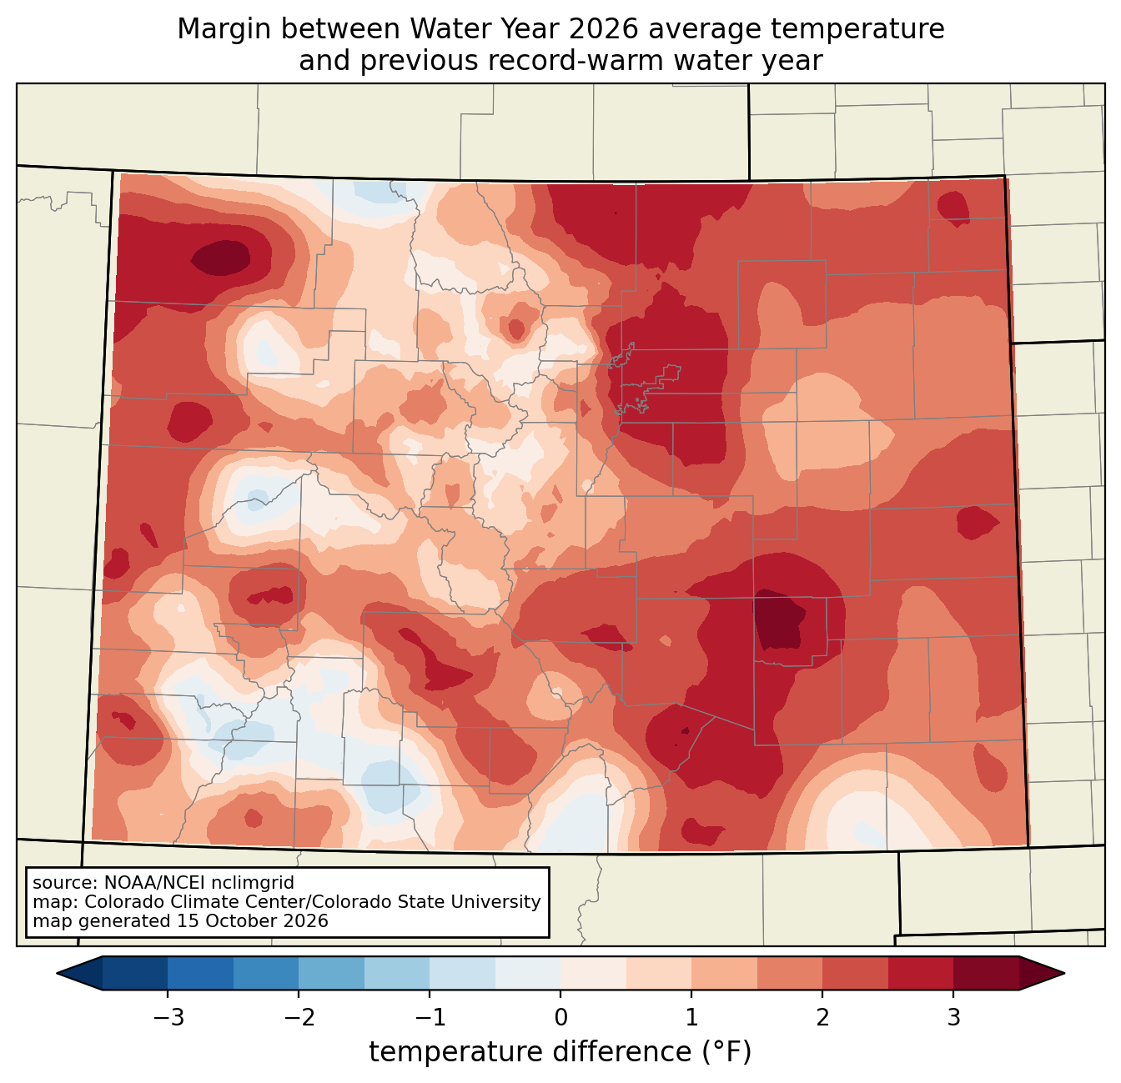
Colorado’s Warmest Water Year on Record (by a lot)
In some locations, Water Year 2026 average temperatures were 2.5-3°F+ warmer than the previous record-warm water year—a very impressive margin.

Slide 13
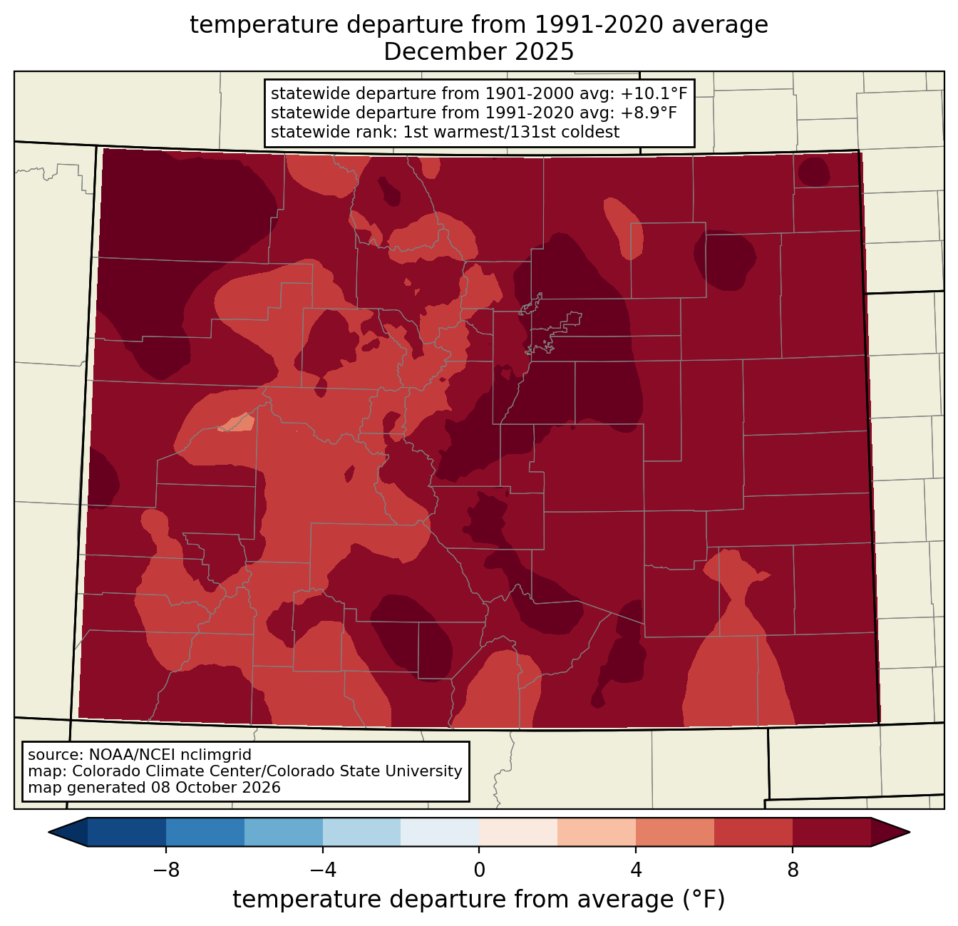
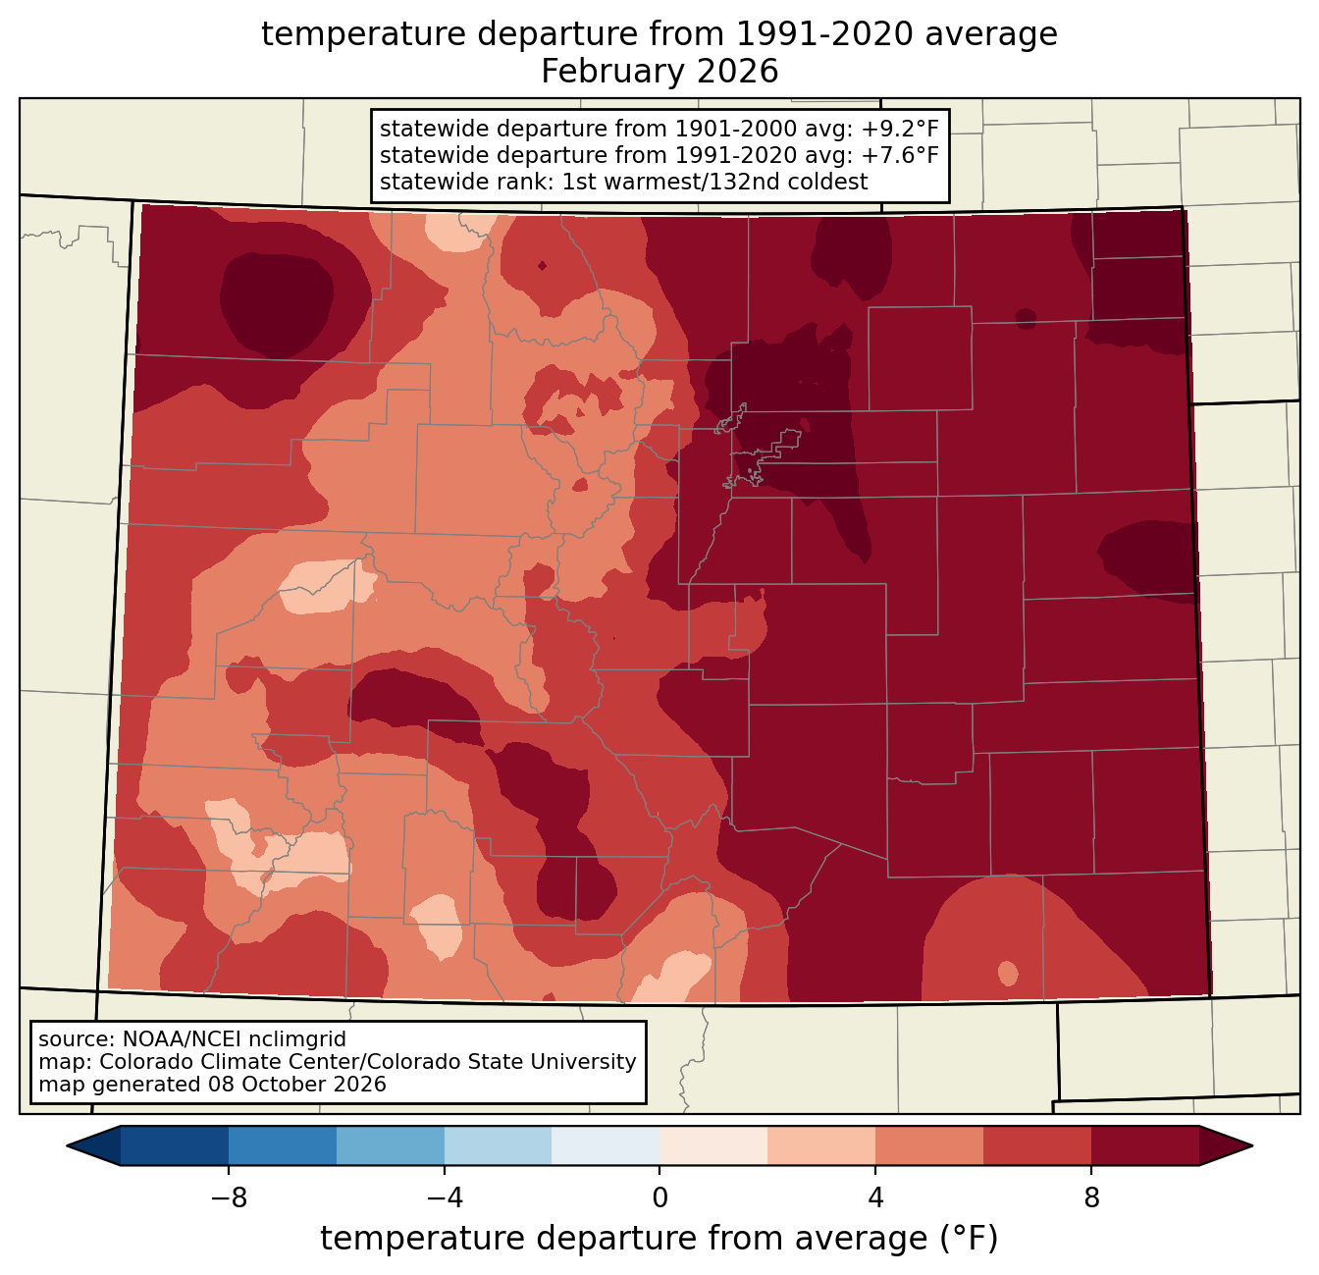
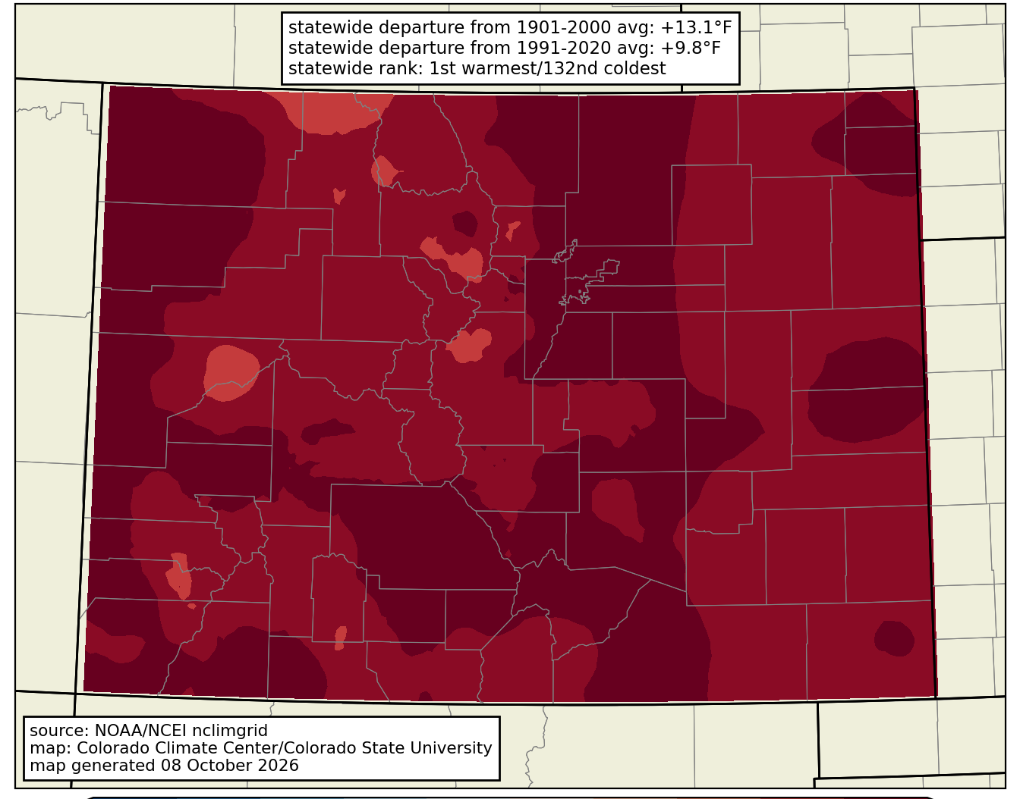
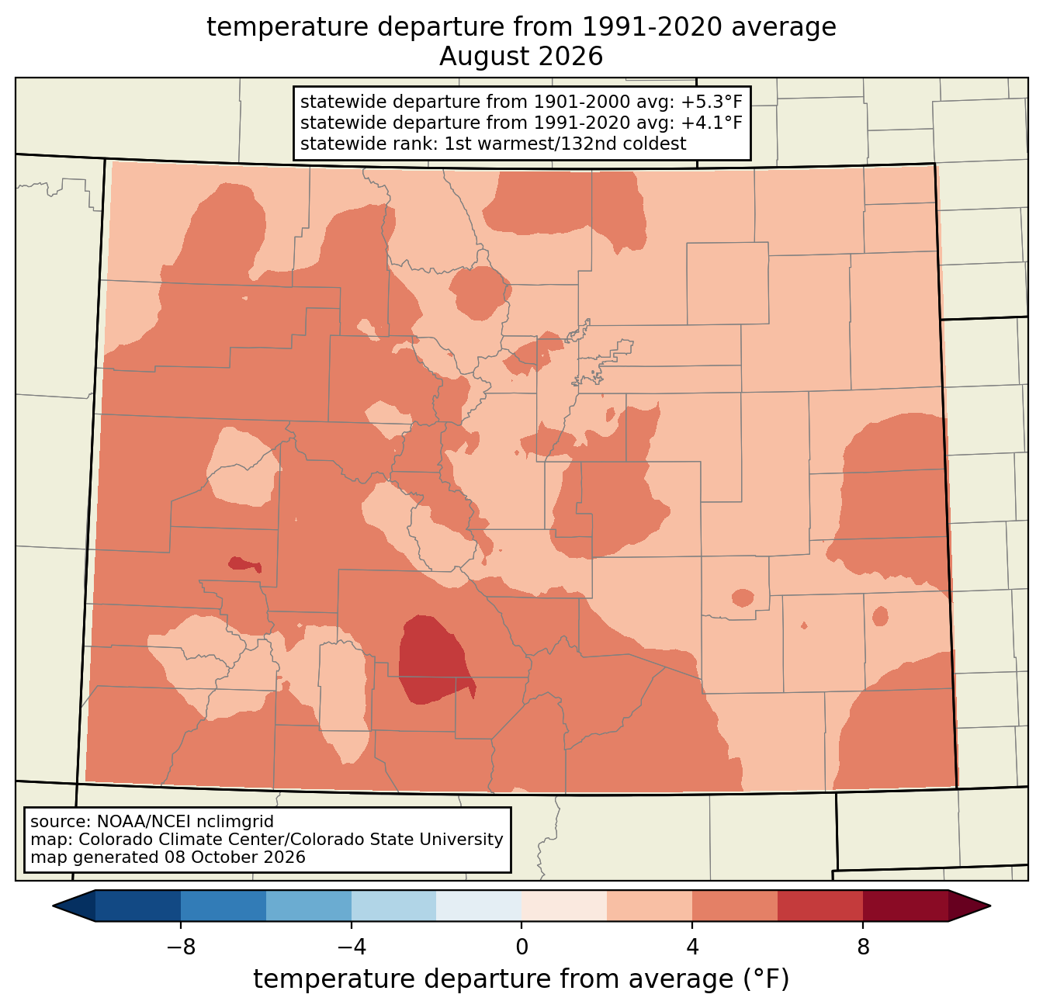
Four different months were record-warm
Dec: +8.9°F
Feb: +7.6°F
March was the most anomalous month relative to 1991-2020 average temperatures (more on this in the notable events section)
Mar: +9.8°F
Aug: +4.1°F

Slide 14
Statewide, for every below-average day in WY 2026, there were ~3.6 above-average days.
Statewide, we saw the following during WY 2026:
286 days were above average (only 79 days were below average).
Nearly half the year (165 days) was at least 5°F above average (only 29 days were at least 5°F below average).
75 days (~2.5 months) were at least 10°F above average (only 13 days were at least 10°F below average).

Slide 15
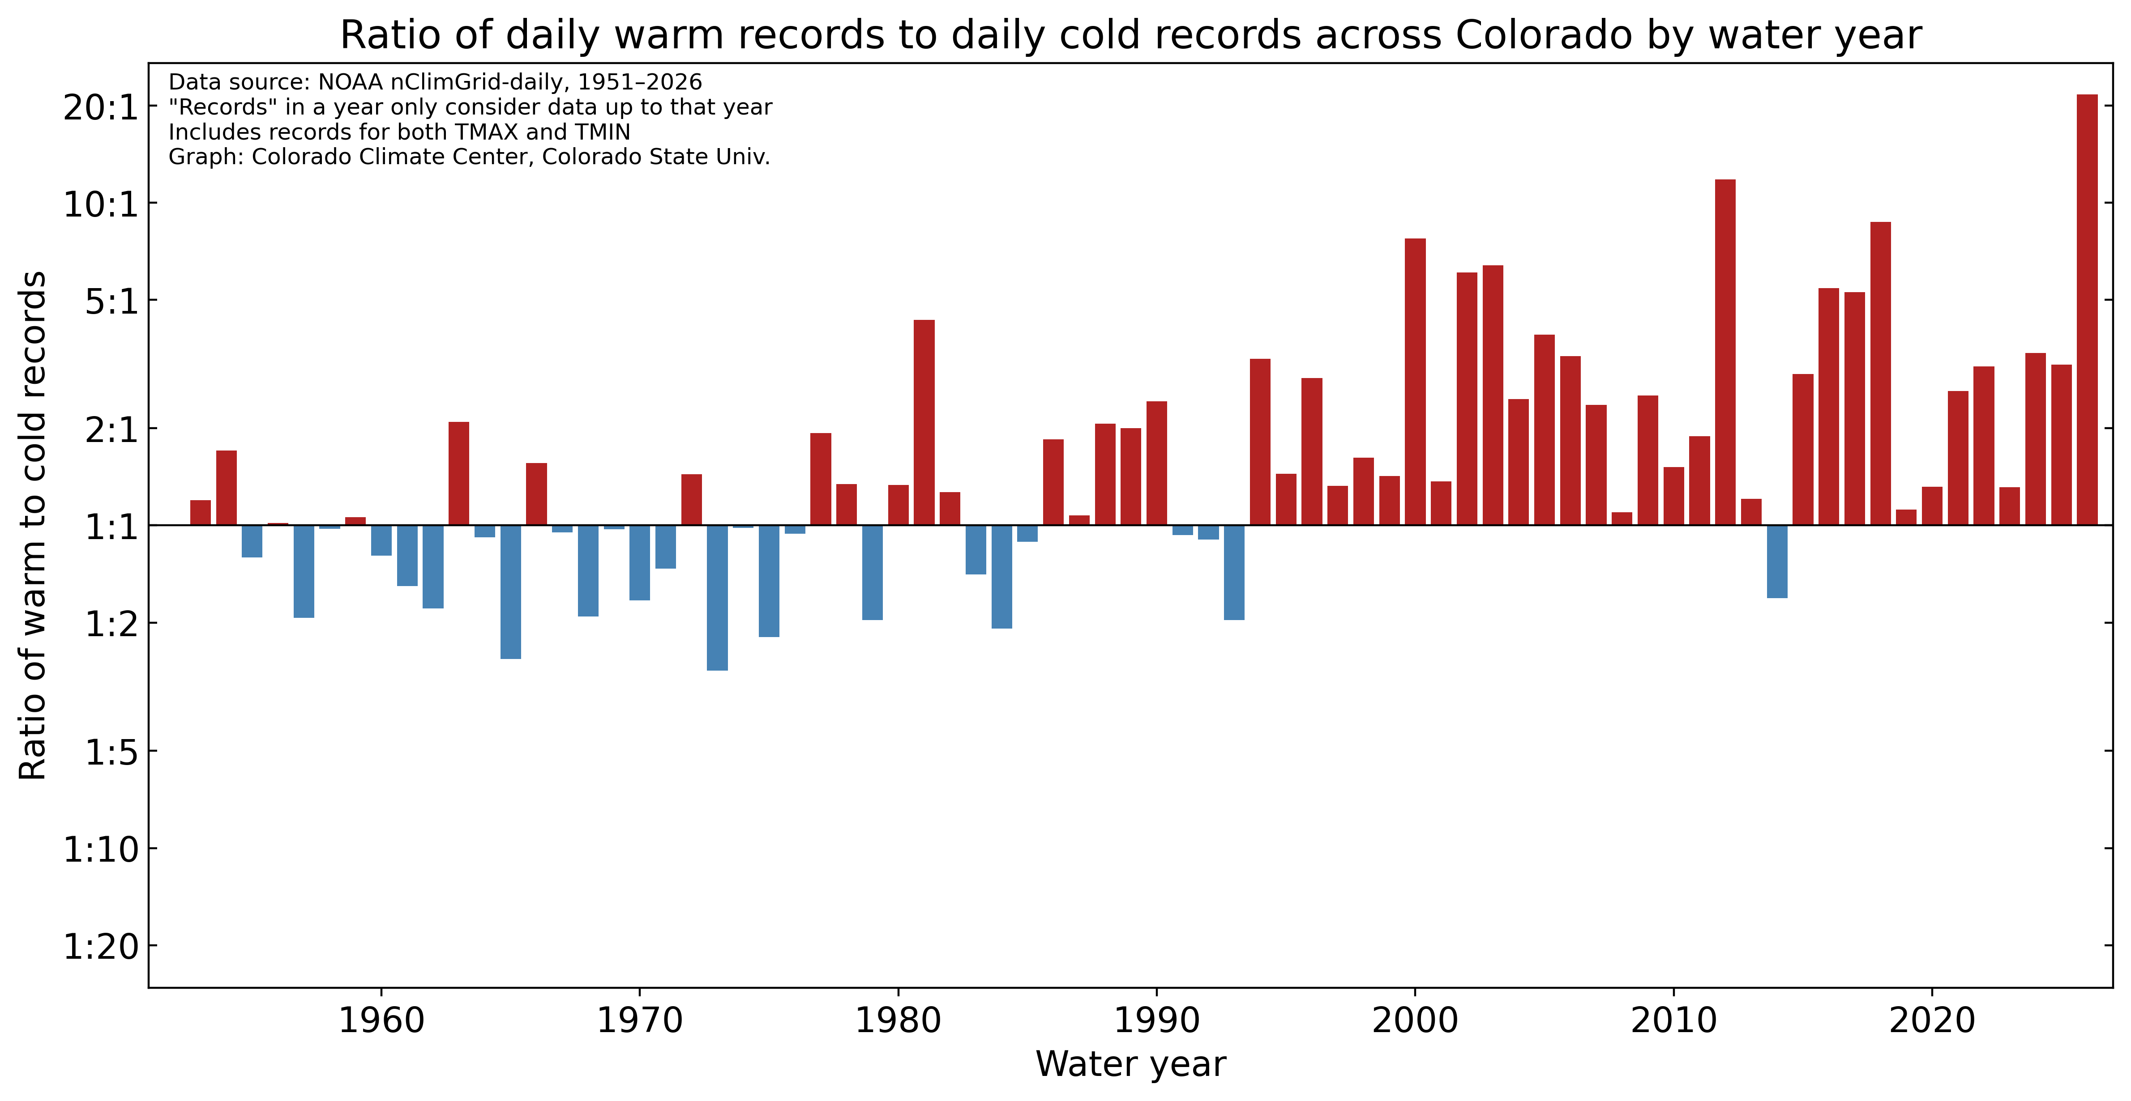
In gridded temperature data, daily warm records outpaced cold records by more than 21 to 1 in Water Year 2026.
There were 21.7 times more daily warm records (both record high temperatures and record warm lows) than cold records (record lows and cool highs) in WY2026, the most unbalanced this ratio has ever been.

Slide 16
Daily Station Records
Across individual station records, warm records outweighed cold records ~14:1. For comparison, the ratio last year was ~2:1.
 | Max (Tmax) |  | Min (Tmax) |  | Max (Tmin) |  | Min (Tmin) |  | Precipitation |  | Snowfall
 | Tied | Broken | Tied | Broken | Tied | Broken | Tied | Broken | Tied | Broken | Tied | Broken
Oct | 25 | 30 | 0 | 1 | 66 | 402 | 0 | 1 | 20 | 120 | 0 | 0
Nov | 67 | 196 | 1 | 4 | 79 | 249 | 1 | 0 | 8 | 38 | 0 | 4
Dec | 137 | 989 | 3 | 9 | 106 | 1079 | 0 | 4 | 19 | 66 | 2 | 24
Jan | 48 | 116 | 18 | 177 | 65 | 284 | 21 | 166 | 13 | 42 | 9 | 33
Feb | 80 | 233 | 3 | 79 | 60 | 407 | 4 | 20 | 31 | 56 | 4 | 10
Mar | 153 | 1645 | 4 | 22 | 146 | 1395 | 5 | 15 | 6 | 18 | 2 | 12
Apr | 35 | 57 | 9 | 35 | 51 | 205 | 4 | 9 | 24 | 79 | 1 | 7
May | 64 | 190 | 17 | 102 | 52 | 178 | 14 | 44 | 8 | 58 | 4 | 33
Jun | 34 | 44 | 2 | 6 | 38 | 133 | 13 | 50 | 16 | 34 | 0 | 0
Jul | 153 | 341 | 0 | 4 | 216 | 627 | 3 | 4 | 22 | 91 | 0 | 0
Aug | 253 | 818 | 6 | 32 | 183 | 580 | 7 | 8 | 22 | 75 | 0 | 0
Sep | 33 | 44 | 8 | 22 | 162 | 612 | 0 | 0 | 36 | 144 | 0 | 0
Total | 1082 | 4703 | 71 | 493 | 1224 | 6151 | 72 | 321 | 225 | 821 | 22 | 123

Slide 17
Record-breaking statewide warmth
Hottest days
(average of high and low temperature statewide)
Averaged across the state, and considering both daily high and low temperatures, July 27, 2026 was the hottest single day on record for Colorado, breaking the previous record from July 21, 2025. Three of the 10 hottest days on record happened this July.
We also recorded the warmest October day (October 4), the two warmest December days (December 25 and 23), the nine warmest March days (the 26th, 22nd, 21st, 25th, 20th, 30th, 31st, 19th, and 27th), and the three warmest August days (the 3rd, 9th, and 10th).
Rank | Statewide average temperature (°F) | Start date
1 | 78.88 | July 27, 2026
2 | 77.23 | July 21, 2005
3 | 77.13 | July 26, 2026
4 | 76.92 | June 26, 2012
5 | 76.92 | June 27, 2012
6 | 76.67 | July 21, 2026
7 | 76.54 | July 22, 2005
8 | 76.26 | June 25, 2012
9 | 76.24 | July 23, 2005
10 | 76.13 | July 26, 2003
Data from NOAA nClimGrid-daily, 1951-present. “Days” in this dataset are defined from 6am-6am, so August 3 is the average of the high temperature on August 2 and the low on the morning of the 3rd

Slide 18
Heat waves and cold snaps
Top statewide 4-day heat waves since 1951
Using the heat wave definition from the Climate Change in Colorado report, Colorado experienced seven statewide heat waves in WY2026, the most in any year (data back to 1951). The previous most heat waves in one year was five, in 2002, 2003, and 2022.
The heat wave from July 25-28 was the hottest on record statewide, and three of the top 10 heat waves happened this year. And this doesn’t even include the record-breaking warmth in December and March, because ”heat waves” as defined here are based on the very highest temperatures rather than how unusual they were for the time of year.
Although there was one period of cold weather in late January, it was not quite persistent enough to qualify as a statewide ”cold wave”.
Rank | Statewide average temperature (°F) | Start date | End date
1 | 76.72 | July 25, 2026 | July 28, 2026
2 | 76.51 | June 24, 2012 | June 27, 2012
3 | 76.13 | July 20, 2005 | July 23, 2005
4 | 75.36 | July 16, 2003 | July 19, 2003
5 | 75.06 | June 29, 1990 | July 2, 1990
6 | 74.87 | July 24, 2003 | July 27, 2003
7 | 74.84 | August 9, 2026 | August 12, 2026
8 | 74.6 | July 20, 2026 | July 23, 2026
9 | 74.58 | July 5, 2001 | July 8, 2001
10 | 74.57 | June 15, 2021 | June 18, 2021
Data from NOAA nClimGrid-daily, 1951-present. “Days” in this dataset are defined from 6am-6am, so August 3 is the average of the high temperature on August 2 and the low on the morning of the 3rd

Slide 19
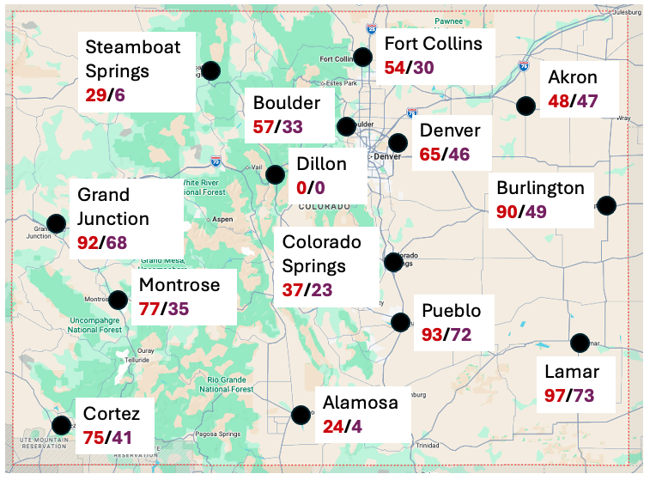
90 degree days were frequent, and some stations recorded their most on record.
Location | 2026 | 1991-2020 Average
Akron | 48 | 47
Alamosa | 24 | 4
Boulder | 57 | 33
Burlington | 90 | 49
Colorado Springs | 37 | 23
Cortez | 75 | 41
Denver | 65 | 46
Dillon | 0 | 0
Fort Collins | 54 | 30
Grand Junction | 92 | 68
Lamar | 97 | 73
Montrose | 77 | 35
Pueblo | 93 | 72
Steamboat Springs | 29 | 6
Number of 90 Degree Days in Water Year 2026
2026/1991-2020 Average
Broken or tied records in red

Slide 20
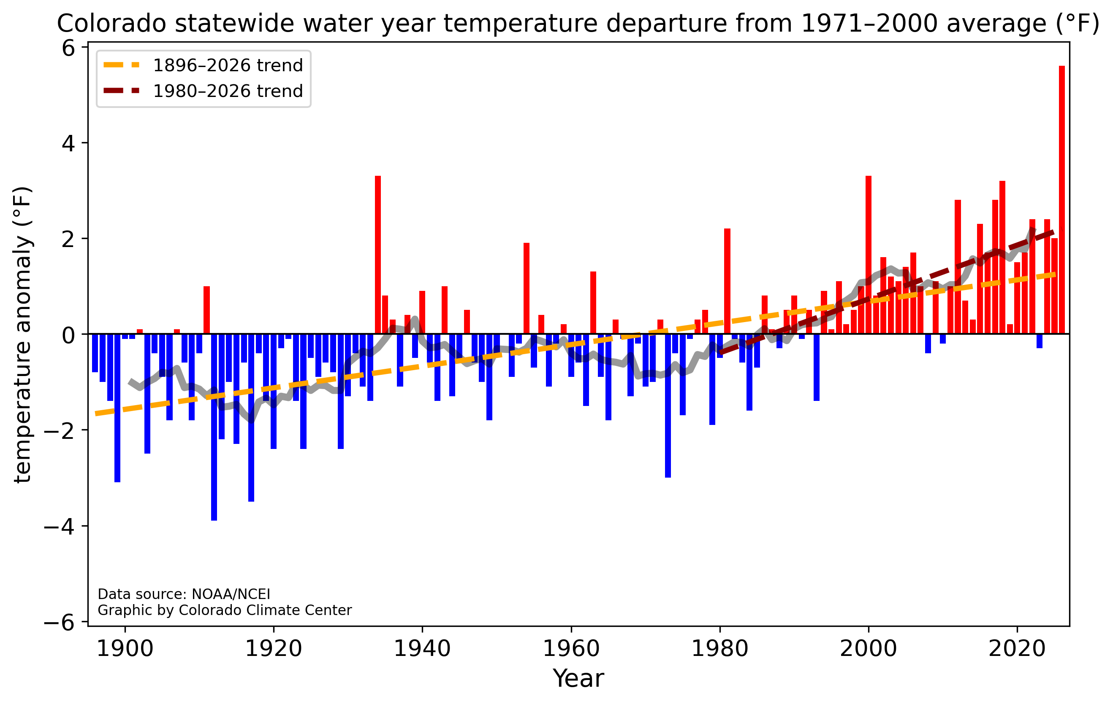
Temperatures have been steadily increasing in Colorado, but this year stood out even in our changing climate.
The difference between the 1st and 2nd place years (2026 and 1934) is equal to the difference between the 2nd and 24th place years.

Slide 21
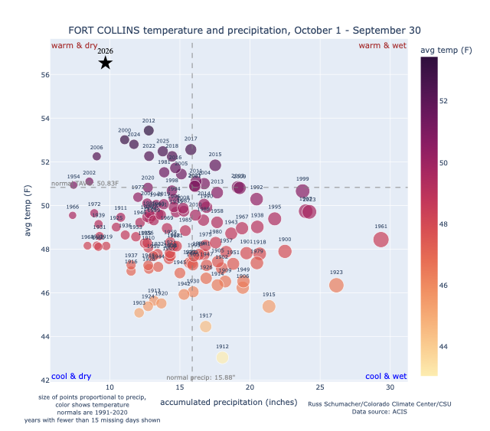
Warm & dry
Warm & wet
Water Year 2026, Fort Collins
Warmest water year by a large margin for Fort Collins
11th driest water year; driest since 2006
Cool & dry
Cool & wet

Slide 22
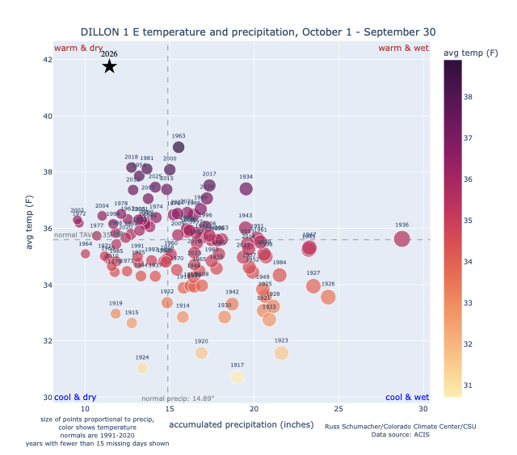
Warm & dry
Warm & wet
Water Year 2026, Dillon
Warmest water year by a large margin for Dillon
8th driest water year; driest since 2004
Cool & dry
Cool & wet

Slide 23
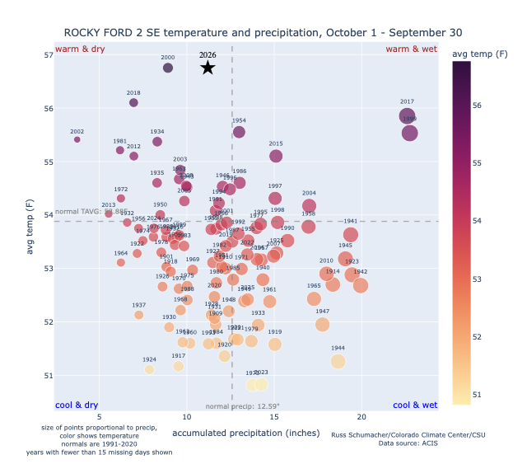
Warm & dry
Warm & wet
Water Year 2026, Rocky Ford
Tied with 2000 for warmest water year at Rocky Ford
Precipitation slightly below average
Cool & dry
Cool & wet

Slide 24
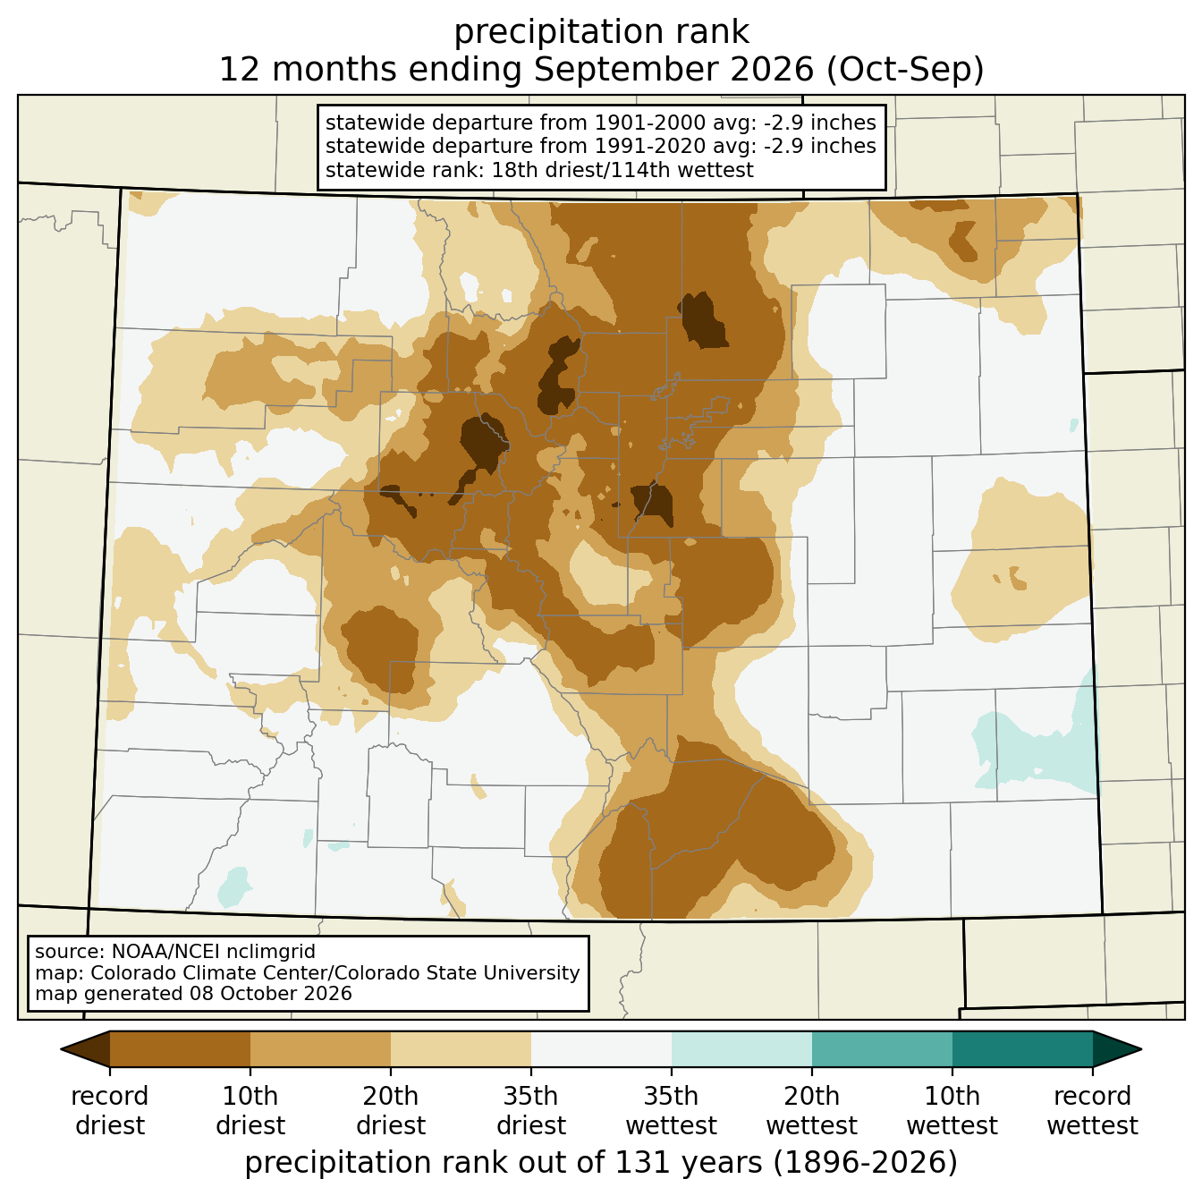
Statewide, Colorado saw its 18th-driest Water Year on record
However, there were notable disparities among different locations in the state. For the North-central Rockies, Front Range, Urban Corridor, and parts of the Eastern Plains, it was top-10 dry.

Slide 25
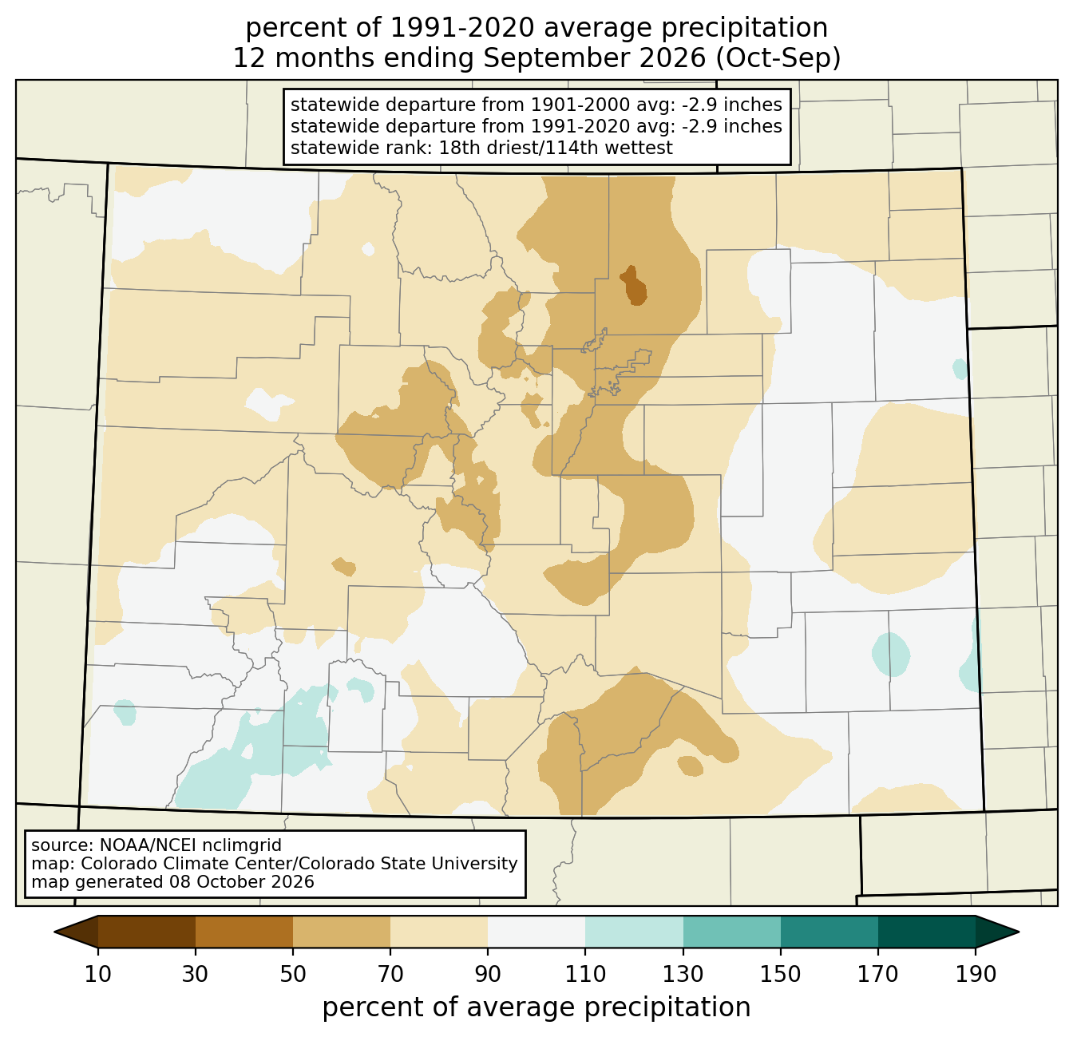
Precipitation across most of the state was below average
Precipitation deficits were felt throughout the state over the past 12 months, though a few wet periods balanced out drier stretches in some areas, especially for the San Juans and parts of the Eastern Plains.

Slide 26
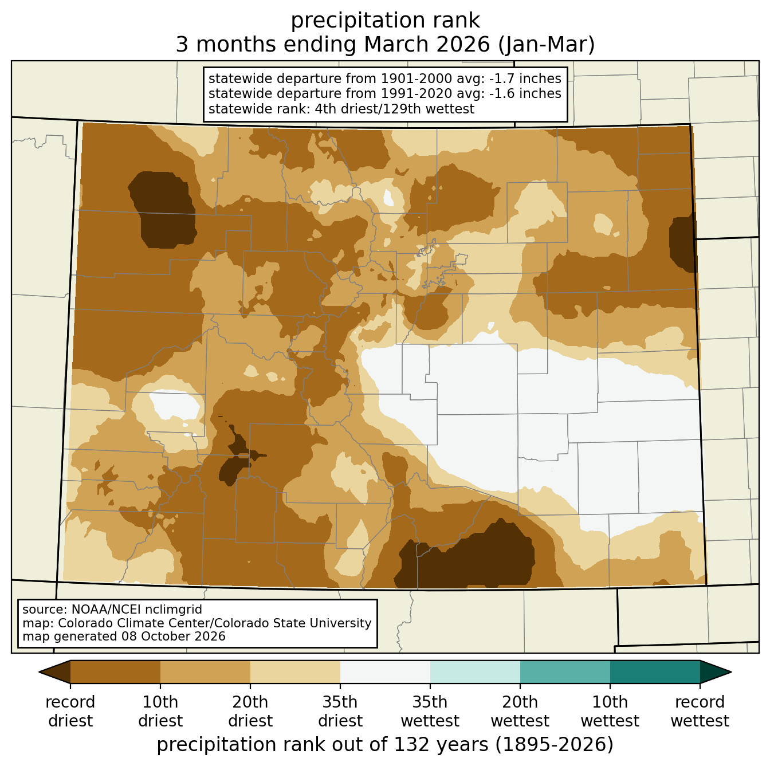
The peak snow season months were dry
January-March was the 4th-driest on record statewide. It was at least top-10 dry across most of the mountain areas, where snowpack buildup occurs.

Slide 27
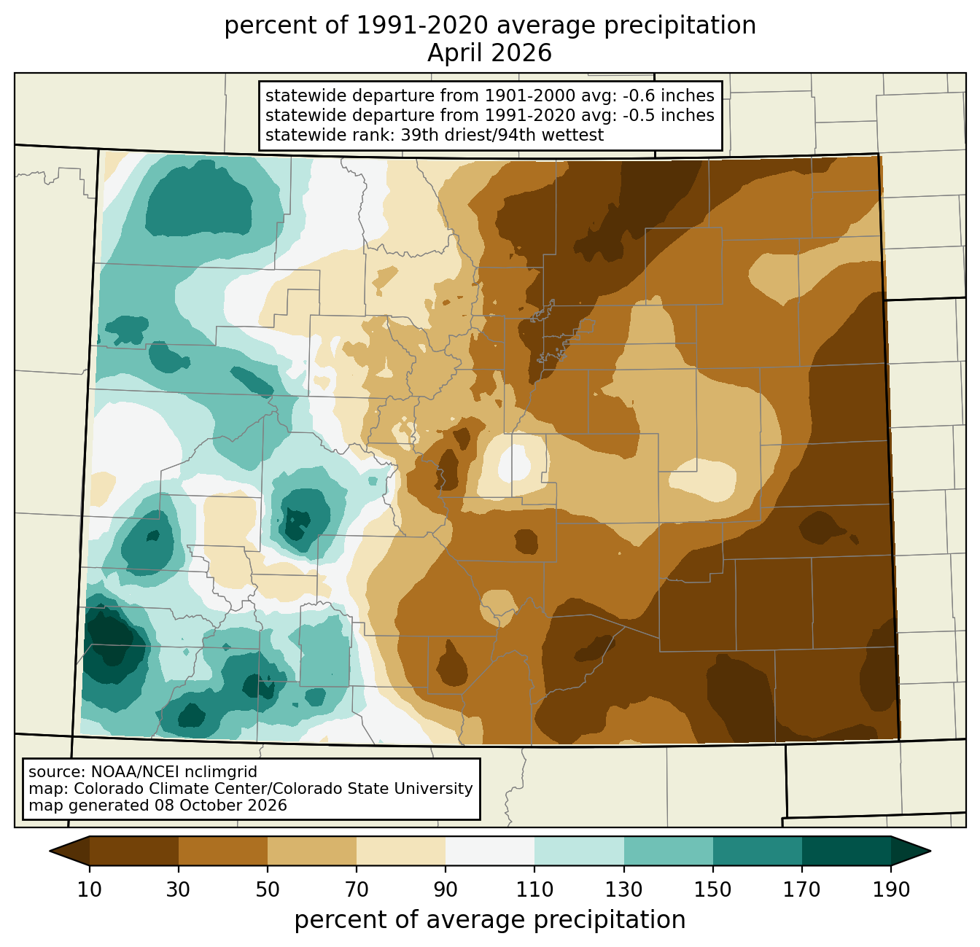
Agricultural areas were dry at a key moment in the season
April precipitation is crucial for both crops and rangelands across the eastern Plains, and it was way below average this year. Coupled with much above-average temperature, drought quickly developed and agricultural lands suffered severe impacts.

Slide 28
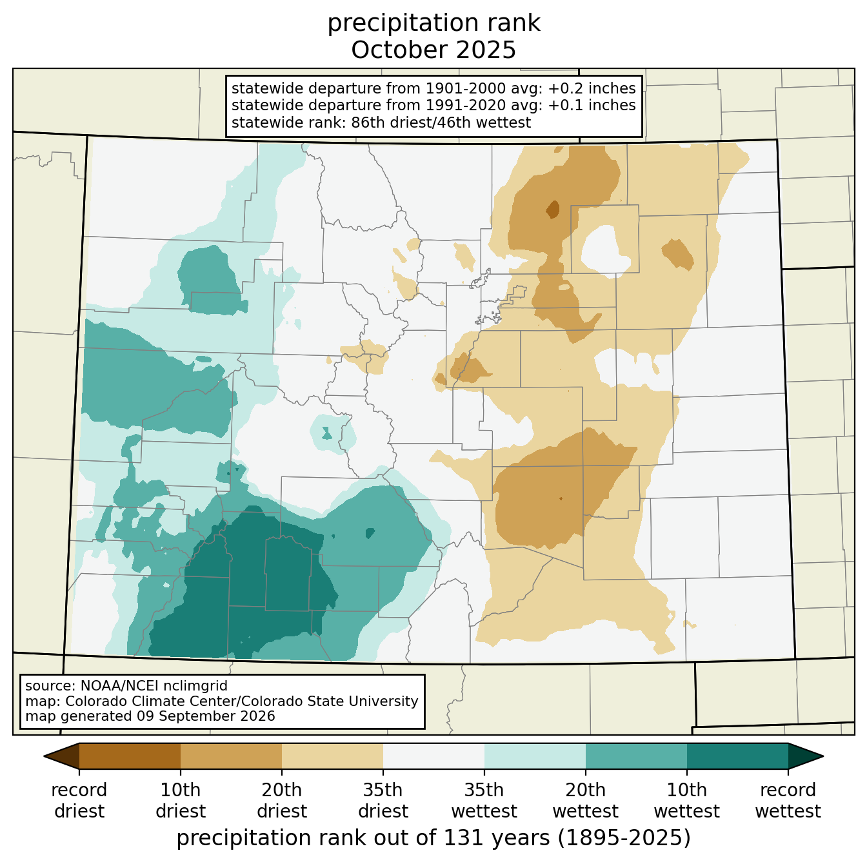
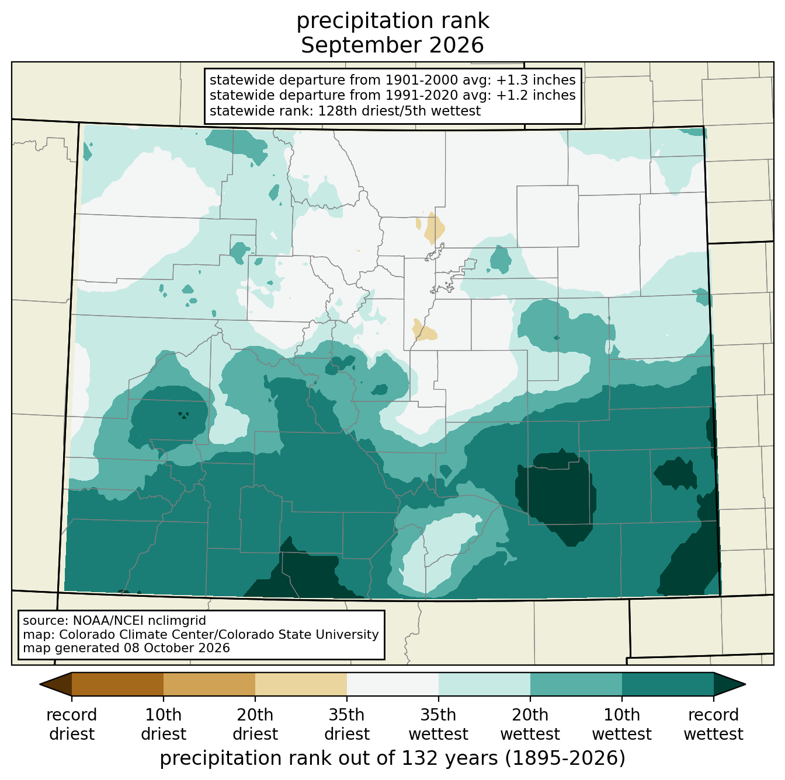
October 2025 and September 2026 were two of the wettest months in the WY. In October 2025, precipitation fell in the form of heavy rain causing flooding in the San Juans. And while September precipitation can be helpful for readying soils for winter crops (e.g., winter wheat), it’s less helpful for crops that get harvested in the fall.
Had it not been for the wet September, WY2026 would have ranked much drier: the first 11 months of the Water Year (October-August) was the 6th driest on record.
And November-August ranked as the 3rd driest for that period.

Slide 29
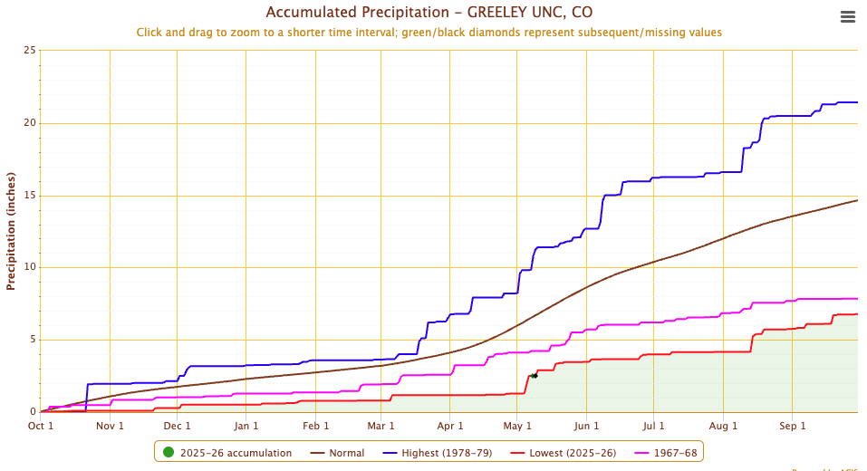
In Greeley, only 6.78” of precipitation fell during WY 2026, less than half of the normal of 14.62”.
It was also more than an inch less than the previous record (7.84” in WY 1968).

Slide 30
Drought

Slide 31
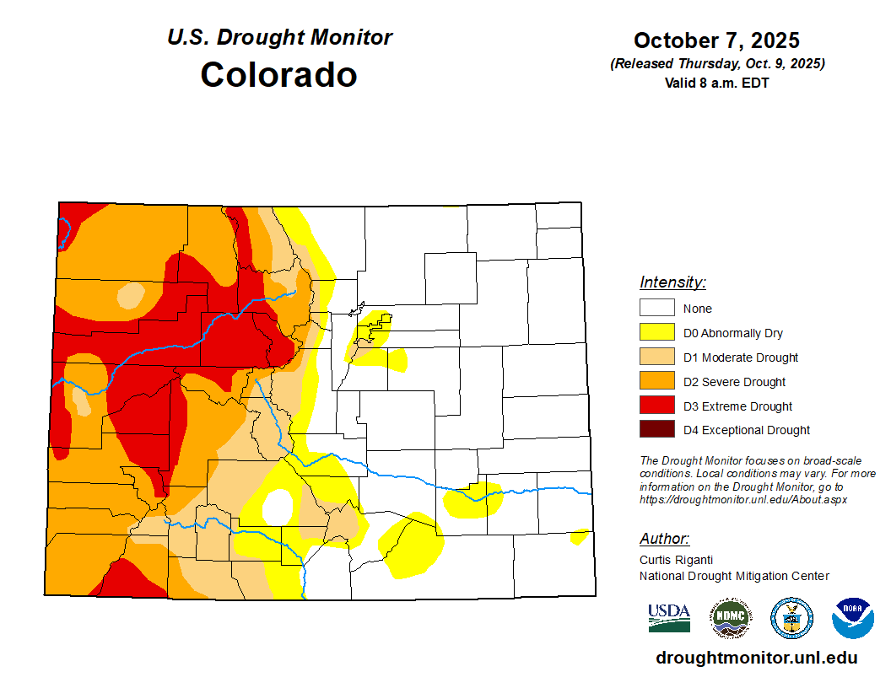
US Drought Monitor for WY 2026
Most of the water year featured widespread drought across Colorado.
Drought has been relentless in some locations. For instance, parts of Garfield and Pitkin County have been in D3 or D4 for 15 straight months and counting

Slide 32
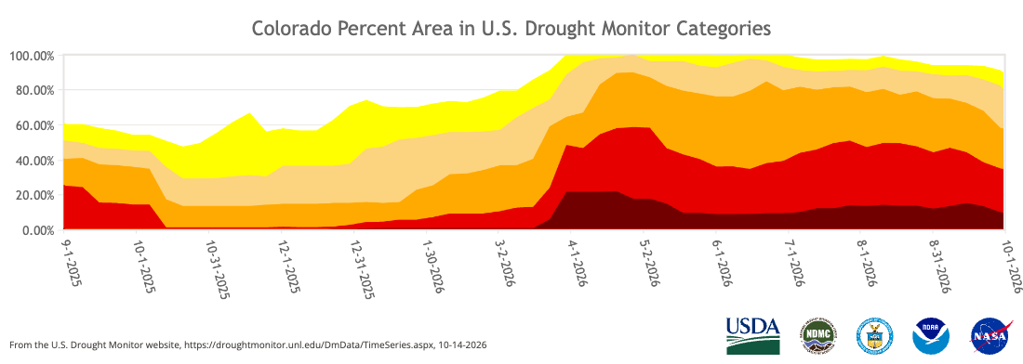
WY2026 USDM evolution: we ended the WY worse off than when we started.
Key moments in the 2026 USDM:
12/23: D4 drought returns to Colorado
1/20: Over 50% of the state goes into D1+ conditions
4/28: 100% of the state goes into D1+ conditions
Percent of Colorado in various drought categories throughout Water Year 2026.

Slide 33
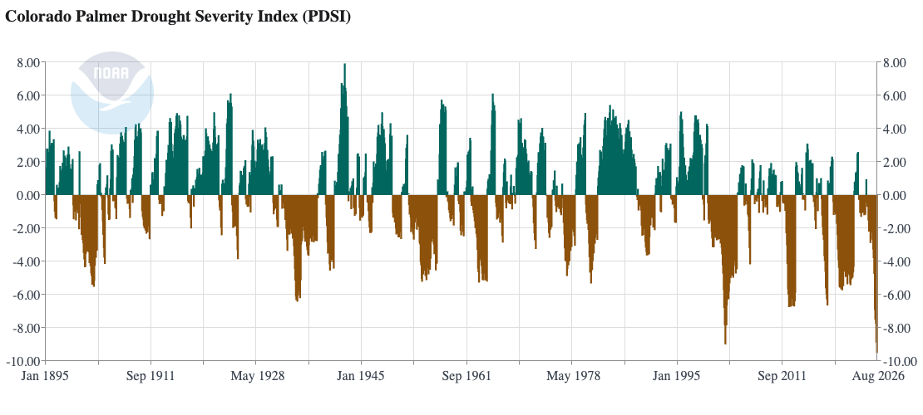
Statewide Palmer Drought Severity Index was the lowest on record at the end of August, slightly worse than 2002.

Slide 34
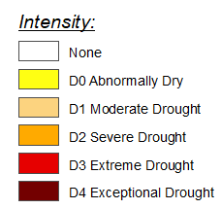
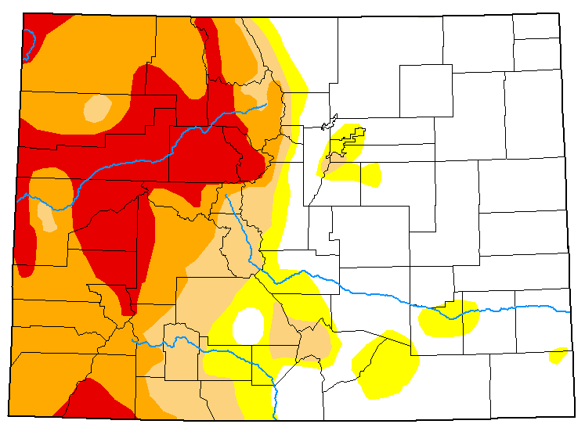
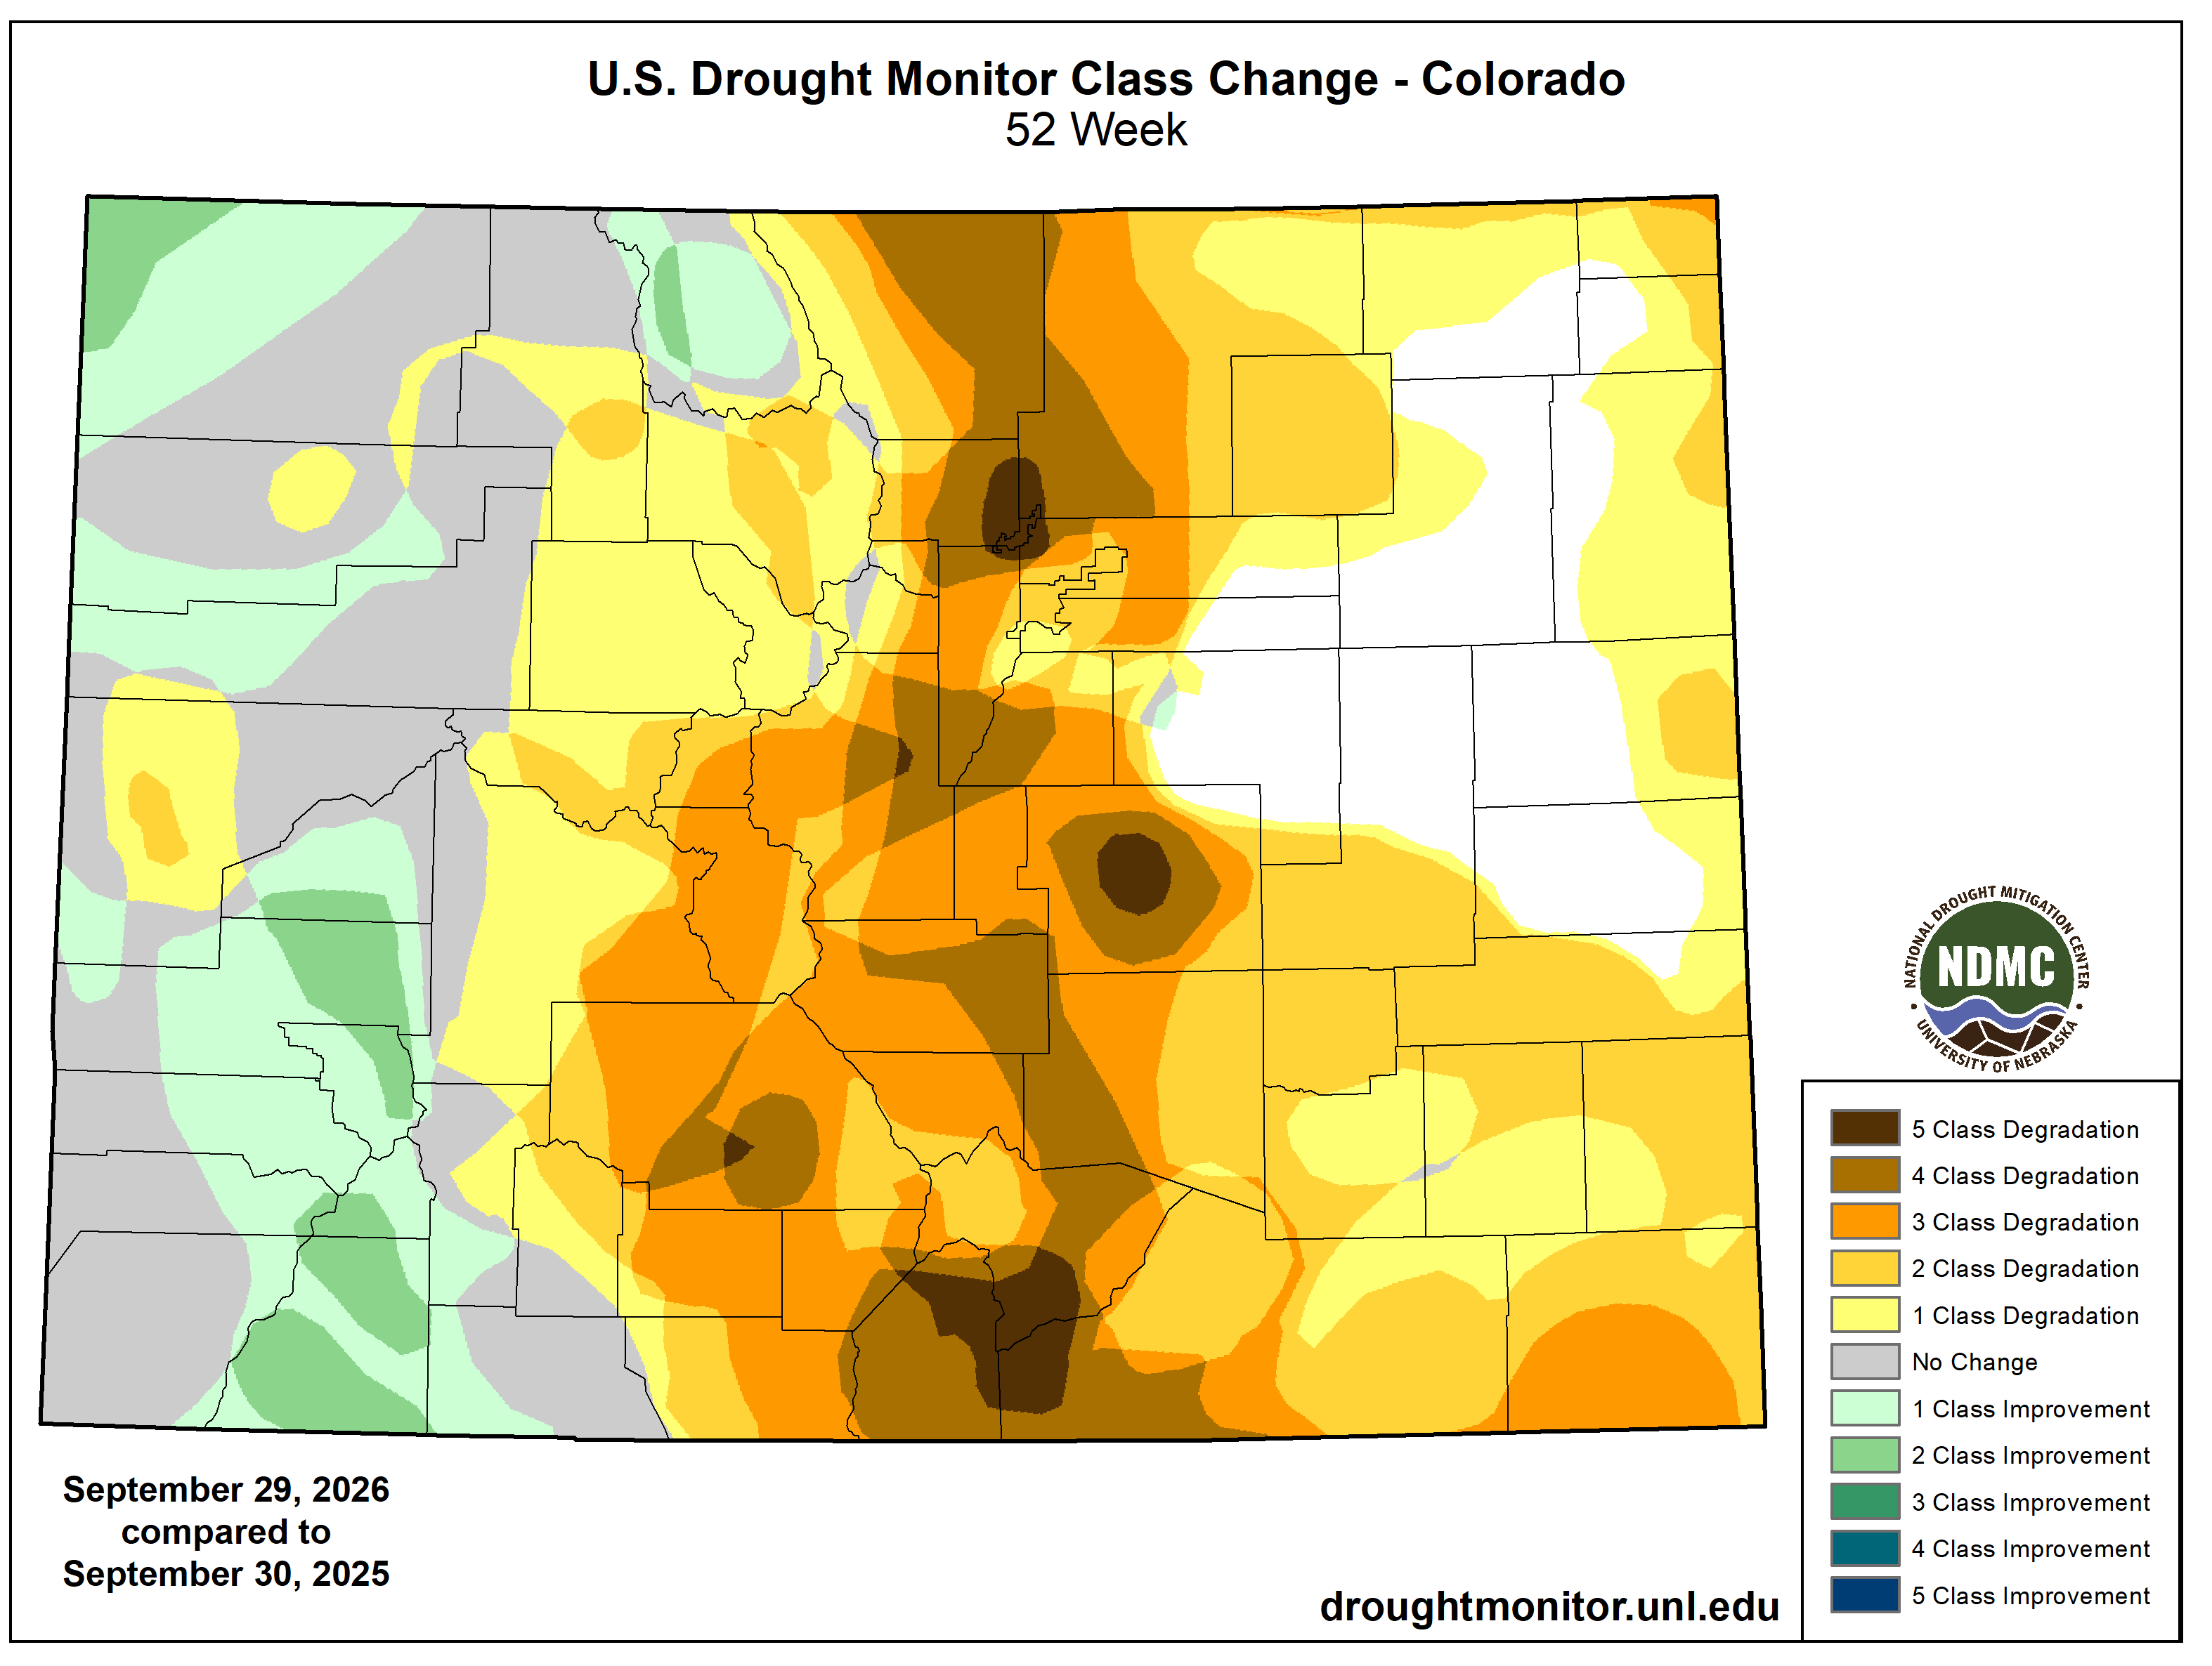
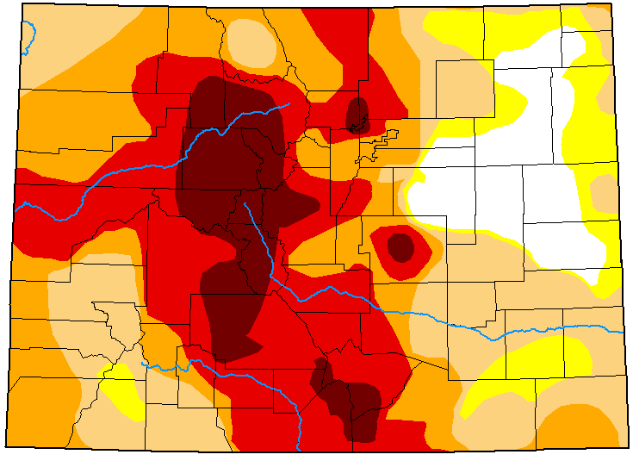
USDM Maps: beginning vs. end of WY 2026
Sep. 30, 2025
Sep. 29, 2026

Slide 35
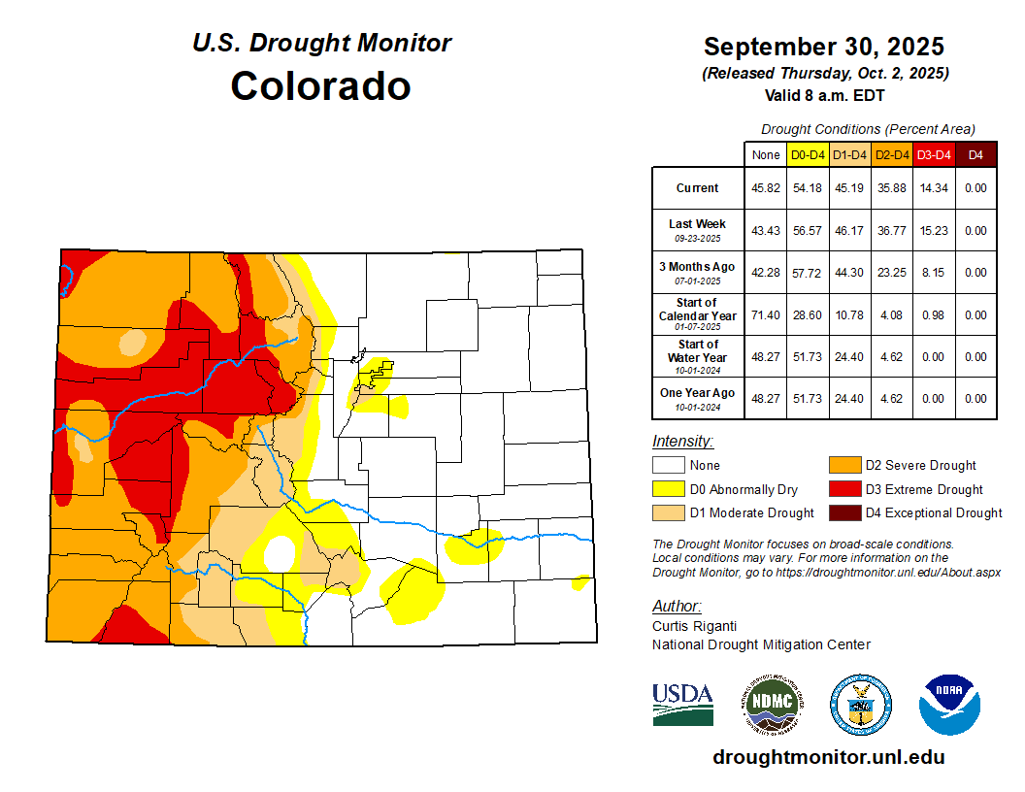
Start of WY 2026: A divide between west and east
At the start of WY2026, there was a prominent east-west divide in drought conditions: widespread D2-D3 conditions were in place across western Colorado, while most of the eastern half of the state was drought-free.
% area in moderate (D1) drought or worse: 45%
% area in extreme (D3) drought or worse: 14%

Slide 36
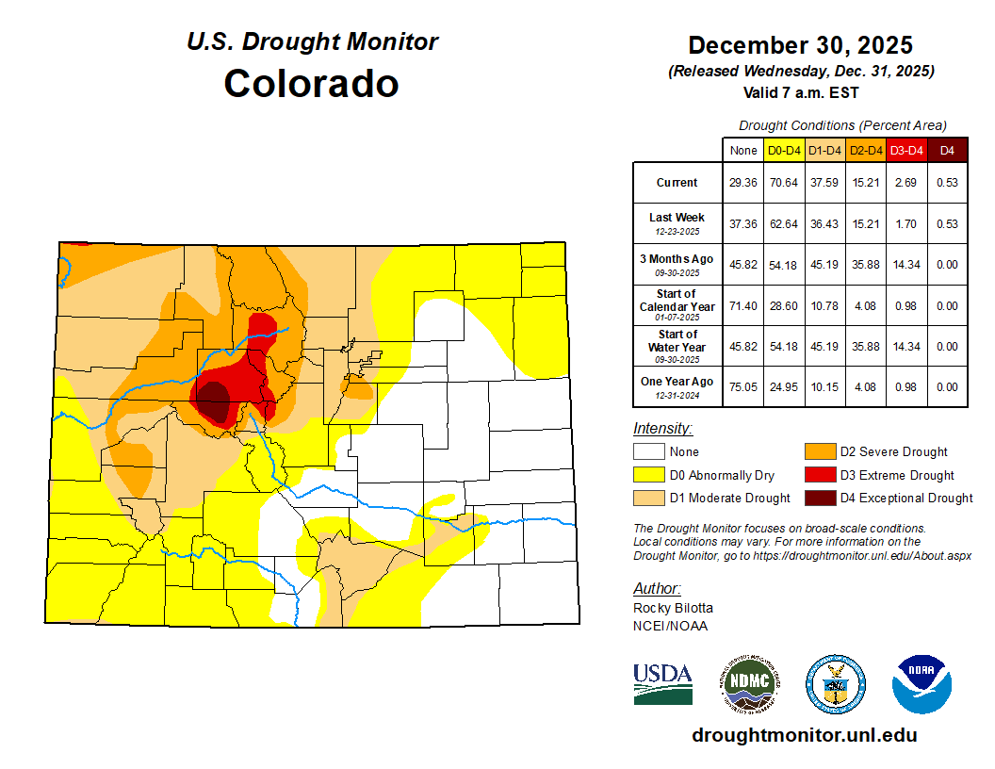
Early winter warmth worsens conditions in the High Country
After a record warm December, a near record-warm November, and below-average precipitation, large snow deficits were already starting to appear across the Central Mountains areas.
% area in moderate (D1) drought or worse: 38%
% area in extreme (D3) drought or worse: 3%

Slide 37
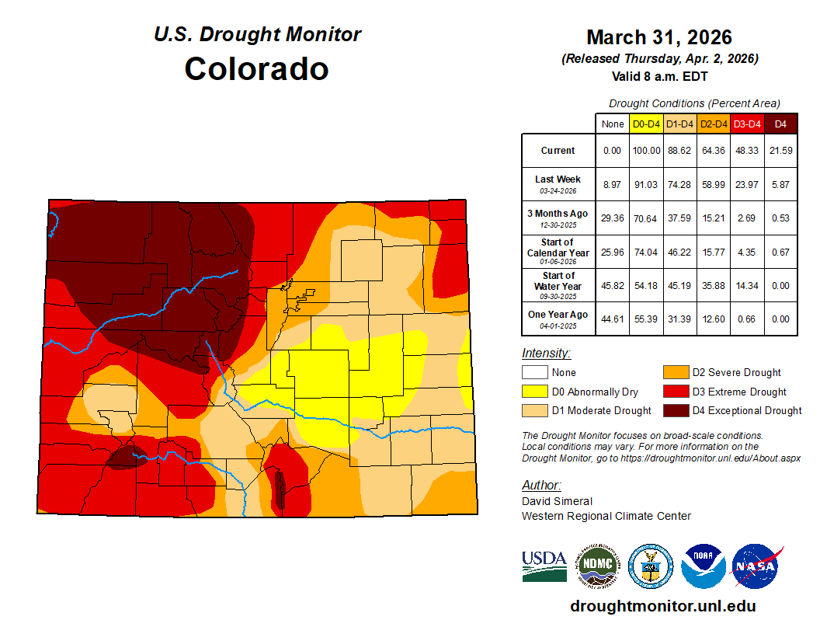
Drought worsens throughout the spring
Snowpack deficits continued to build throughout the spring, leading to worsening and expanding drought in the mountain areas. Below-average precipitation across the lower elevations also allowed drought to creep in across the Plains.
The record-setting March heat prompted conditions to deteriorate more quickly. By the end of that month, about half of the state was experiencing extreme or exceptional drought.
% area in moderate (D1) drought or worse: 89%
% area in extreme (D3) drought or worse: 48%

Slide 38
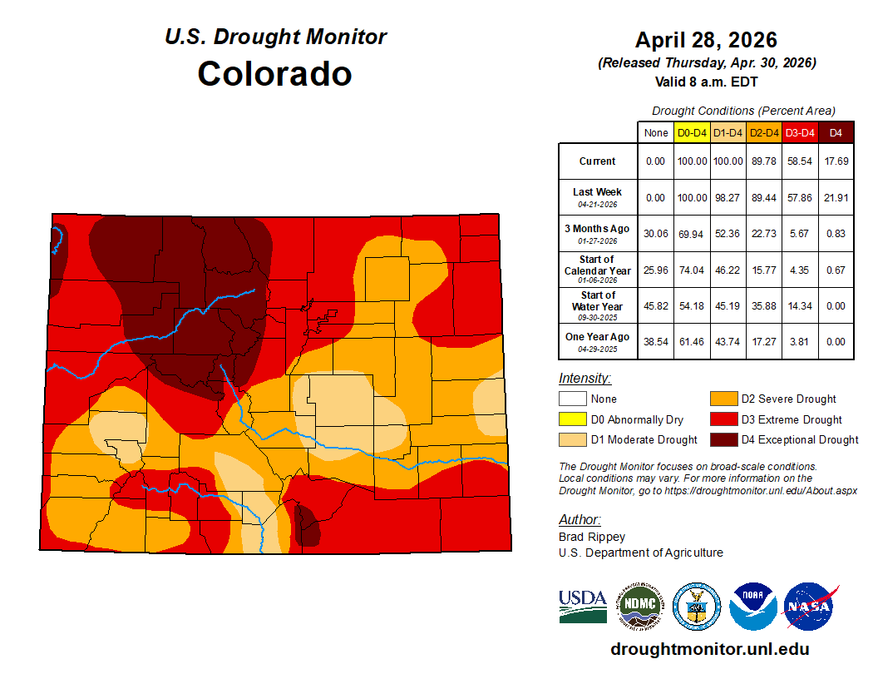
April flash drought
April precipitation was well below-normal across the Eastern Plains, leading to flash drought conditions there (more on this in the “notable events” section). At this point in the WY, 100% of the state was experiencing drought.
% area in moderate (D1) drought or worse: 100%
% area in extreme (D3) drought or worse: 59%

Slide 39
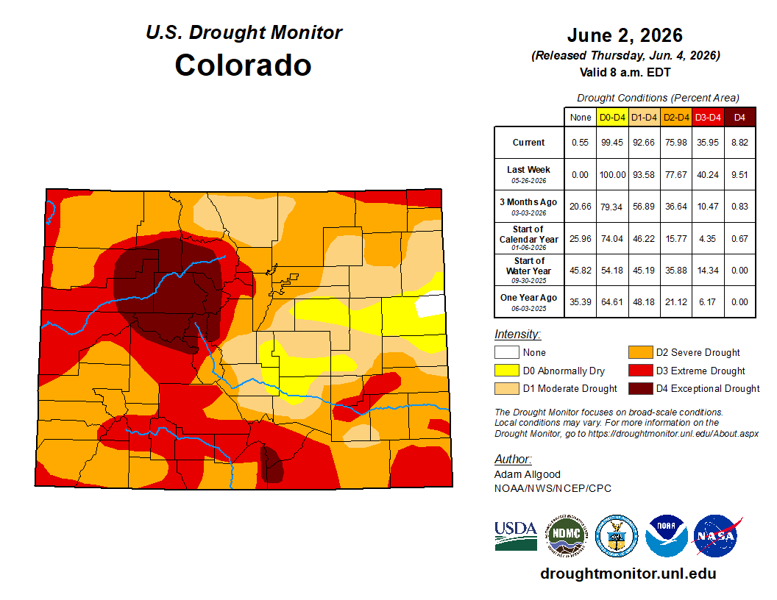
Early June improvements
May was cooler and wetter than previous months, which brought some drought relief to the Eastern Plains and northwest CO.
Still, evidence of severe hydrological drought was present throughout the state: record-low peaks in streamflow were being reported around this time.
% area in moderate (D1) drought or worse: 93%
% area in extreme (D3) drought or worse: 36%

Slide 40
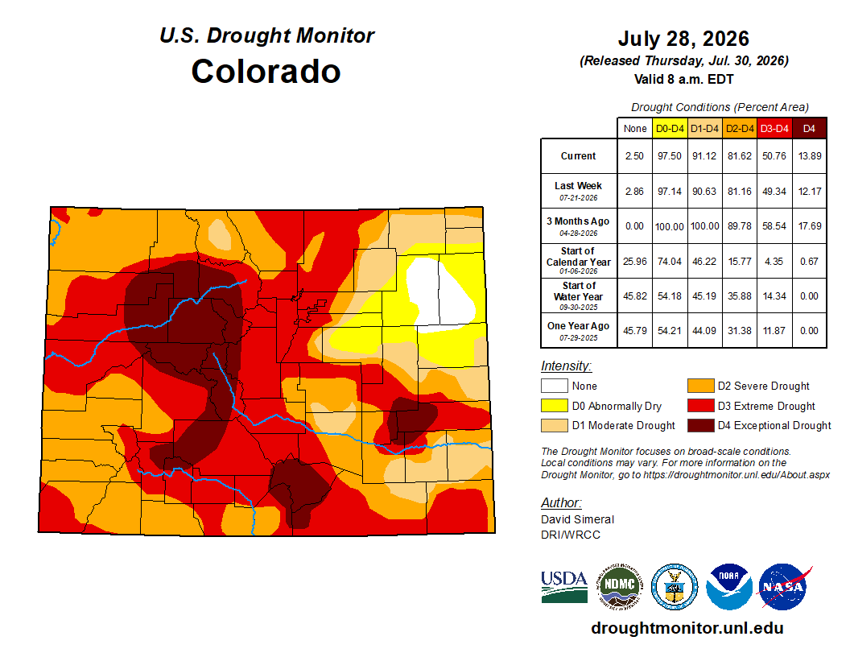
Conditions worsen over the summer
Very warm weather in June and July along with spotty precipitation allowed existing drought to worsen further.
Parts of the Northeast Plains benefitted from heavier precipitation, leading to drought-free conditions across a small area.
% area in moderate (D1) drought or worse: 91%
% area in extreme (D3) drought or worse: 51%

Slide 41
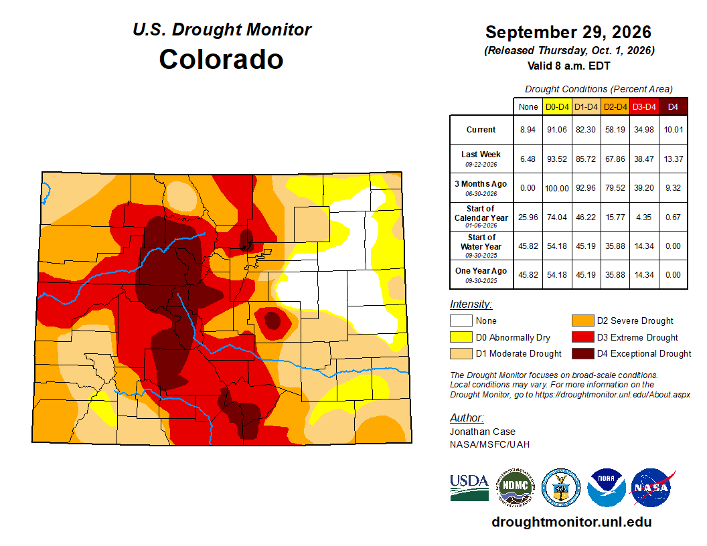
Rounding out WY2026 with improvements
Noteworthy improvements in drought conditions were not made until late September, as several rounds of heavier precipitation fell, particularly across the southern half of the state.
Note that additional precipitation fell during the last couple of days in the month that led to improvements in the Oct. 6 USDM.
% area in moderate (D1) drought or worse: 82%
% area in extreme (D3) drought or worse: 35%

Slide 42
Water: Snowpack, Streamflow & Reservoirs

Slide 43
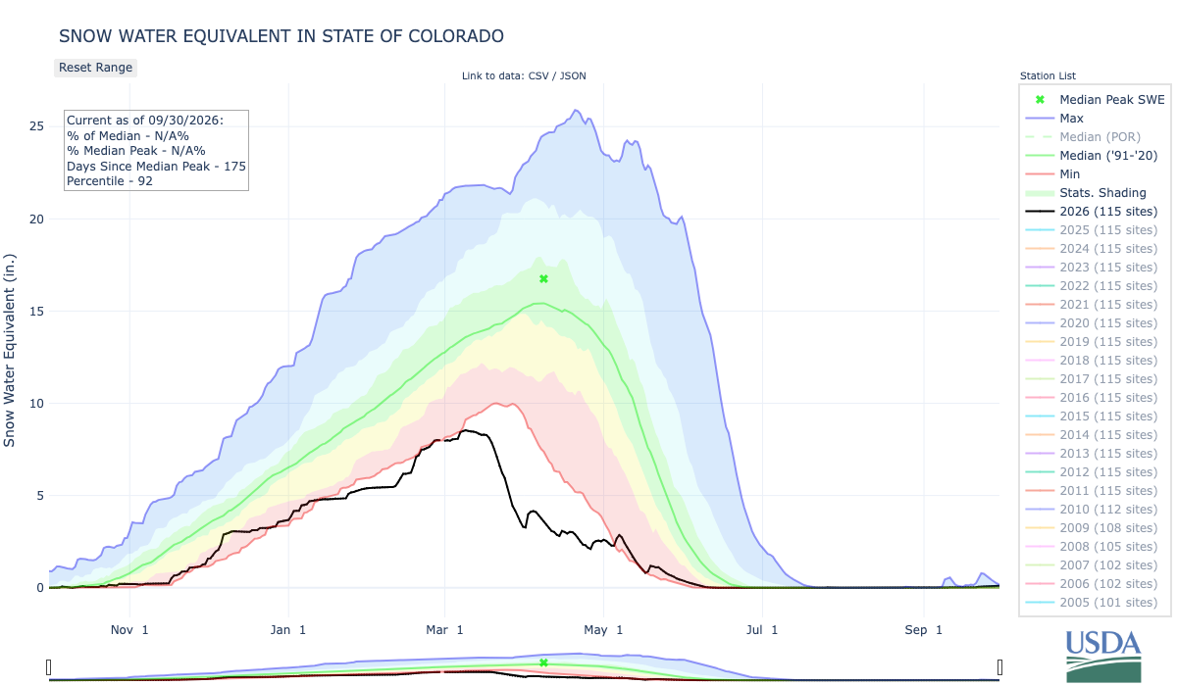
This year’s mountain snowpack was the lowest on record for Colorado
The peak was very low (51% of average statewide) and about a month early, followed by rapid melting in the unprecedented March heat wave
Statewide averaged snow water equivalent for WY 2026 (black line) at automated SNOTEL stations. Source: NRCS.

Slide 44
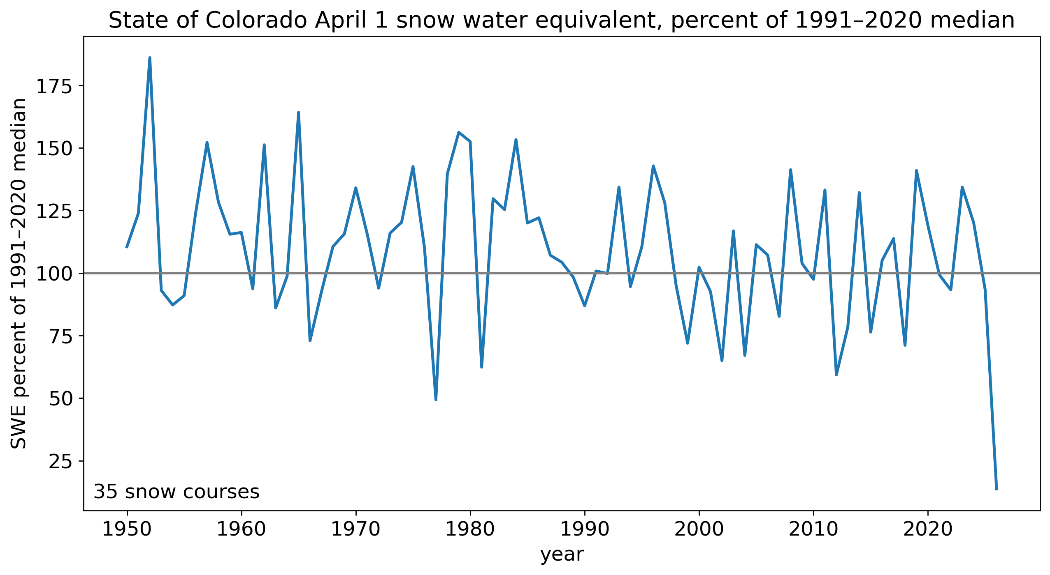
A snowpack unlike any on record
The worst water years for Colorado snowpack in recent times were 1977, 1981, 2002, and 2012.
As of April 1 (and May 1), this year was well below all of those years.
April 1 data from 35 manual snow courses across Colorado with records back to at least 1950. Data from NRCS.

Slide 45
Snowpack was consistently low throughout the state
60 of 64 snow course sites reported 50+ year lows on April 1
For even more on this year’s snow drought, check out our blog post on this topic.
Year with the lowest snow water equivalent on April 1, for snow course sites with at least 50 years of data. Data from NRCS.

Slide 46
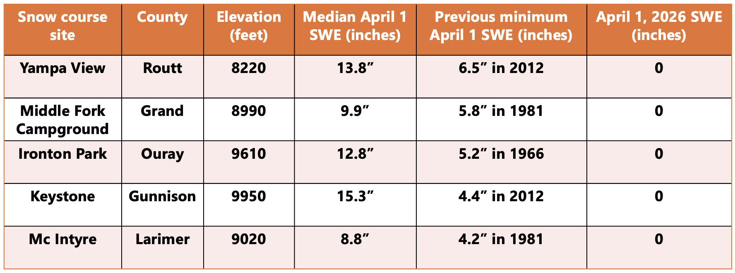
Snow courses that never before had less than 4-6” of SWE on April 1 reported none on that date this year

Slide 47
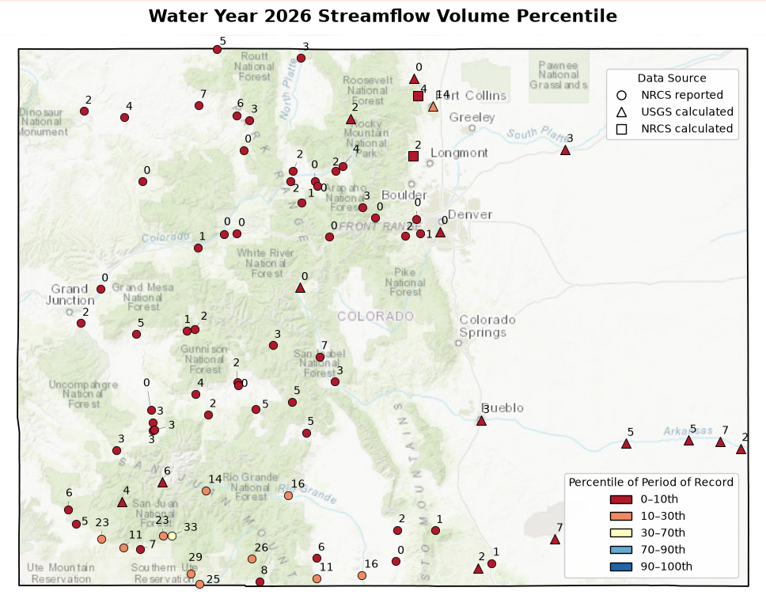
With record-low snowpack came record-low streamflow
Runoff from mountain snowpack is our primary source of water in Colorado. Given that was in limited supply this year, low flows along rivers were reported throughout the state.
2026 WY cumulative streamflow percentiles for USGS and NRCS streamgauge sites.

Slide 48
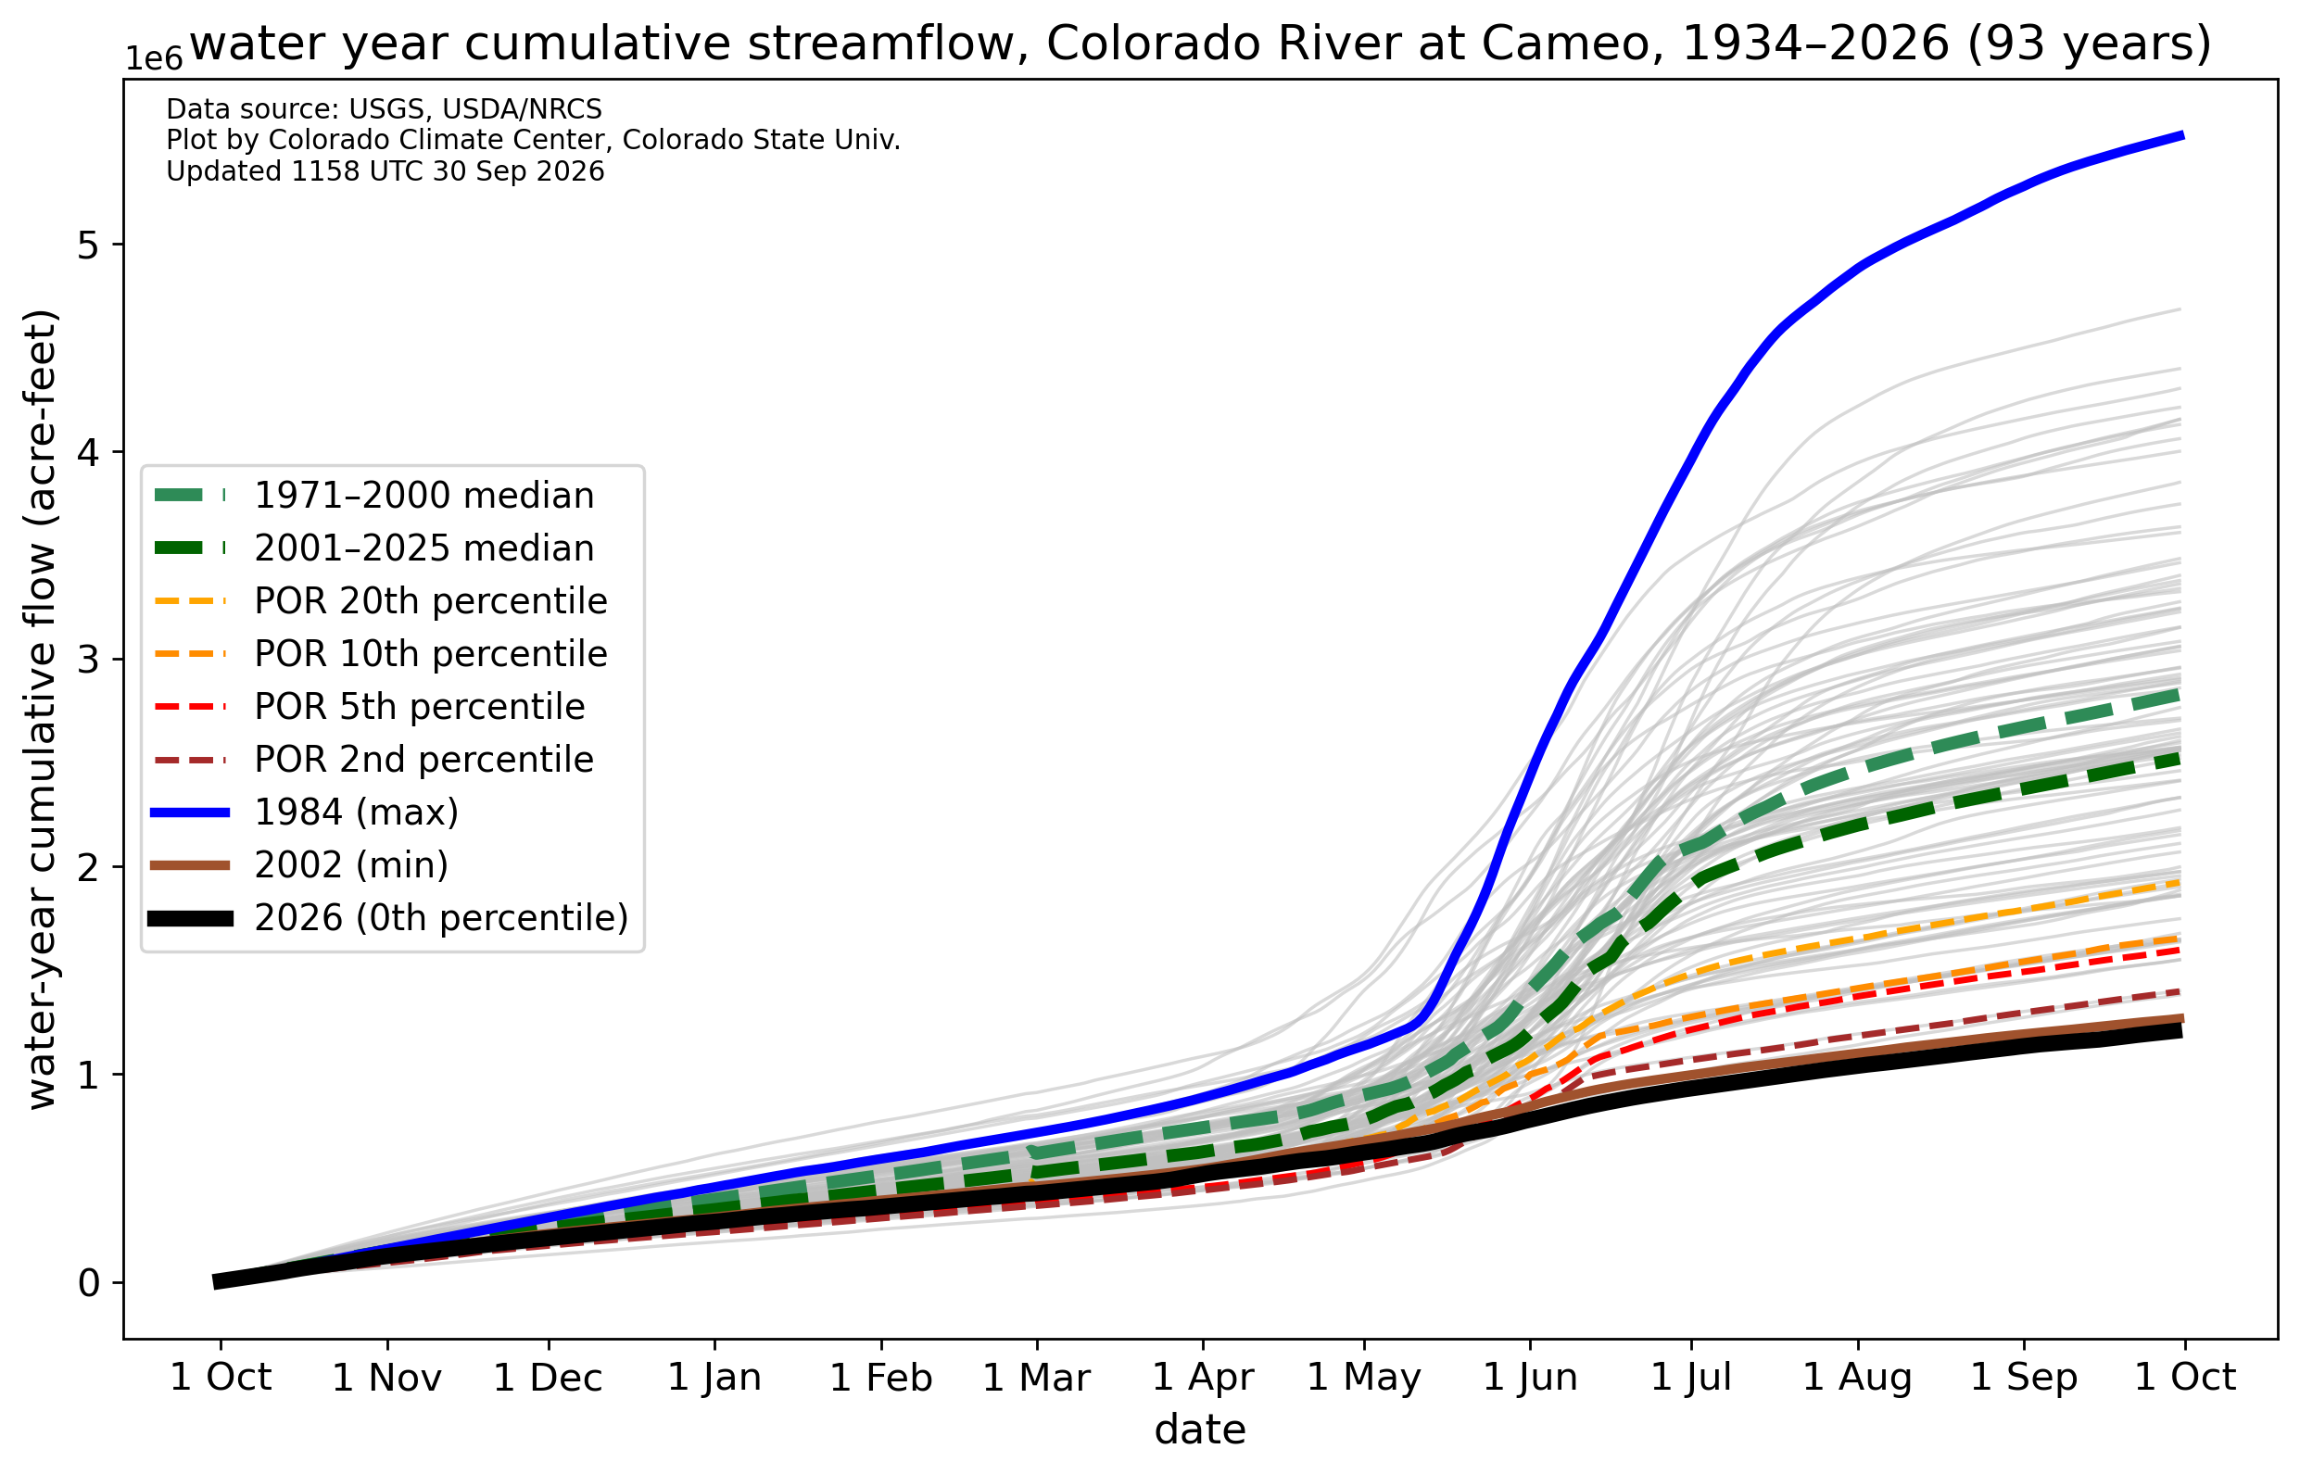
The Colorado River was one of many locations where record-low streamflows were reported
Cumulative streamflow throughout the WY was worse than 2002 (a very bad drought year in CO)
Cumulative streamflow for WY 2026 (black line) for the Colorado River at Cameo compared to historical flows. Data from USGS.

Slide 49
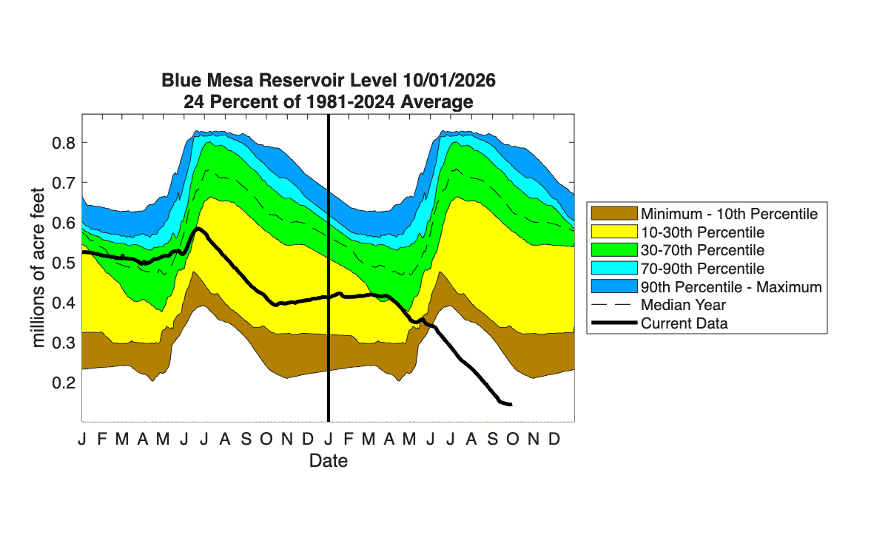
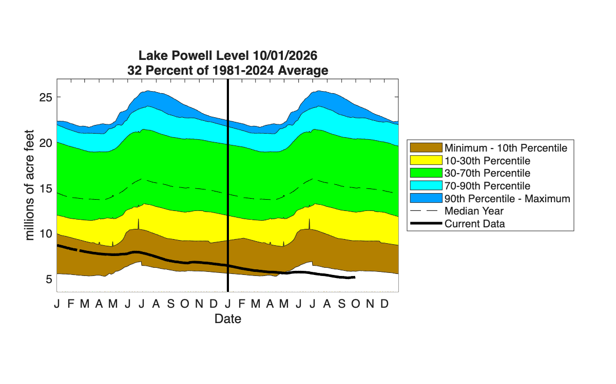
Low streamflow meant high demand for water and storage reductions in reservoirs.
Blue Mesa far below previous summer low
Powell (& Mead) at record lows since filling

Slide 50
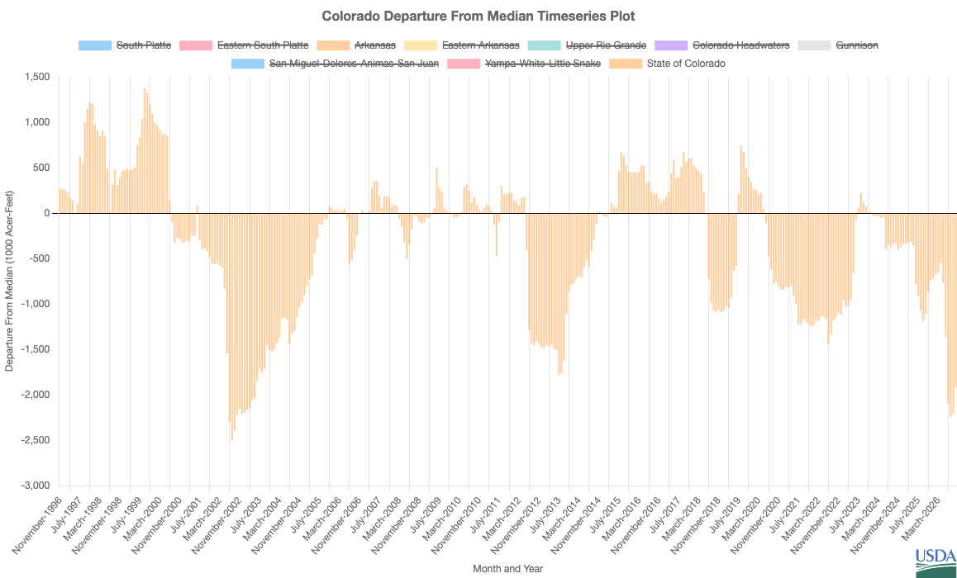
Storage in Colorado’s reservoirs was more than 2 million acre-feet below average, the lowest levels since 2002
Departure from median storage in Colorado reservoirs
Source: USDA/NRCS

Slide 51
Notable Events

Slide 52
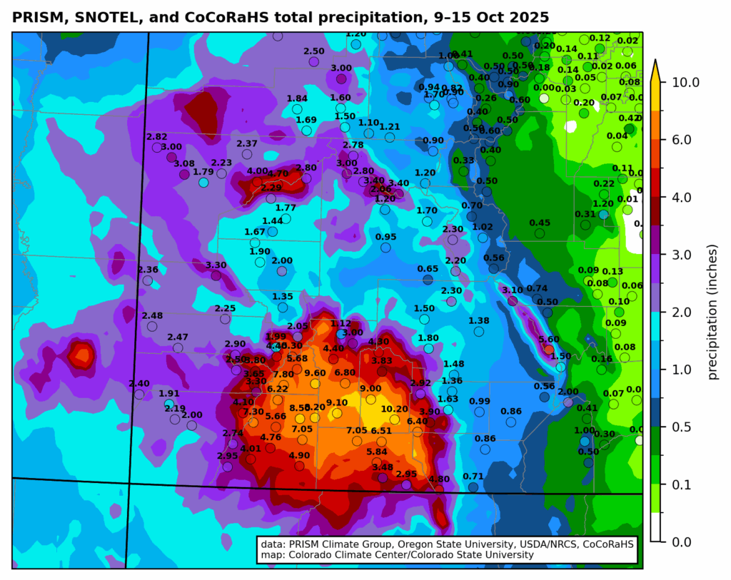
October 2025: Very heavy rainfall and flash flooding in SW Colorado
Over 8” of precipitation fell in some locations
See our blog for more on the October floods.

Slide 53
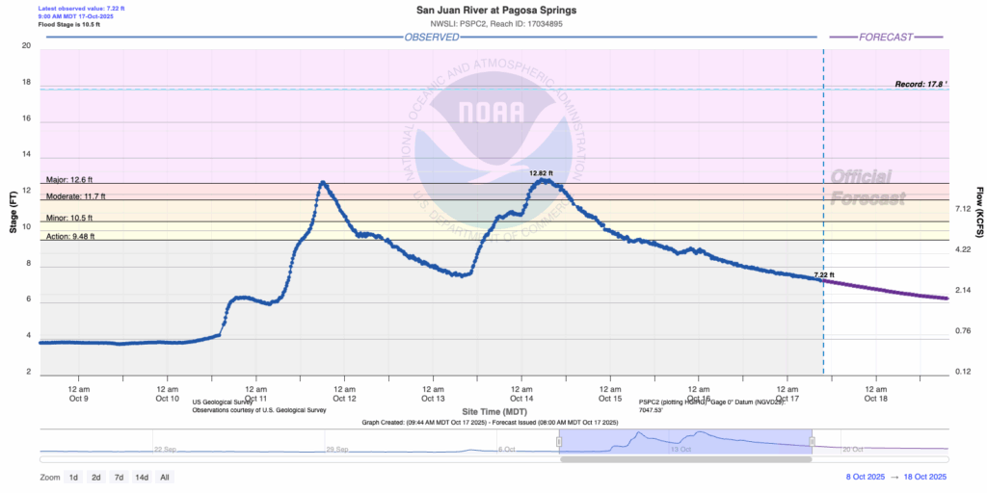
The flood event resulted from two back-to-back remnant tropical systems (Hurricane Priscilla and Tropical Storm Raymond) that brought abundant warm, moist air to SW CO over the course of several days.
San Juan River at Pagosa Springs
Major flood stage
The San Juan River was one of the impacted areas, reaching major flood stage twice (Oct 11 and 14).
See our blog for more on the October floods.

Slide 54
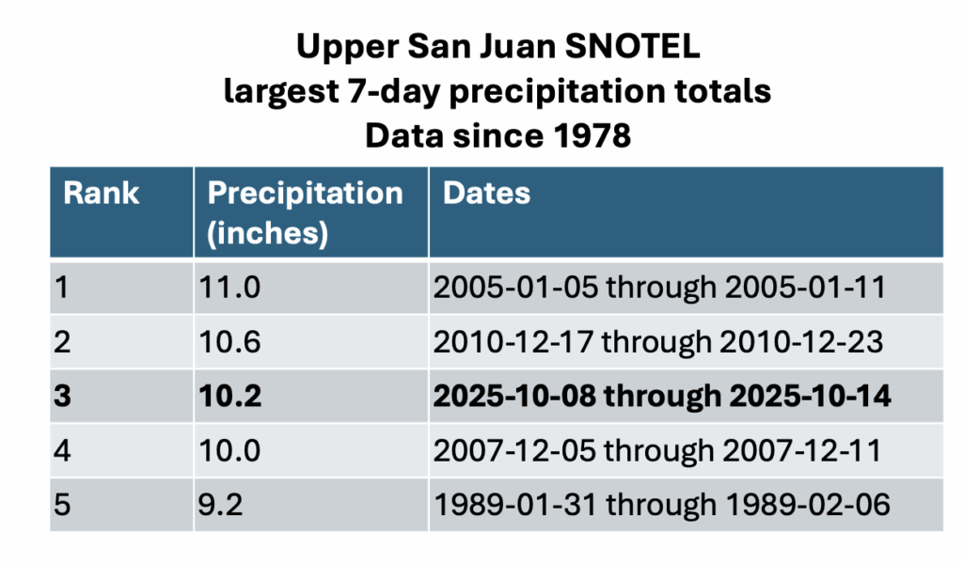
The amount of rain that fell was highly unusual for the area. The Upper San Juan SNOTEL station (right) reported its 3rd-highest 7-day precipitation total on record (dating back to 1978), and its highest 7-day total in the fall months.
In terms of fall rainstorms in SW CO, only the “Sonora Hurricane” of October 1911 rivals this event.
See our blog for more on the October floods.

Slide 55
Southwest CO Flooding
Flood damage in Vallecito, which was evacuated due to the heavy rain-driven flooding. Images from Jeremy McBride/the Durango Herald.
Flooding in downtown Pagosa Springs. (photo by Gwen Dunn/Sherpa Real Estate, obtained via the Denver Gazette).

Slide 56
November 2025: Late first snows
Year | Date of First Snow: Boulder, CO
2025 | 11/29
1978 | 11/26
1931 | 11/19
1930 | 11/18
2021 | 11/17
First snows arrived very late for parts of Colorado’s Front Range Urban Corridor. Average first snow dates for this area of CO usually occur in mid-Oct. This year, we saw the following:
Boulder: Record late
Loveland: Record late
Evergreen: Record late
Denver: 2nd latest
Greeley: 2nd latest
Colorado Springs: 3rd latest
Fort Collins: 5th latest
Year | Date of First Snow: Denver, CO
2021 | 12/10
2025 | 11/29
1934 | 11/21
1931 | 11/19
2016 | 11/17
Very mediocre snow totals on 11/29, the first snow of WY 2026 for much of the Front Range Urban Corridor. Data from CoCoRaHS.

Slide 57
December 2025: Record-setting heat
City | # days ≥ 60°F in Dec 2025 | Previous record (year)
Akron | 14 | 12 (1980, 1939)
Alamosa | 3 | 2 (2021)
Boulder | 18 | 17 (1980)
Colorado Springs | 15 | 13 (1939)
Cortez | 11 | 8 (1939)
Denver | 18 | 15 (1980)
Fort Collins | 17 | 13 (1980)
Grand Junction | 3 | 2 (several)
Greeley | 18 | 17 (1980)
Trinidad | 19 | 18 (1980)
December 2025 was our first record-warm month of WY 2026. One of the notable stats that came out of that month was the frequency of unusually warm days. Several long-standing climate stations set new records for most number of 60°F+ December days, including sites that rarely see temperatures that warm during this time of year. For some locations, more days in December were at least 60°F than were not.

Slide 58
December 2025: Winds and wildfires
Several downslope windstorms prompted power outages (both preventative and due to downed powerlines). In one of the events, several wildfires broke out across the eastern Plains, burning more 10,000 acres.
Radar image from NWS Goodland, KS, showing multiple wildfire smoke plumes on Dec. 17.
Widespread local storm reports showing numerous wind gusts > 60mph on Dec. 17-18.
Photo from Joshua Baumgardner/obtained from Denver7.

Slide 59
January 2026: Our only real cold snap of WY 2026
Several daily record low temperatures (both for minimum and maximum temperatures) were set during a multi-day cold snap in late Jan.
Record low temperatures set on January 26 for stations with at least 40 years of data.

Slide 60
February 2026: our remarkably warm winter continued
February solidified our ridiculously warm winter as several long-term climate sites continued to tally ≥60°F days
For example, Fort Collins (top panel) recorded more than twice as many ≥60°F days than it had seen in any other winter in its 125+ year history.

Slide 61
February 2026: our remarkably warm winter continued
Daily, monthly, and seasonal high temperatures were set late in the month
While notable in its own way, this record-setting heat would be overshadowed by March…
Record high temperatures set on February 24-25 for stations with at least 40 years of data.

Slide 62
March 2026: An unprecedented heat dome for the time of year
Records smashed across Colorado and the western US
10 states with their warmest March on record
Satellite imagery of the heat dome, courtesy of CIRA/CSU/NOAA
See our blog post for more on the March heatwave.

Slide 63
March 2026: Record-smashing warmth
In much of Colorado, March 2026 had a week’s worth of days warmer than any March day in the last 75 years
See our blog post for more on the March heatwave.

Slide 64
March 2026: Record-smashing warmth
For some locations, maximum temperatures in March 2026 were so warm that they exceeded all-time maximum April temperatures between 1951-2025
Statewide, April 2026 would go on to be more than 1°F cooler than March 2026 (even though April was still warmer than average)
See our blog post for more on the March heatwave.

Slide 65
March 2026: Record-smashing warmth
Mar. 18-21
The heat lasted multiple days, and it was far warmer than any heat wave that we’ve seen in the month of March.
The nine warmest March days on record statewide happened in March 2026.
Colorado’s top-25 March heat waves since 1951, defined as 4-day averaged statewide temperatures. Data from NCEI nclimgrid.
See our blog post for more on the March heatwave.

Slide 66
March 2026: Record-smashing warmth
Several hundred stations across Colorado set new monthly March records, some by as much as 10°F (!!)
See our blog post for more on the March heatwave.

Slide 67
March 2026: Record-smashing warmth
The heat led to rapid decline in snowpack that occurred much earlier than usual (comparable to what we typically see in May-June)
See our blog for more on the March heatwave’s impact on snowpack.

Slide 68
April 2026: Flash drought across the Eastern Plains
4-category degradations in 8 weeks across southeastern Colorado amid the hot and dry conditions

Slide 69
April 2026: Flash drought across the Eastern Plains
Rapid declines in soil moisture at a critical time of year for agriculture
Soil moisture for Burlington, CO for WY2026. Data from WLDAS.

Slide 70
April 2026: Flash drought across the Eastern Plains
The drought caused major impacts to rangelands later in the spring and summer

Slide 71
May 2026: A late-season Front Range snowstorm
After a lackluster winter, the Front Range foothills and Urban Corridor saw a big snow (for many, the largest of the year). Over 2ft fell in the Estes Park area.
Unfortunately, the snow had little to no impact on the overall winter snowpack.
CoCoRaHS snowfall reports for May 5-6.

Slide 72
June 2026: Severe Storms
June is Colorado’s climatological peak in severe weather, and there were several rounds of storms that brought high winds, flash flooding, and hail
Wind damage in Akron on June 22, where there were reported gusts in excess of 100mph. Photo from AccuWeather.
Hail in Colorado Springs on June 23. Photo from CoCoRaHS.
Flooding near Evergreen on June 24. Photo from CBS Colorado.

Slide 73
June-July 2026: Wildfires ignite across the state
Persistent above-average temperatures, below-normal precipitation, and early meltoff promoted dry conditions across the state. Numerous wildfires ignited at the end of June and early July.
Smoke plume and pyrocumulus clouds from the Aspen Acres fire. Photo from July 1, obtained from Watch Duty.
Flames and smoke from the Gold Mountain Fire near Ouray on June 28, obtained via CPR.

Slide 74
June-July 2026: Wildfires ignite across the state
High winds promoted extreme fire behavior and rapid growth. For example, the Aspen Acres Fire, discovered on June 29th, had grown to over 35,000 acres by July 1st.
Extreme weather conditions also presented life-threatening challenges for firefighting efforts. Tragically, the Knowles Fire (located near the larger Snyder Fire) claimed the lives of four firefighters.
Smoke plumes from wildfires in Colorado and neighboring states on 6/29 as seen by GOES-18. Imagery courtesy of CIRA/CSU/NOAA.

Slide 75
June-July 2026: Wildfires ignite across the state
2026 5000+ acre wildfires
113 Incident
Ultimately, two of the 10 largest Colorado wildfires in terms of acres burned were this year: Aspen Acres (#7) and Ferris (#10)
Willow
Snyder
County Rd 169
24
Gold Mountain
Elk
Aspen Acres
Ferris
Sharpe
Ballard

Slide 76
July-August 2026: Flash flooding and debris flows
Debris flow at Curecanti National Recreation Area, July 16. From Black Canyon of the Gunnison National Park.
Flooding in Ouray County, July 29. From Ouray County Government.
Heavy rains brought flash flooding and debris flows across southwest Colorado, including in some burn scar areas
Palm Theater in Telluride filled with mud on July 17. From Telluride Fire Protection District
Flooding in Beulah, August 15. From Pueblo County Sheriff’s Office.

Slide 77
September 2026: heavy rain continues
Water Year 2026 ended wet, especially for southern Colorado, leading to additional localized flooding and debris flows. Some places had their wettest September on record after extreme drought earlier in the water year.
Flooded roadway near the CSU Plainsman Research Station near Walsh on October 1. Photo courtesy of Zane Jenkins.
Flood debris clean up at Chimney Rock National Monument near Pagosa Springs around September 17. Photo from the Pagosa Daily Post.

Slide 78
September 2026: rounding out a record-warm Water Year
The prolonged warmth of WY2026 was on full display when St. Mary’s Glacier, a semi-permanent snowfield known as a summertime ski destination, fully melted out in mid-September
St. Mary’s Glacier on Sep. 12, 2024 (left) compared to Sep. 17, 2026 (right). Photos by Matt Siegfried and Ryan Venturelli, obtained via Colorado Public Radio.

Slide 79
Visit us on the web:
climate.colostate.edu
Subscribe to our mailing list for monthly climate updates: https://climate.colostate.edu/subscribe.html
Primary Media Contacts:
Allie Mazurek (Lead Author), Engagement Climatologist: Allie.Mazurek@colostate.edu
Russ Schumacher, State Climatologist: Russ.Schumacher@colostate.edu
Peter Goble, Assistant State Climatologist: Peter.Goble@colostate.edu
Additional Contributors:
Kristie Davis, CoAgMET Analyst: Kristie.Davis@colostate.edu
Noah Newman, Education and Outreach Specialist: Noah.Newman@colostate.edu

